Slide 1
Curbing AMR with a One health approach : Are we on the right track ?
Antoine Andremont
Former Professor University of Paris-Cité (France)
Antoine.andremont@gmail.com

Slide 2
Where are resistant bacteria ?
Just as susceptible one they are mostly in ecosystems such as the digestive tract of all living animals (including humans)
A single digestive tract contains ~10 ¹⁴ bacteria
1 to 10% are excreted everyday and join the environment
Both for humans and animals
Anyplace in the world.
In comparison the number of bacteria at infectious sites is very, very, very low.
So, if you want to deal with the problem of AMR, you better take that into account. You must deal with ecosystems

Slide 3
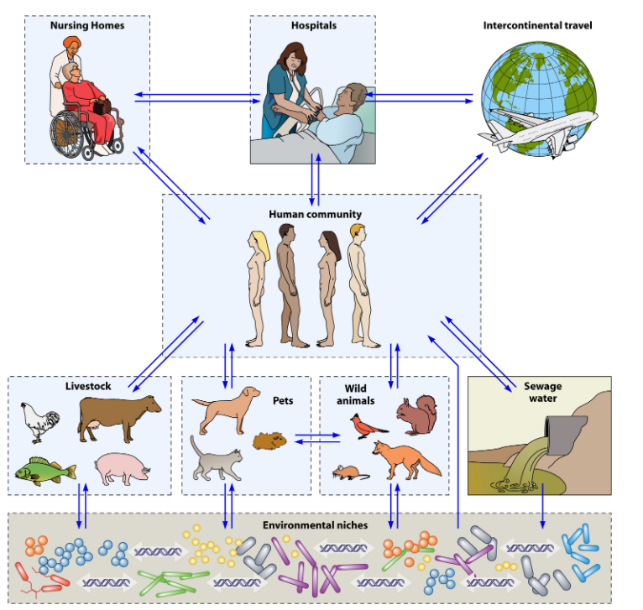
The circulation of bacteria between humans, animals and the environment
Woerther et al, 2013

Slide 4
Why a OH approach is preferred to a sectorial one to curb AMR ? *
OH recognizes that human, animal and environmental health are interconnected and interdependent.
Requires collaboration and cooperation across the sectors.
Takes into account the complex interrelationships between the sectors
Seeks to address AMR in a holistic and integrated way.
Involves participation of multiple stakeholders (healthcare professionals, veterinarians, environmental scientists, policy makers, …..) working from multiple angles.
A sectorial approach, focuses on addressing AMR within a single sector, such as human medicine or animal medicine or agriculture
Not considering the potential impacts or contributions of other sectors.
This can lead to unintended consequences and may not be effective in addressing AMR in a comprehensive and sustainable way.
* Chat GPT on Jan 2, 2023

Slide 5
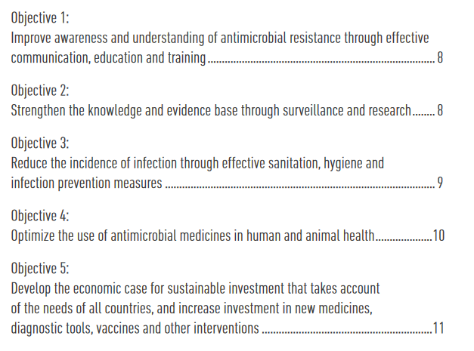
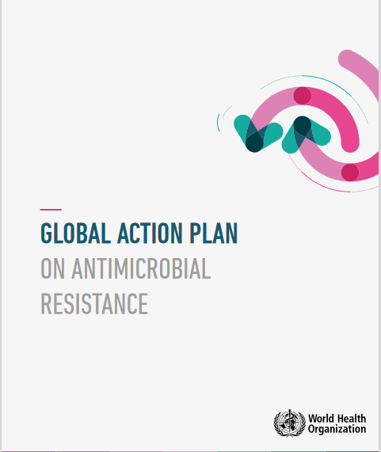
The good news
The One health (OH) approach is becoming more visible, at least in the institutions.
WHO Global Action Plan from 2015 has put OH at the highest public health level with a clear pathway for action.
5 Objectives that we will review

Slide 6
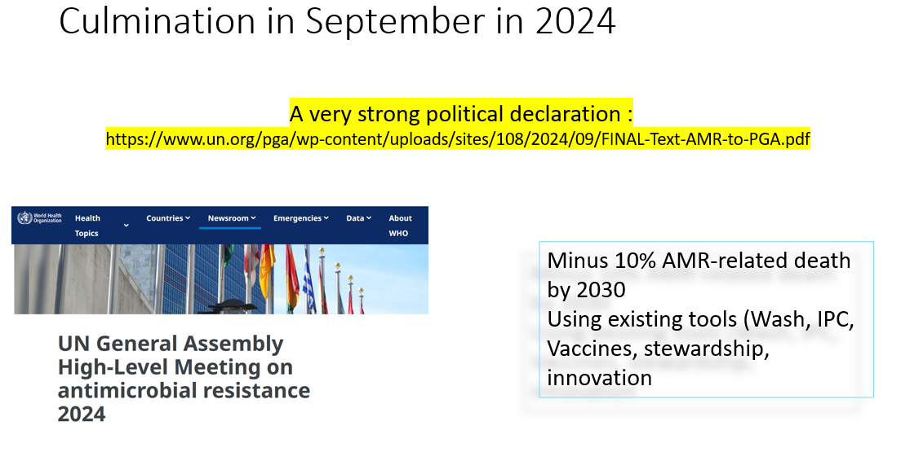
As far as objective One “Awardness” is concerned, AMR and OH are in the frontline everywhere in international conferences
Minus 10% mortality using existing tools
Minus 20% antibiotic use in humans while ensuring access in LMICs
Minus 30% in animal/agriculture use

Slide 7
However, the visibility of AMR in the population is still low
There is no simple way to differentiate an infection caused by a resistant organism from one caused by a susceptible one
Treatment failure is a bad surrogate because it can be due to other causes
Lab capacity is often very low, particularly in LMICs
The concept is not easy to understand, with comparison of the “disease/no disease one”
The rates of resistance vary from a microbe to another, and from a country to another

Slide 8
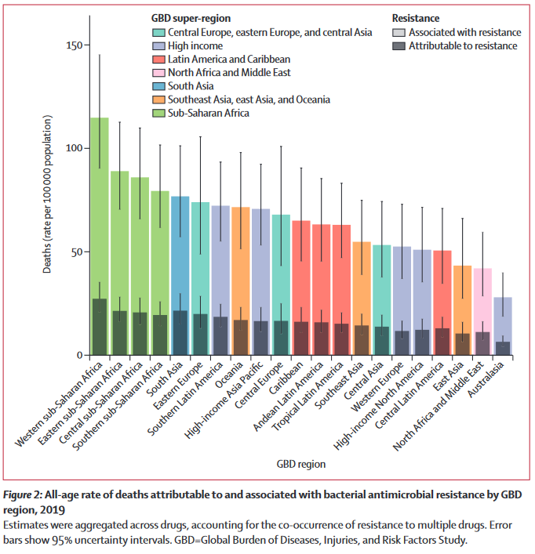
Concerning objective 2 “Surveillance and research”
At last, some outstanding global solid data in The Lancet Jan 2022 : 1·27 million (95% UI 0·911–1·71) deaths directly attributable to bacterial AMR.
Large variations between regions

Slide 9

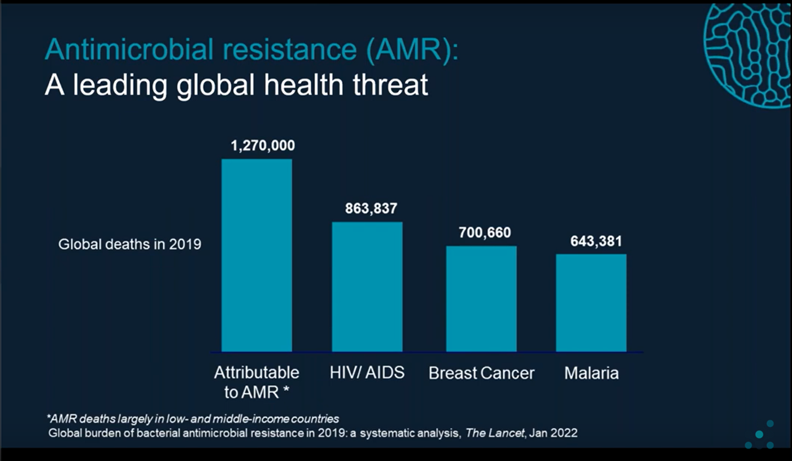
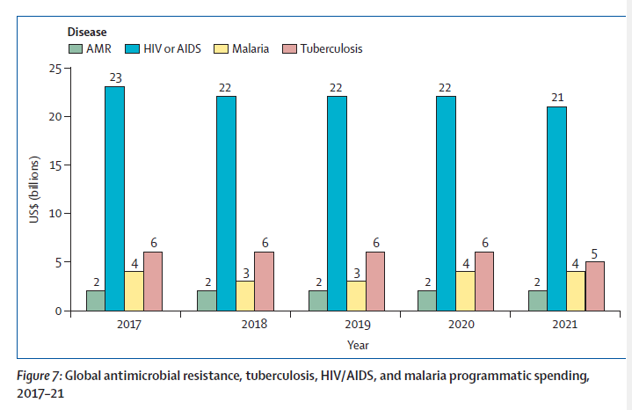

Concerning Objective 2 “Surveillance and research”
1·27 million annual deaths directly attributable to bacterial AMR. Lancet 2022 :
Iruka N Okeke et al. Lancet 2024

Slide 10
However, surveillance at one point is not enough and trends in time are definitively needed.
The “Glass WHO surveillance system” is a formidable tool for that purpose and is being implementedfor several years now in some countries

Slide 11
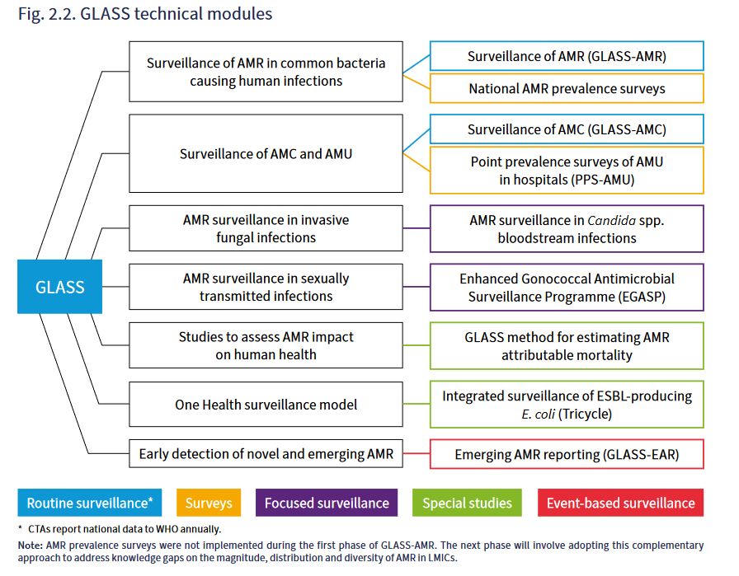
GLASS has now published a large number of technical manuals that you can use in your own country
https://iris.who.int/bitstream/handle/10665/364996/9789240062702-eng.pdf

Slide 12
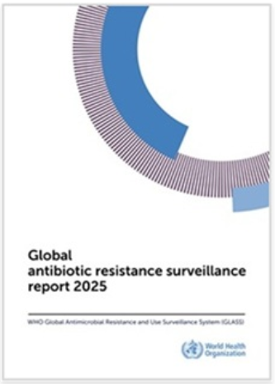
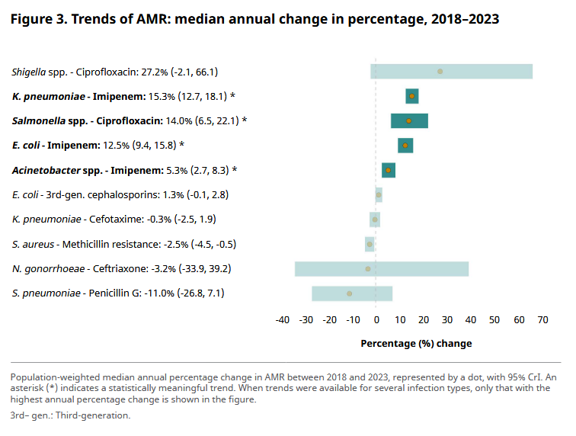

Already alarming trends emerge

Slide 13
GLASS has now published a large number of technical manuals that you can use in your own country
https://iris.who.int/bitstream/handle/10665/364996/9789240062702-eng.pdf

Slide 14
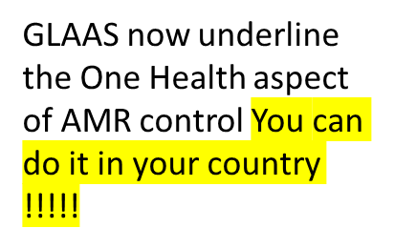

GLASS has now published a large number of technical manuals that you can use in your own country
https://iris.who.int/bitstream/handle/10665/364996/9789240062702-eng.pdf

Slide 15
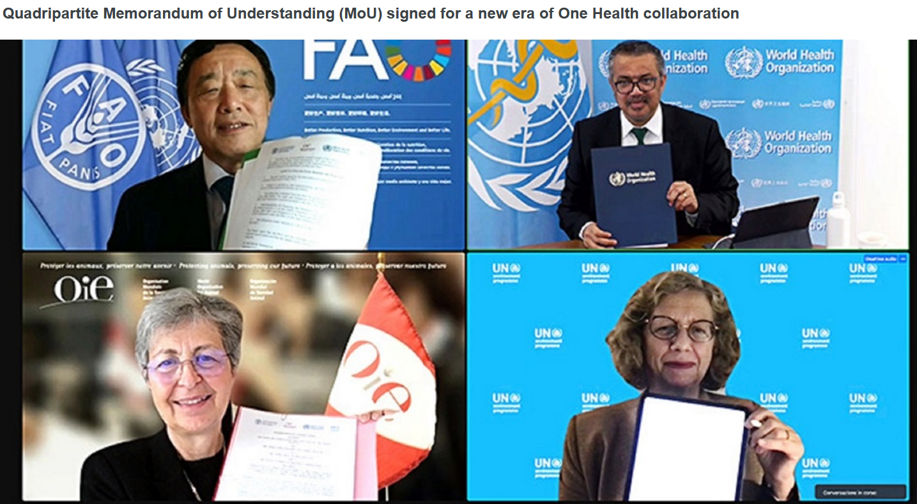
Objective 3 : Reduce the incidence…. The very tough part…..
In addition of being a global health problem, AMR is also a One Health question
The UN Quadripartite secretariat includes WHO, WHOA, FAO and UNEP

Slide 16
Reduce work in silo is absolutely necessary, event if some subjects are sectorial…
Working OH is very difficult (you will discover that …)
Working OH is a spirit of mind and an attitude

Slide 17
Reduce work in silo is absolutely necessary, event if some subjects are sectorial…
Working OH is very difficult (you will discover that …)
Working OH is a spirit of mind and an attitude
What I do in one sector always influences what happens in the others, although to various extend.

Slide 18
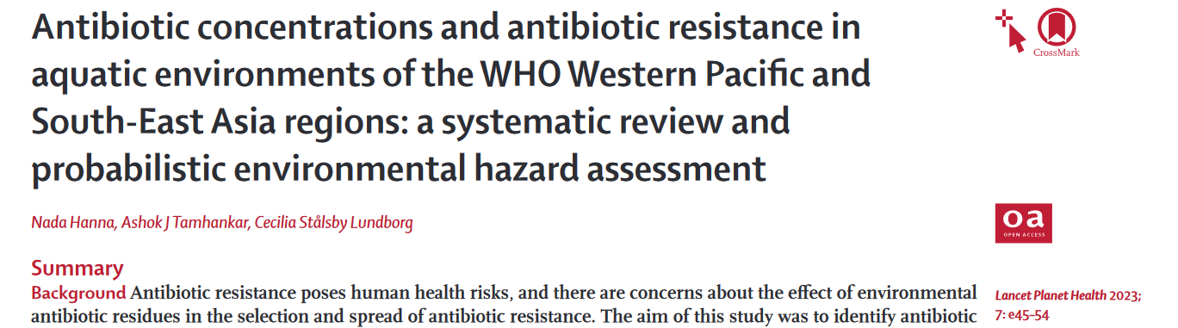
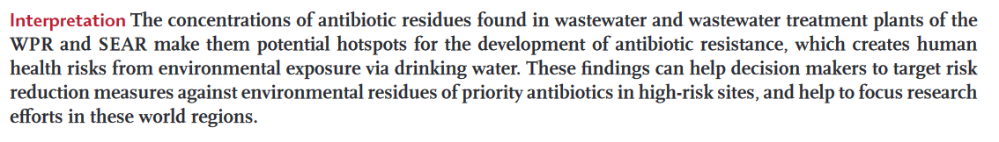
Review papers on the environment are now available

Slide 19
The One health aspect, taking the environment in the loop, is key because AMR shares many similarities with greenhouse gas emissions and global warming
I know that it is often difficult for physicians and veterinarians to work with environmentalists because of cultural differences but…

Slide 20
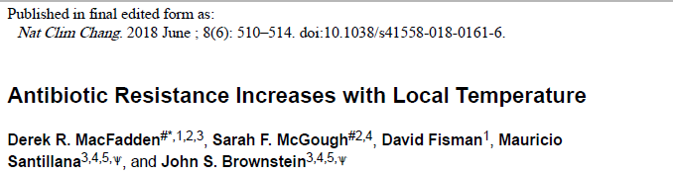

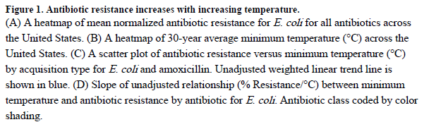
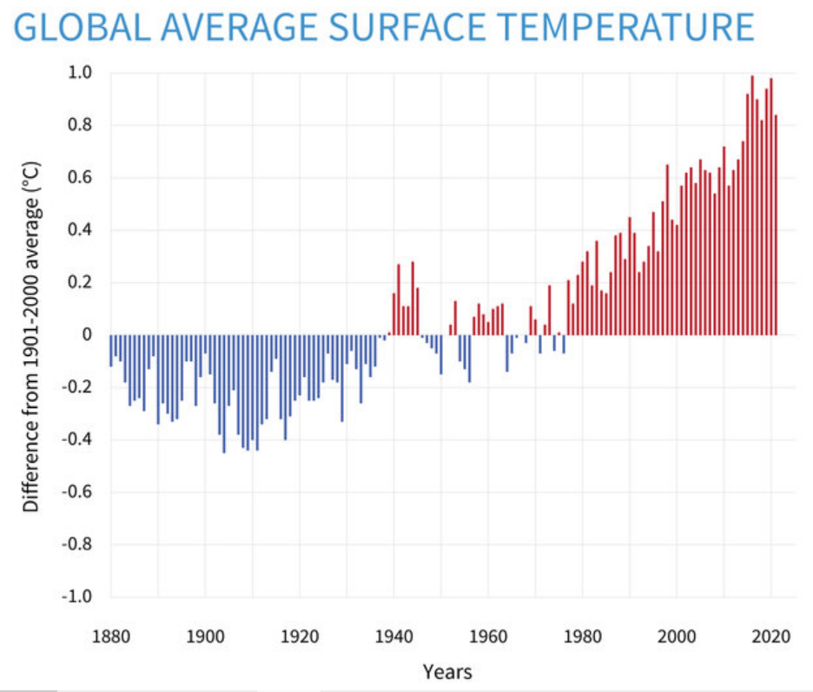

Slide 21
You will not be surprised that country characteristics that affect LMICS are more and more described as very important with regards of the burden of AMR, just as it is for the consequences of climate change.

Slide 22
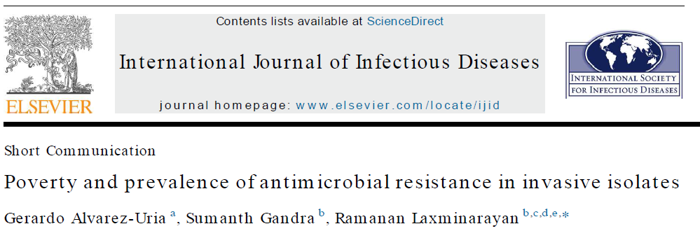

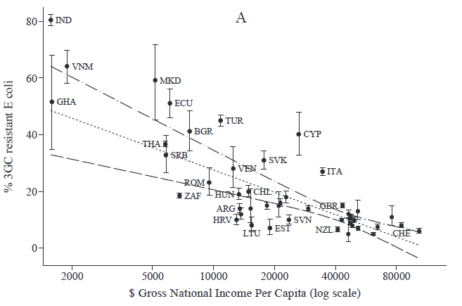
CDDEP.org

Slide 23
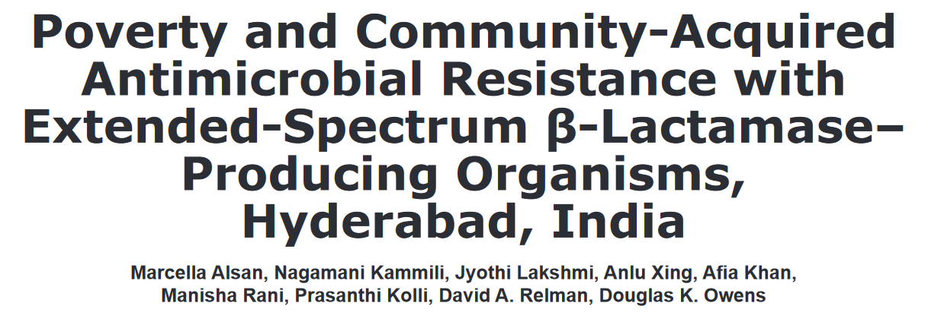
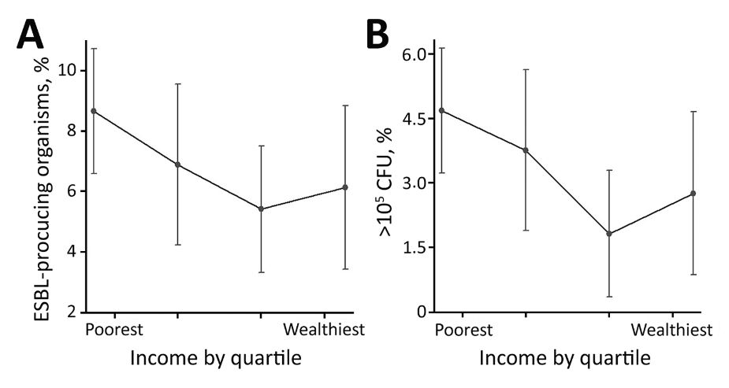
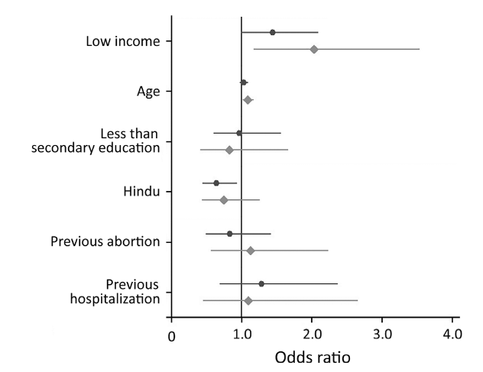
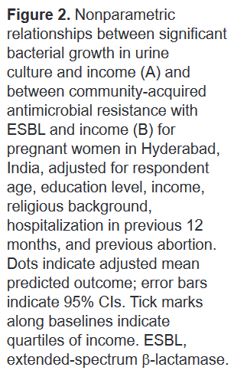
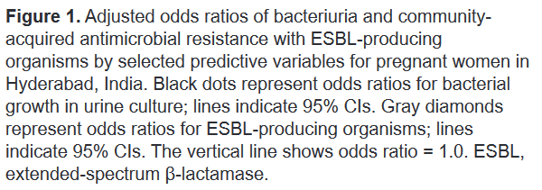
The link with poverty has been confirmed at the individual level for ESBL UTI

Slide 24
In addition to the similarities between AMR and greenhouse gas, there are also biological links between the two phenomenoms (at least one described so far)

Slide 25
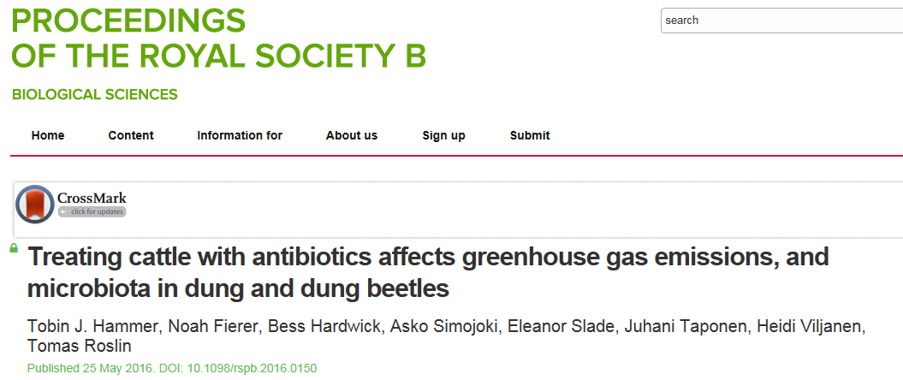
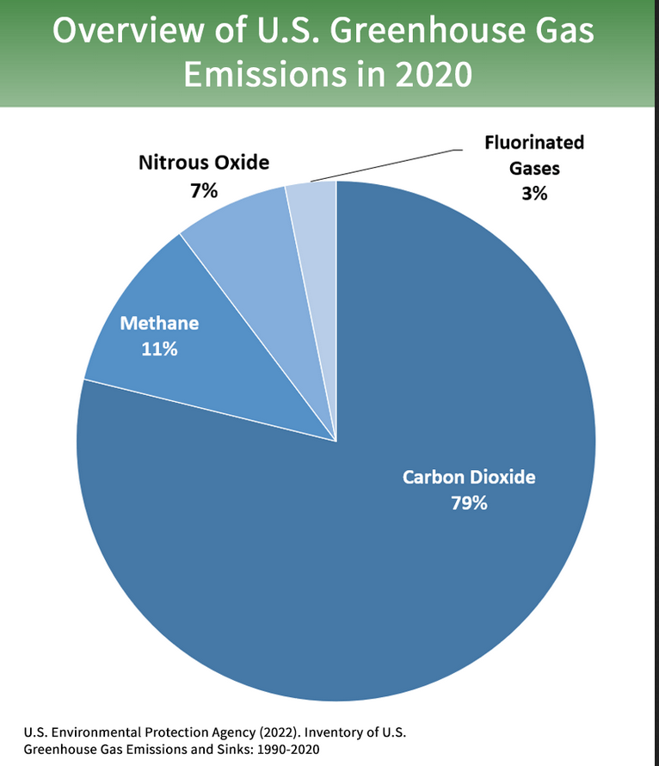
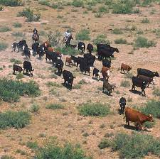
Cyclines administration increased 1.8 times the amount of Methan produced by cattle.!!.
“We believe that the tetracycline treatment favors the growth of methanogenic archaea in the cows’ intestinal tract by reducing the bacteria in the gut.” T.J. Hammer
Direct impact on climate change !

Slide 26
All that makes clear that the best way to curb AMR is to reduce the amount of antibiotics we use, which is the objective 4 from the WHO GAP.
In Europe highly significant progress have been made in veterinarian usage; less in human usage.
Data are not yet clear on why there is such a difference and what are the most recent trends in highly populated countries such as China or India or Nigeria. More to come is awaited ?

Slide 27
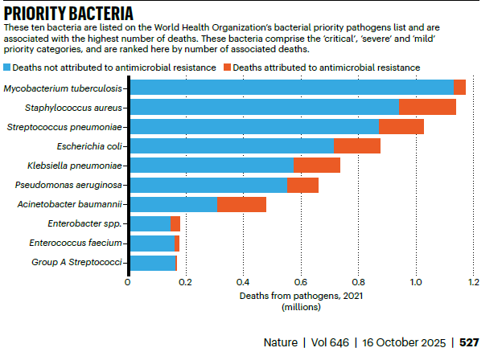
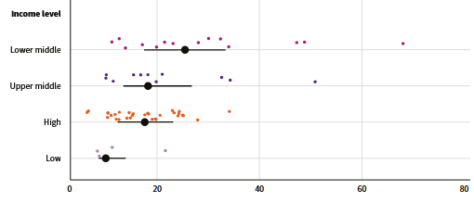
At the same time the lack of access to antibiotics for many patients is obvious also, particularly in LMICs.
AMU part of GLASS, 2022
Huge difference between countries are obvious
Lack of access may cause more death than resistance

Slide 28

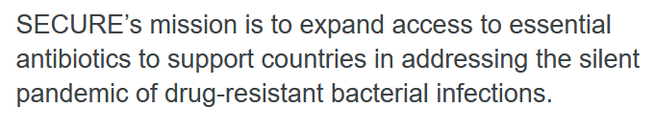
While we have to push very hard on the break (reduction of excess), we must not forget that access is also very challenging in many places
https://www.who.int/groups/secure-expanding-sustainable-access-to-antibiotics

Slide 29
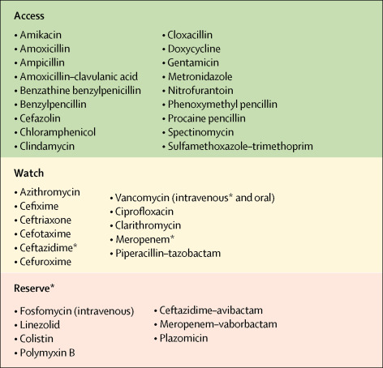
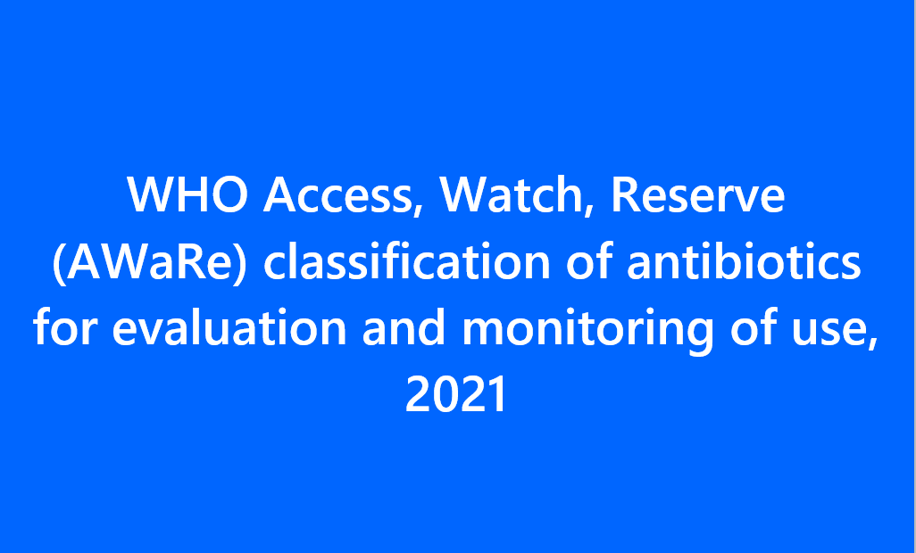
We have to push very hard on the break, however without forgetting that access is also very challenging in many places
https://www.who.int/groups/secure-expanding-sustainable-access-to-antibiotics
https://www.who.int/publications/i/item/2021-aware-classification

Slide 30
We have to push very hard on the break, however without forgetting that access is also very challenging in many places
D’ici 2030, au moins 70 % de la consommation humaine d’antibiotiques devrait être représentée par des antibiotiques du groupe Access.
https://www.who.int/groups/secure-expanding-sustainable-access-to-antibiotics
https://www.who.int/publications/i/item/2021-aware-classification

Slide 31
However, the access system is based on the assumption that old antibiotics select less than new ones, particularly for more recent mechanisms of resistance.
This might not be completely true….

Slide 32
The Objective 5 is somewhat “opposite of obj. 4”, it is to progress towards new treatments or preventive measures
So far we have not been very successful with little or no really new antibiotics on the market….
We will hear that the economics behind are very difficult whatever the model chosen….
My personal opinion is that it will somewhat remain so as long as we will not massively invest in :
  Rapid et easy to use diagnostics concomitantly… (companion test concept)
  Artificial intelligence and models easily usable on apps ( driving aid concept)
  Which may be more important than new molecules !!!

Slide 33
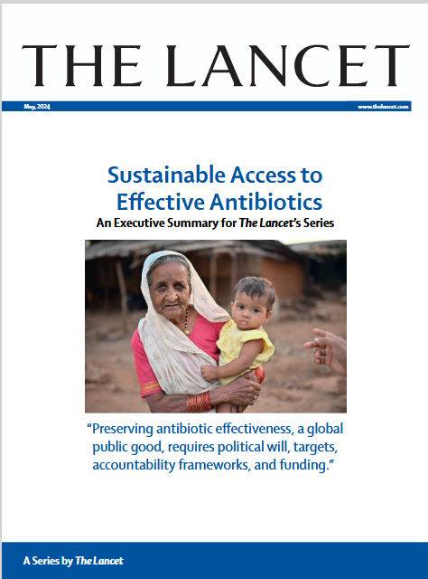
The Objective 5 is somewhat “opposite of obj. 4”, it is to progress towards new treatments or preventive measures
So far we have not been very successful with little or no really new antibiotics on the market….
We will hear that the economics behind are very difficult whatever the model chosen….
My personal opinion is that it will somewhat remain so as long as we will not massively invest in :
  Rapid et easy to use diagnostics concomitantly… (companion test concept)
  Artificial intelligence and models easily usable on apps ( driving aid concept)
  Which may be more important than new molecules !!!

Slide 34
A warning before conclusion on the real meaning of the One Health concept for AMR.
It means that action (Up or down) towards AMR in one of the sectors ( Human, animal, agriculture, environment) influences the other ones.
It does NOT mean that specific sectorial actions are not justified, and often needed as such
But their modalities may vary a lot from a sector to another
Be suspicious when the OH concept is used too broadly “everywhere and for any action….”
OH is a “spirit” of mind

Slide 35
So my conclusions for today are in grey, hopefully turning rose with YOUR action
We have made progress and are on the right track for objective 1 and 2, although the road is still very long ahead….
Objective 3 is still very far away and probably linked to strong action against reduction of inequalities between countries, better global governance, and controlling climate change
Objective 4 and objective 5 are probably those where people of your generation will make the difference, invent new avenues, and leave an antibiotic world a little better than that we, the boomers, have left behind !
AND YESSSSSS the OH AS A SPIRIT OF MIND approach is absolutely needed !

Slide 36
Thank you very much for your attention !

