Slide 1



Improving implementation in antimicrobial stewardship in low resources countries
Séminaire Spilf, SAPI, SMF
Gabriel Birgand
@gbirgand
2026

Slide 2
Which factors determine the use of antimicrobials in low resources countries?

Slide 3



Several levels of analysis
Age, Gender, Constitutional factors
Healthcare
Professional

Slide 4
Several levels of analysis
A
Indiv. characteristics
Behavioural theories: Knowledge, beliefs, change capacities, benefits to comply
Healthcare
Professional

Slide 5
Several levels of analysis
Organisational aspects:
Resources, funding
Teamwork
Leadership
Education, training
Surveillance, audit, feedback
Protocols, objectives…
Organisational context (hospital)
A
Indiv. characteristics
Healthcare
Professional

Slide 6
Several levels of analysis
Global level:
Cultural aspects
Recommendations
Surveillance, indicators
National and cultural context
Organisational context (hospital)
A
Indiv. characteristics
Healthcare
Professional

Slide 7
Several levels of analysis
National and cultural context
Contexte institutionnel (hôpital)
A
Healthcare
Professional

Slide 8
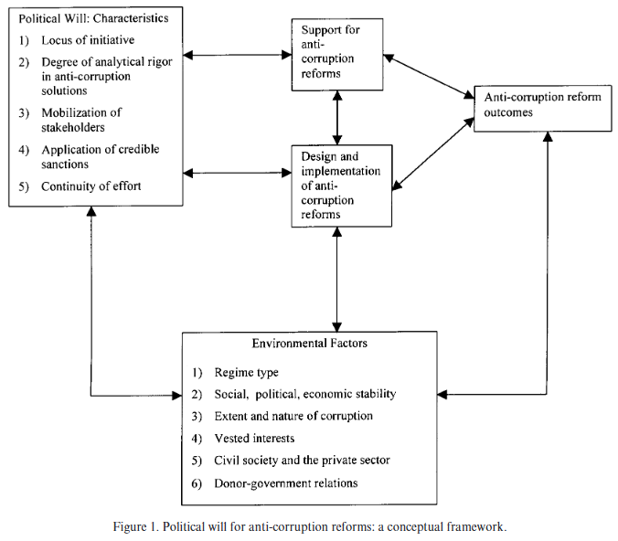
Lack of political will by governments
Political will: ‘the commitment of political leaders and bureaucrats to undertake actions to achieve a set of objectives and to sustain the costs of those actions over time’
Strong factor that influences decision making, budgetary allocations, public private partnerships, inflow of technical expertise and/ or funds into a nation
Fosters the development and implementation of NAP on AMR
Dearth of political will → poor or absent regulatory frameworks
Brinkerhoff DW. Public Adm Dev 2000; 20: 239–52. https://doi.org/10.1002/1099-162X(200008)20:3<239::AID-PAD138>3.0.CO;2-3

Slide 9
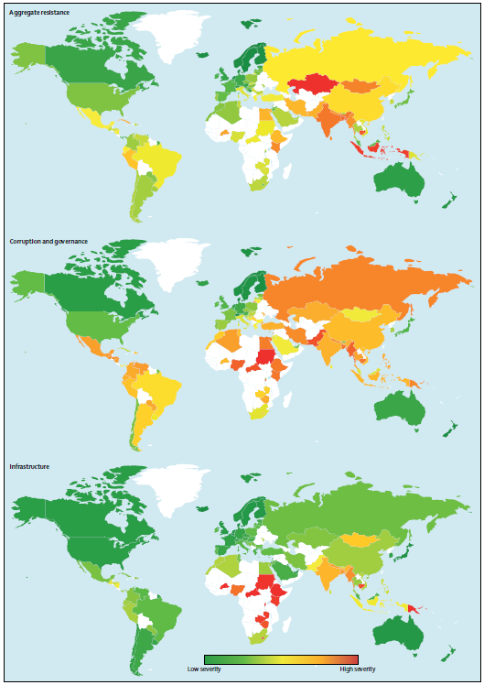
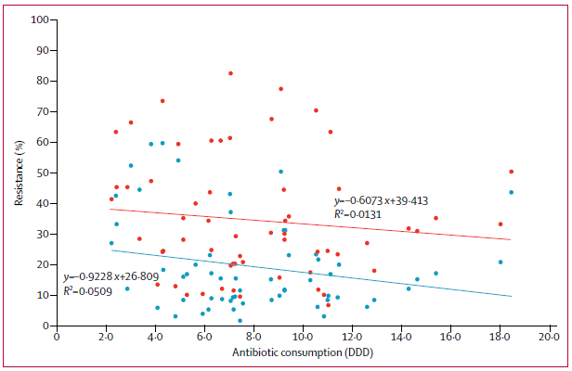
Lack of political will by governments
Resistance
73 countries, lower antimicrobial resistance indices,
E. coli resistance (and aggregate resistance) associated with:
Better infrastructure (p=0.014 and p=0.0052)
Better governance (p=0.025 and p<0.0001)
Corruption/governance
Infrastructure
Collignon, Lancet Planet Health 2018; 2: e398–405

Slide 10
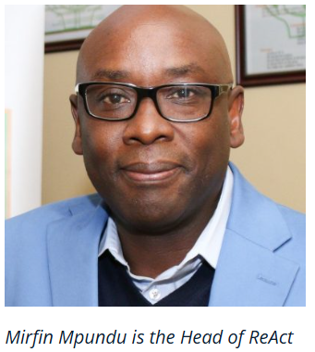
Lack of political will by governments
Lack of allocated resources for AMR NAP activities (AMR Focal Point) in national budgets
Zimbabwe’s AMR NAP = USD 44.6 million over five years (from 2017)
Year 1 2017 = USD 3.4 million, Year 2 2018 = USD 10.2 million
Average annual cost = USD 7.5 million
Required resources not available domestically
Most LMICs received external financial support to develop their AMR NAPs
GARDP: https://revive.gardp.org/moving-from-paper-to-action-the-status-of-national-amr-action-plans-in-african-countries/

Slide 11
Lack of political will by governments
Political engagement limited to NAP launch events without follow-through
AMR Focal Points have competing primary responsibilities and limited time for AMR coordination
Inter-ministerial coordination meetings rarely occur, leading to fragmented or single-ministry implementation
Some NAPs are not embedded in national policies or structures, limiting access to funding
Several NAPs are weak, not context-specific, expired, and lack prioritization and costing
Exclusion of finance ministries contributes to weak financial commitment and support
Addressing AMR requires a paradigm shift in planning and coordination across sectors and ministries
Strong intersectoral collaboration and shared ownership are essential for effective AMR implementation
GARDP: https://revive.gardp.org/moving-from-paper-to-action-the-status-of-national-amr-action-plans-in-african-countries/

Slide 12
Poor implementation of NAP on AMR
Paucity of data and weak surveillance structures
Data collection manual with incomplete unreliable data sets (AST, clinical data) → information not readily available to guide antibiotic use nor policy formulation
Dearth of technical capacity
Lack personnel with adequate training in AMS and other skills required for effective networking, communication and governance of initiatives

Slide 13
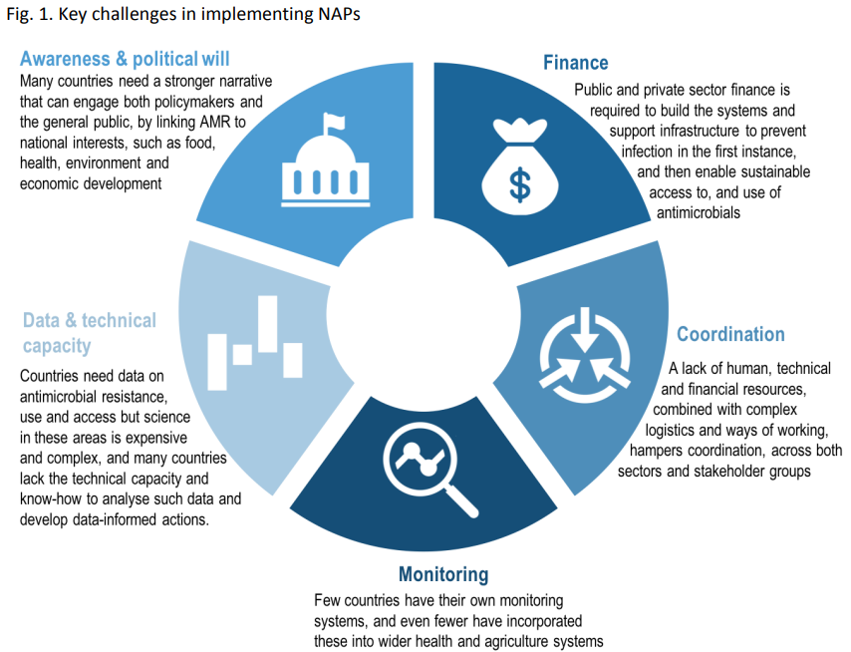
Lack of political will by governments
Four broad categories:
Countries with no plan or strategy on AMR Countries preparing a plan or having it approved
Countries with a plan but having difficulty in implementing it
no mechanism for implementation/coordination
logistical, technical or institutional challenges
cannot access enough resources
countries with a plan or strategy that are implementing it well
https://cdn.who.int/media/docs/default-source/antimicrobial-resistance/iacg-amr-national-action-plans-110618.pdf?%20sfvrsn=53e4eb22_4

Slide 14
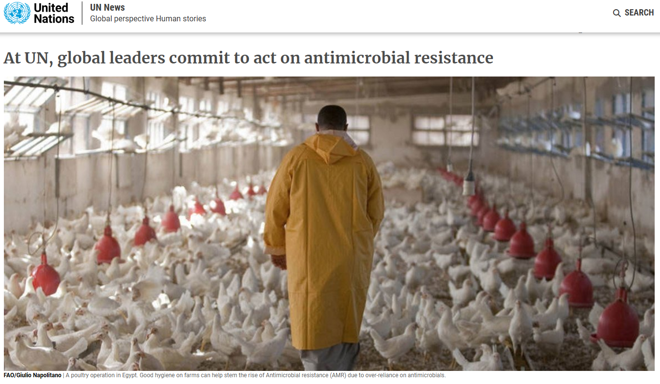
Lack of political will by governments
May 2015, World Health Assembly endorsed the Global Action Plan (GAP) on AMR that called upon member states to develop NAPs to address AMR.
December 31st 2019 and according to the WHO Regional Office for Africa,
33 African countries had AMR NAPs,
16 politically endorsed at government level,
13 technically endorsed and still going through countries legislative processes and the rest were being developed.
https://news.un.org/en/story/2016/09/539912/

Slide 15
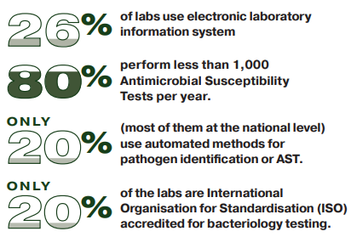
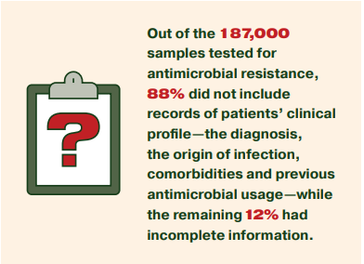
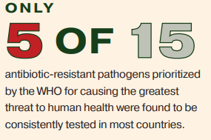
Lack of access to quality laboratory services
Inadequate access: insufficient quantity and quality
SSA: 380 lab accredited to intern. stands, absence in 37/49 countries
Lack of resources
Manpower, inadequate infrastructure, insufficient lab supplies, supply chain management, poor maintenance, inadequate quality management, dearth of regulation by government
Pathogen detection and AST:
obsolete phenotypic methods slow, prone to errors → inaccurate clinical decision making
Inequitable access
Lab services located in urban areas
Absence of guidance by diagnostic lab
presumptive management of patients,
blind prescription of antibiotics
or referral of very sick cases
Mapping Antimicrobial Resistance and Antimicrobial Use Partnership. Incomplete antimicrobial resistance (AMR) data in Africa: the crises within the crises. 2022.

Slide 16
Perception, values and beliefs of consumers or end users of antibiotics
Demand from individuals, relatives or care givers
Patrilineal, traditional or religious cultures
Ex: dependent on husband (or male family head), traditional ruler or religious leader.
Environment of self-medication and inappropriate ATB use:
Lack of proper knowledge and misinterpretation of symptoms facilitated unnecessary use of ATB
Use of the previous prescription
Recommendations from the drug sellers
Unavailability of competent doctors for consultations
Low socioeconomic status
Mild disease symptoms
Sociocultural preferences for a particular route of administration
→ inappropriate dosing
Outpatients in some LMICs to insist on intravenous or intramuscular antibiotics even when oral alternatives may suffice
Ndaki et al. BMC Public Health (2025) 25:705 https://doi.org/10.1186/s12889-025-21553-6

Slide 17
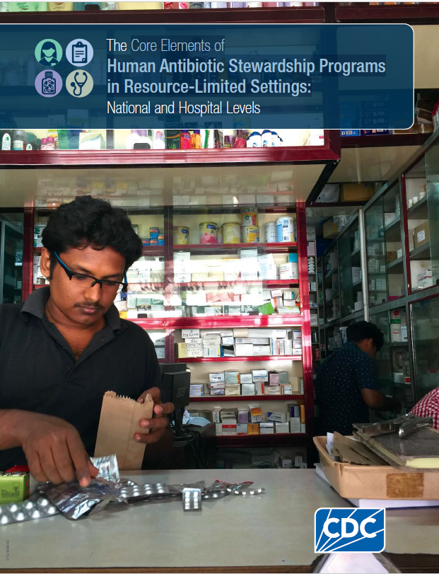
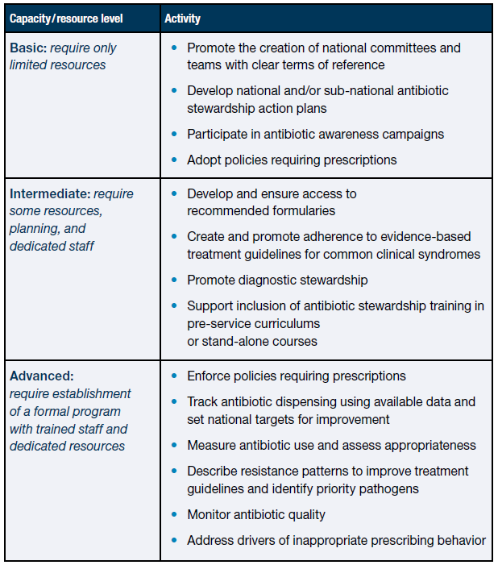
Core Elements of ASP in Resource-Limited Settings
CDC - The Core Elements of Human Antibiotic Stewardship Programs in Resource-Limited Settings: National and Hospital Levels

Slide 18
Several levels of analysis
Organisational context
A
Indiv. caracteristics
Healthcare
Professional

Slide 19
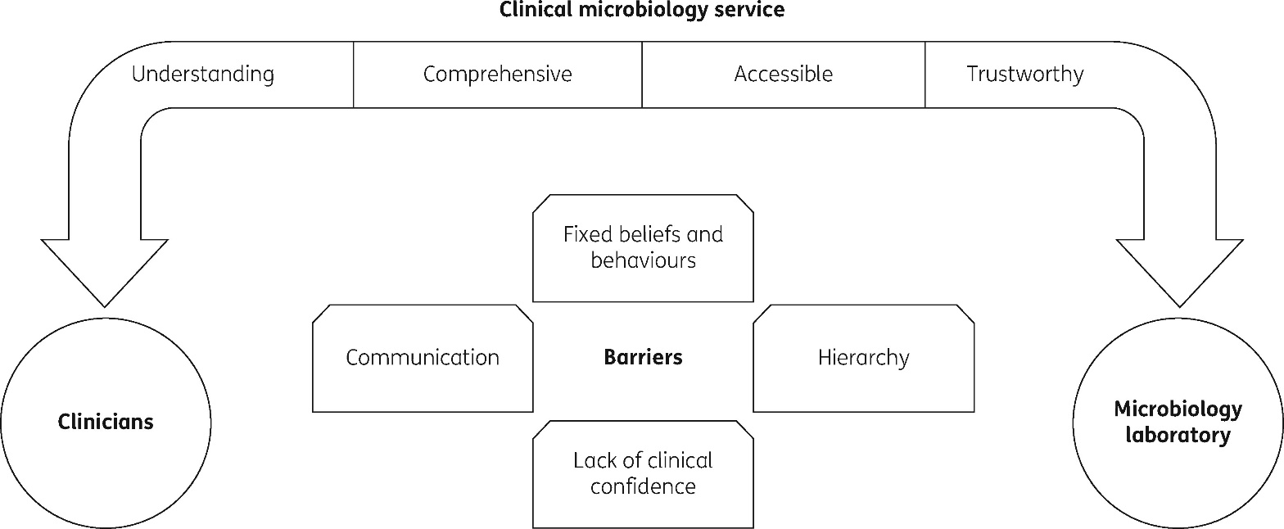
Poor use of laboratory services by clinicians
Assumption that clinical diagnosis is sufficient, laboratories not necessary
Senior physician instructs a junior physician not to use the laboratory
Poor communication between physicians and the hospital’s laboratory
Lack of awareness of problem of inappropriate ATB use and role of clinical micro lab
Long turn-around times or delays
Lack of confidence in the accuracy of results
Absence of clinical microbiologists, patients not able to pay laboratory tests
If treatment failure, repeated (or ‘trial and error’) antibiotic switches
Fox-Lewis S, J Antimicrob Chemother 2018; 73: 509–16. https://doi.org/10.1093/jac/dkx414

Slide 20
Inadequately trained drug dispensers
Dearth of trained pharmacists, poorly trained staff who lack the required knowledge, attitude and skills of proper drug dispensing
Dispensing = reviewing prescriptions and preparing, packaging, labelling, recording, and transferring medicines, counselling patients or caregivers on correct use of medicines
Correct antibiotic, in the right form, packaging, and dosage, proper advice
Dispensers need
Training: basic knowledge of antibiotics, including dosage, side effects, and drug interactions
Good communication skills and a positive professional attitude are essential for effective dispensing
Front Public Health . 2020 Apr 28:8:140.

Slide 21
Illegal drug vendors in the community
Closely related to the problem of inadequately trained drug dispensers
Over 50% of antimicrobials are purchased without prescriptions in the community in Low resources settings
Antimicrobials sold by illegal drug vendors in markets, stalls and commuter vehicles
69% (95% CI 58–80) non‑prescription dispensing of ATB among community drug retail outlets in SSA countries
Belachew et al. Antimicrob Resist Infect Control (2021) 10:13 https://doi.org/10.1186/s13756-020-00880-w

Slide 22
Lack of access to effective antibiotics
‘Having drugs continuously available and affordable at public or private health facilities or drug outlets that are within one hour’s walk of the population’
Poor regulatory frameworks
Antibiotics = 17% of these sub-standard or falsified medicines
No pharmaceutical training being involved in the importation and distribution of antibiotics
Poverty and inadequate funding of the health sector
Infrastructural deficits and chronic shortages, sold to patients at subsidized rates in public health facilities
Patients bear high medical costs (at higher prices) from private pharmacies or drugstores, many cannot afford to buy
Mendelson, Lancet 2016; 387: 188–98

Slide 23
Core Elements of ASP in Resource-Limited Settings
Single focal point with responsibility for the program
Support from hospital leadership
Stepwise approach to building a stewardship program
Form an antibiotic stewardship committee
Start with a single priority area of the ASP
Ensure appropriate policies or guidelines are in place
Educate staff and publicize stewardship campaign
Implement stewardship activities targeted at the priority
Monitoring and evaluating processes + impact
CDC - The Core Elements of Human Antibiotic Stewardship Programs in Resource-Limited Settings: National and Hospital Levels

Slide 24
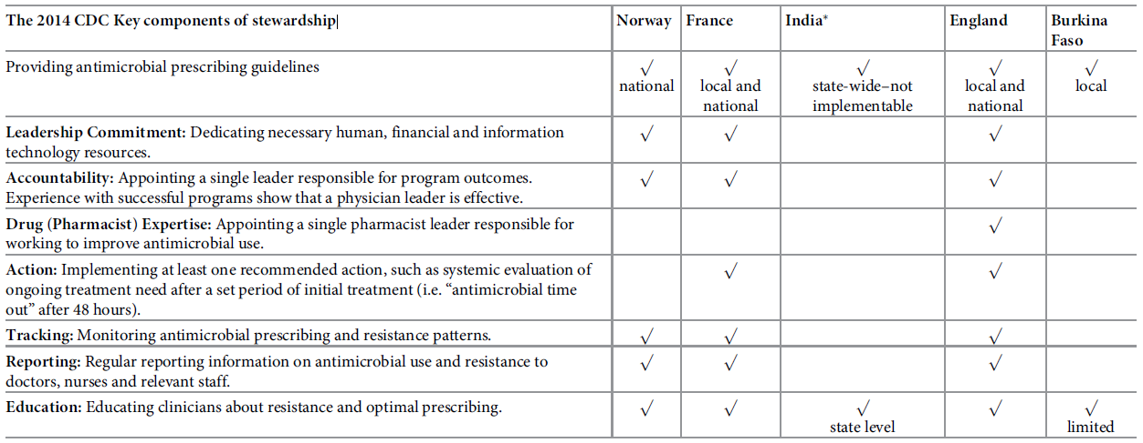
Cultural and contextual determinants of ASP across LMICs & HIC
Government and state infrastructure are perceived as determinants of ASP
Professional boundaries dictate involvement in ASP
Social norms and values in relation to antimicrobial decision making are different in medicine versus surgery
Charani PLOS ONE | https://doi.org/10.1371/journal.pone.0209847 January 16, 2019

Slide 25
Several levels of analysis
A
Indiv. characteristics
Healthcare professionals

Slide 26
Many behavioural theories
Barriers to physician adherence to practice guidelines in relation to behaviour change
Knowledge
Attitudes
Behaviours
Cabana MD et al, JAMA 1999

Slide 27
Many behavioural theories
Barriers to physician adherence to practice guidelines in relation to behaviour change
Knowledge
Attitudes
Behaviours
Lack of familiarity
Volume of information
Time needed to stay informed
Guidelines accessibility
Lack of awareness
Cabana MD et al, JAMA 1999

Slide 28
Many behavioural theories
Barriers to physician adherence to practice guidelines in relation to behaviour change
Knowledge
Attitudes
Behaviours
Lack of confidence
Applicability
Interpretation of evidence
Following guidelines will not cure patient
Lack of agreement with this guidelines
Lack of outcome expectancy
Lack of agreement with this guidelines in general
Lack of self efficacy
Professional believes can’t apply reco
Too rigid
Too cookbook
Lack of motivation
Habit, routine
Cabana MD et al, JAMA 1999

Slide 29
Many behavioural theories
Barriers to physician adherence to practice guidelines in relation to behaviour change
Knowledge
Attitudes
Behaviours
Patient
Clinical case
Recommendations:
Contradictory
Difficult to apply
Environmental barriers
Lack of time/resources
Insufficient support
Increase responsibility
External barriers:
Patient
Guidelines
Environment
Cabana MD et al, JAMA 1999

Slide 30
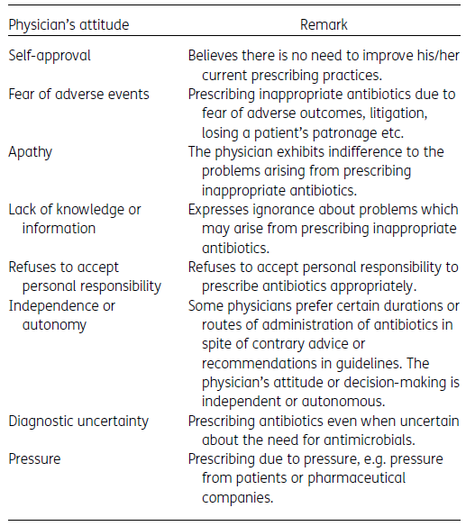
Physician (prescriber) factors
Personal attributes:
Clinical experience, exposure to continuous medical education and speciality
Attitude to the problems of inappropriate antibiotic use and AMR
Lack of institutional guidelines and AMS programmes
Marketing and promotional activities by pharmaceutical companies may influence the prescribing patterns of physicians.
Ethiopia: 55.9% of physicians perceived that pharmaceutical marketing strategies influenced their prescribing
Idemudia Imonikhe Otaigbe JAC Antimicrob Resist https://doi.org/10.1093/jacamr/dlad062

Slide 31
Introduction to behaviour change and implementation sciences

Slide 32
Bundle
Checklist
Résultat
Surveillance
Innovation
Intervention
Outcome
Remerciement Dr Walter Zingg

Slide 33
Bundle
Checklist
?
Résultat
Surveillance
Innovation
Intervention
Implémentation?
Outcome
Remerciement Dr Walter Zingg

Slide 34
Bundle
Comment
Checklist
Résultat
Surveillance
Innovation
Intervention
Implémentation!
Outcome
Remerciement Dr Walter Zingg

Slide 35
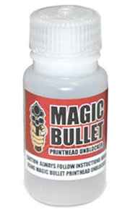
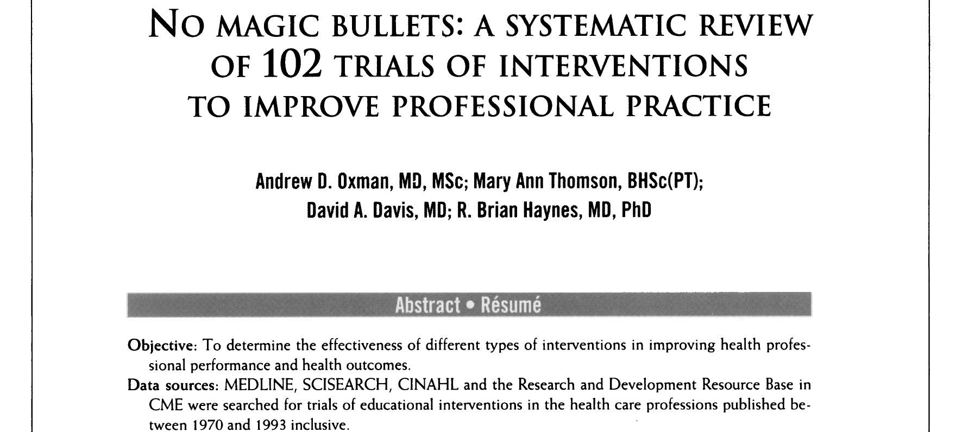
Il n’y a PAS de solution miracle

Slide 36

IMPLEMENTATION = C’est l’adaptation!
Notes:
L’adaptation

Slide 37
Approche systématique de l’implémentation
Définir les “bonnes pratiques de soins”
Analyser l’application actuelle de ces “bonnes pratiques de soins”
Analyser les freins influençant l’application (ou non) des “bonnes prat.”
Développer une stratégie d’amélioration basée sur le diagnostic
Développer un plan, exécuter, évaluer cette stratégie d’amélioration
Grol. BMJ 1997

Slide 38
Approche systématique de l’implémentation
Définir les “bonnes pratiques de soins”
Analyser l’application actuelle de ces “bonnes pratiques de soins”
Phase d’évaluation/diagnostic
Analyser les freins influençant l’application (ou non) des “bonnes prat.”
Développer une stratégie d’amélioration basée sur le diagnostic
Développer un plan, exécuter, évaluer cette stratégie d’amélioration
Grol. BMJ 1997

Slide 39
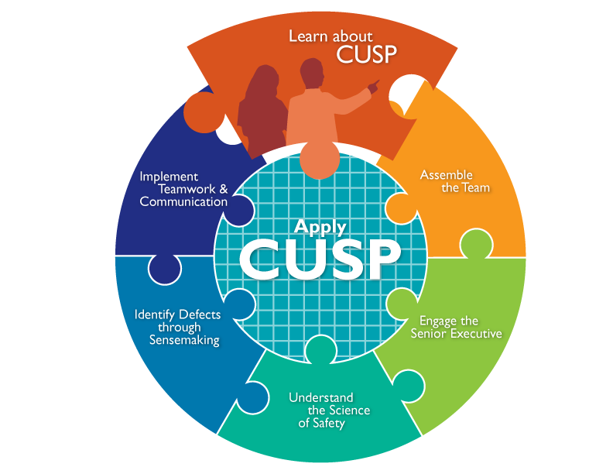
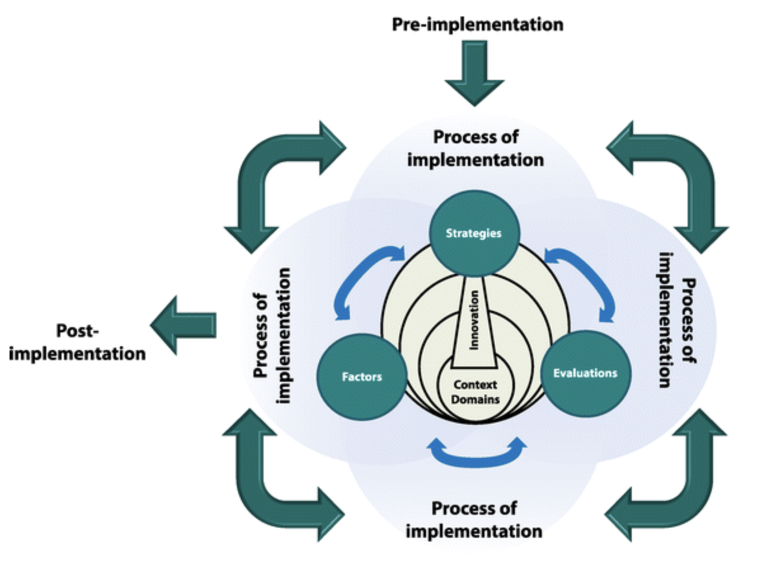
Plusieurs cadres théoriques utilisables

Slide 40
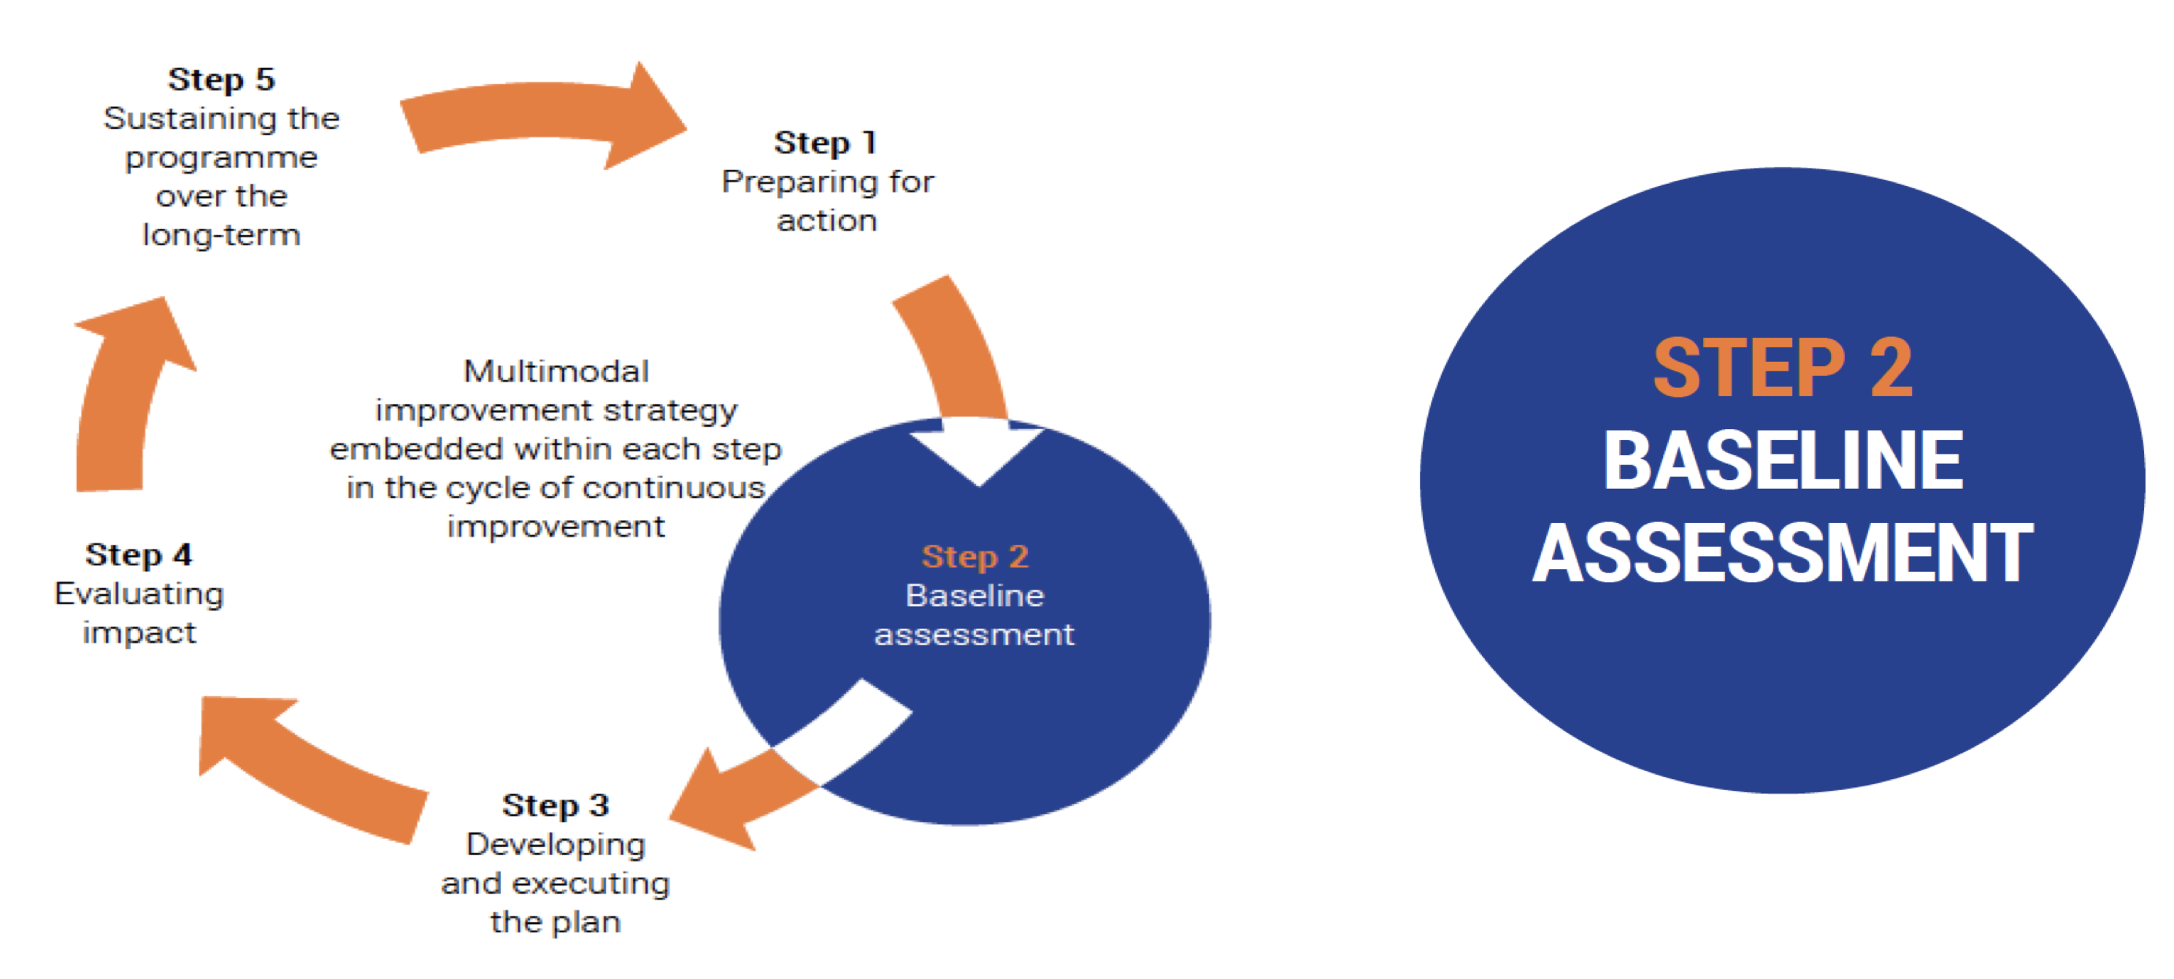
Approche OMS par étapes
Identifier les obstacles et les facilitateurs

Slide 41
Méthodes de changement des comportements

Slide 42
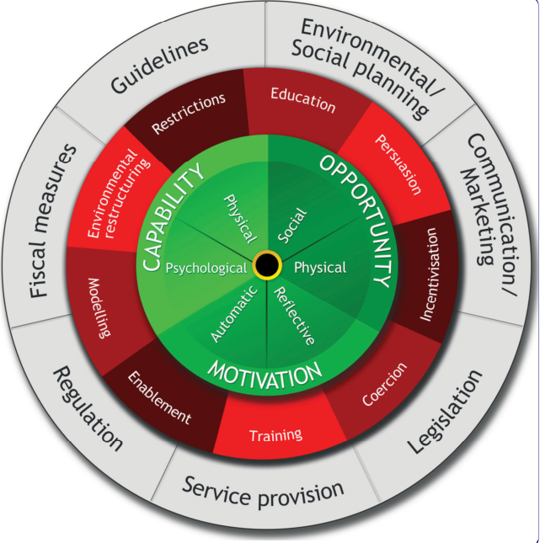
Méthode n°1: Roue de changement des comportements
Source des comportements
Fonction des interventions
Réglementation
réglementation:
Décisions prises par les autorités concernant l’intervention
Michie et al. Implementation Science 2011

Slide 43
COM-B: un outil pour comprendre les comportements…
Capacité
Capacité à comprendre quoi faire et comment le faire
Motivation
Mécanismes réfléchi ou automatique
Comportement
Opportunité
Environnement physique (temps, argent…) et social (influence des autres)
Michie et al, Implementation Science 2011

Slide 44



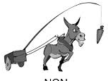


Interventions
Règlementer l’application des comportements
Améliorer la connaissance et la compréhension
Utiliser la communication pour induire un sentiment positif ou négatif et stimuler l’action
Changer le contexte matériel et social
Créer une attente de récompenses
Donner un exemple à suivre
Accroitre les moyens ou réduire les barrières d’accroitre les capacités (au delà de la formation) ou opportunités
Conférer des compétences
Créer une attente de pénalité (financière)

Slide 45
Quelle intervention utiliser?
 | Fonctions des interventions
 | Formation | Persuasion | Récompense | Coercition | Entrainement | Restreindre | Restructurer l’environnement | Modeler | Permettre
Capacité matérielles
Capacités mentales
Opportunité matérielle
Opportunité sociale
Motivation automatique
Motivation réfléchie

Slide 46
Quelle intervention utiliser?
 | Fonctions des interventions
 | Formation | Persuasion | Récompense | Coercition | Entrainement | Restreindre | Restructurer l’environnement | Modeler | Faciliter
Capacité matérielles
Capacités Psycholog.. | √ |  |  |  | √ |  |  |  | √
Opportunité matérielle
Opportunité sociale
Motivation automatique
Motivation réfléchie

Slide 47
Concept des sciences de l’implementation

Slide 48
Implementation science definition
Implementation science is defined as the scientific study of methods to promote the systematic integration of research findings and evidence based practices into care delivery and the de-integration of low value care
Involves early and active engagement of practice partners and end users
Draws from rich theoretical foundation for understanding, designing, and evaluating complex implementation processes and their multilevel contextual interactions
NIH. Dissemination and implementation research in health, 2006

Slide 49

Principes et méthodes
Intervention of implementation
Unique method or technique to facilitate change
At patient, professionnels, organisation, political level
Stratégie d’implémentation
Cocktail, bundle of implementation intervention selectged to overcome barriers identified for implementation success
Difference clinical study/ implementation
Clinical: effect on health
Implementation: effect on the rate and quality of use of guidelines
Complicated to understand…
Aspect multimodale / multifacettes
Adapted to the local context

Slide 50
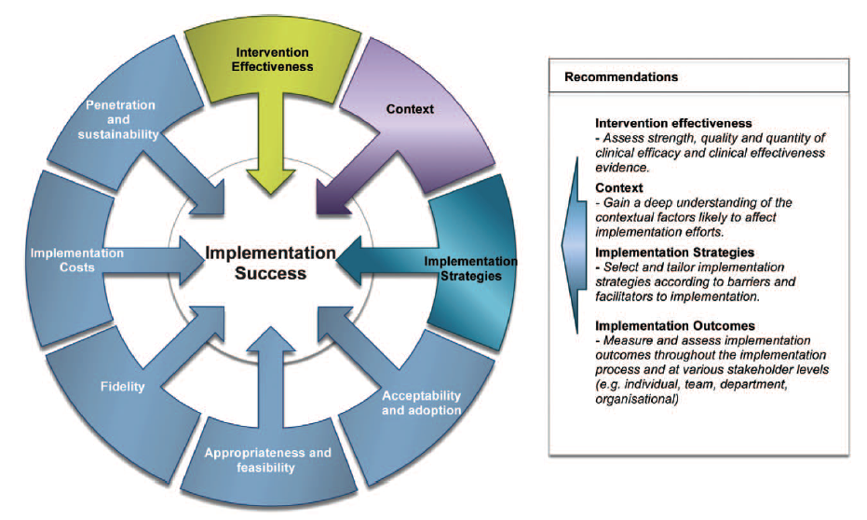
Receipe for implementation success
1- Evaluate the intervention and the context
2- Implementation strategy
3- Evaluation of result
Hull et al, Annals of Surgery 2016

Slide 51
How to apply best practices in infection prevention and control and antimicrobial stewardship? Reflexion on implementation methods.
CFIR
Consolidated Framework for Implementation Research
Damschroder LJ, Aron DC, Keith RE, Kirsh SR, Alexander JA, Lowery JC
Fostering implementation of health services research findings into practice: A consolidated framework for advancing implementation science
Implementation Sci 2009;4: 50

Slide 52
Several levels of analysis
The intervention
National and cultural context
Organisational context (hospital)
A
Indiv. characteristics
Healthcare
Professional

Slide 53
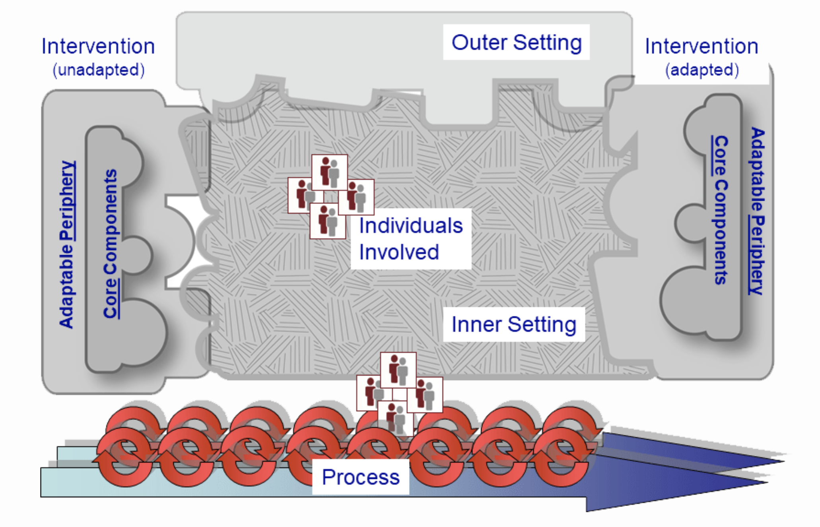
Identifier barrières et facilitateurs

Slide 54
Surmonter les obstacles
Utiliser les facilitateurs
Identifier barrières et facilitateurs

Slide 55
Intervention’s characteristics
Origin of the intervention
Evidence & quality of proof
Avantages of the intervention / alternatives
Adaptability
Possibility to evaluate at small scale (pilot)
Complexity
Design & packaging
Cost

Slide 56
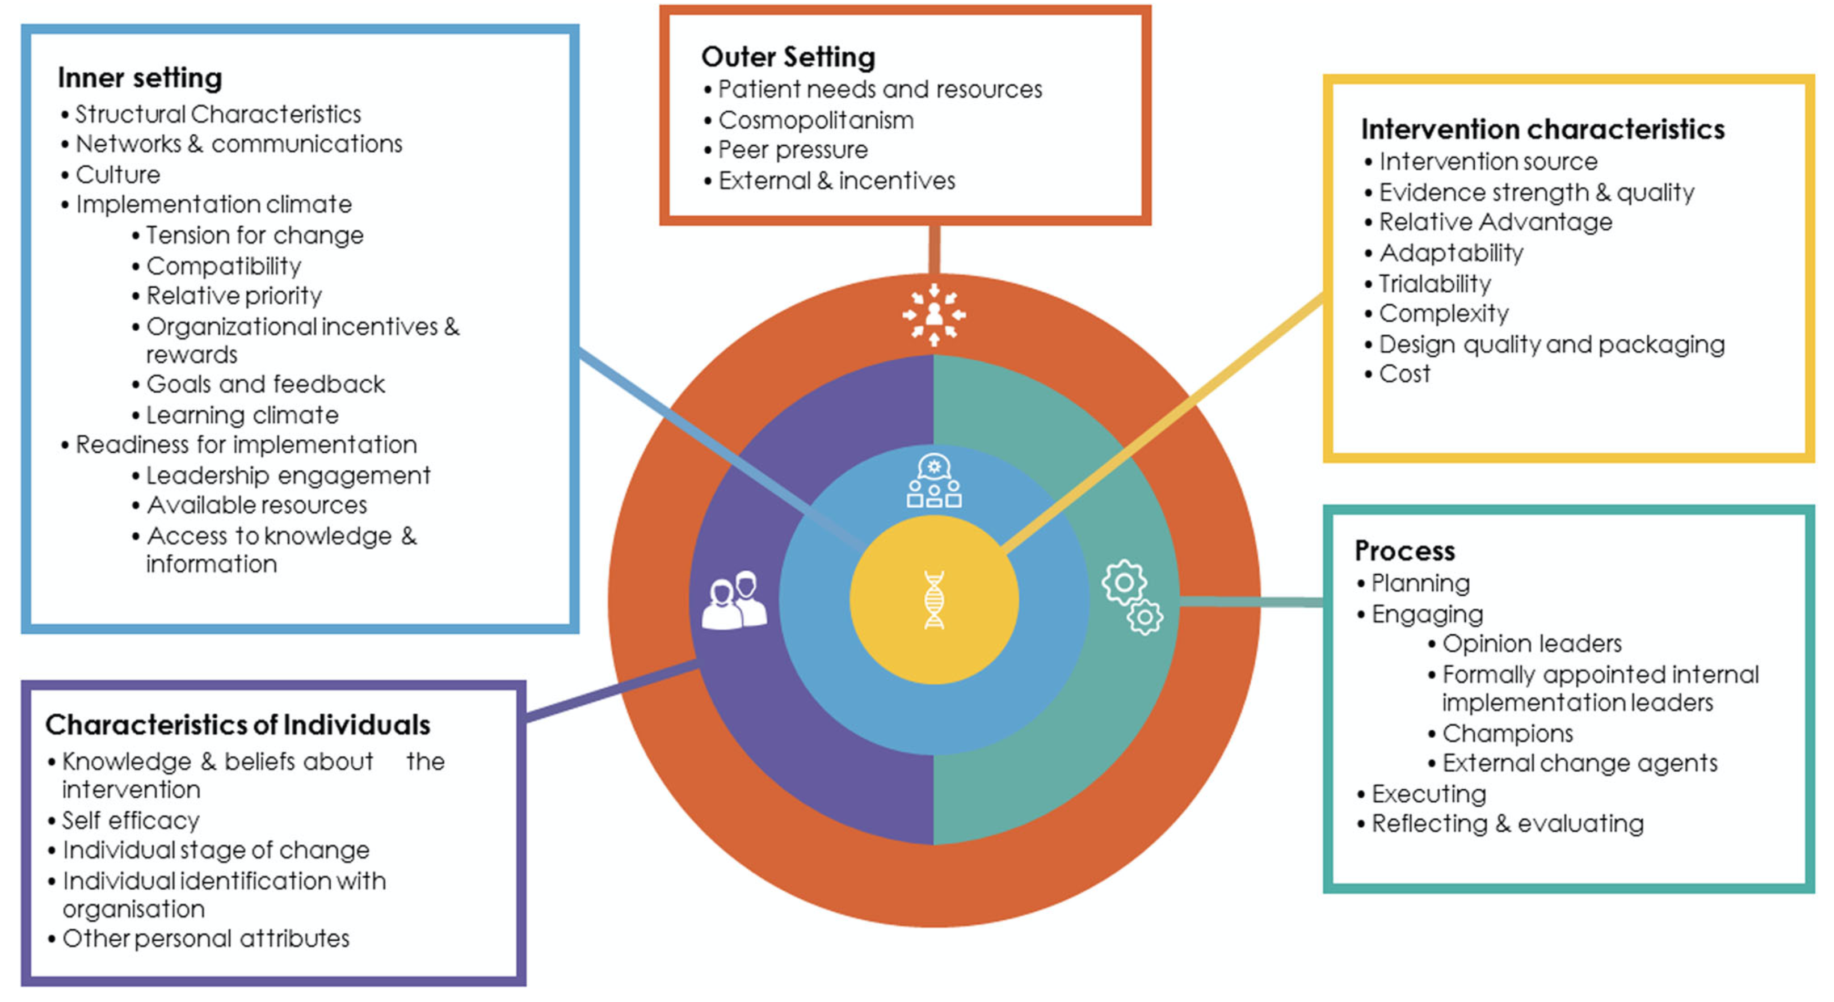
Barrières / facilitateurs
Consolidated Framework for Implementation Research (CFIR)

Slide 57
Step n°1: Evaluation phase
Evaluate the context in terms of barriers and facilitators for the implementation
Qualitative method : Face to face interview or focus group
Quantitative method : Evaluation form
Example d’ASPIRES: “Optimising antibiotic usage along surgical pathways: addressing antimicrobial resistance and improving clinical outcomes.”
Choose among 39 « constructs » most relevant
Define the analysis level: individual or organisation
Define with stakeholders communication pathways

Slide 58



Comment procéder ?
Entretiens
Méthodes qualitatives
Groupes de parole
Sondages

Slide 59
1. Mettre en place des entretiens individuels
Sélection des participants
Créer un guide d’entretien
Conduire les entretiens
Analyser les données
Vous voulez introduire un formulaire d’indication des prescriptions d’antibiotiques

Slide 60
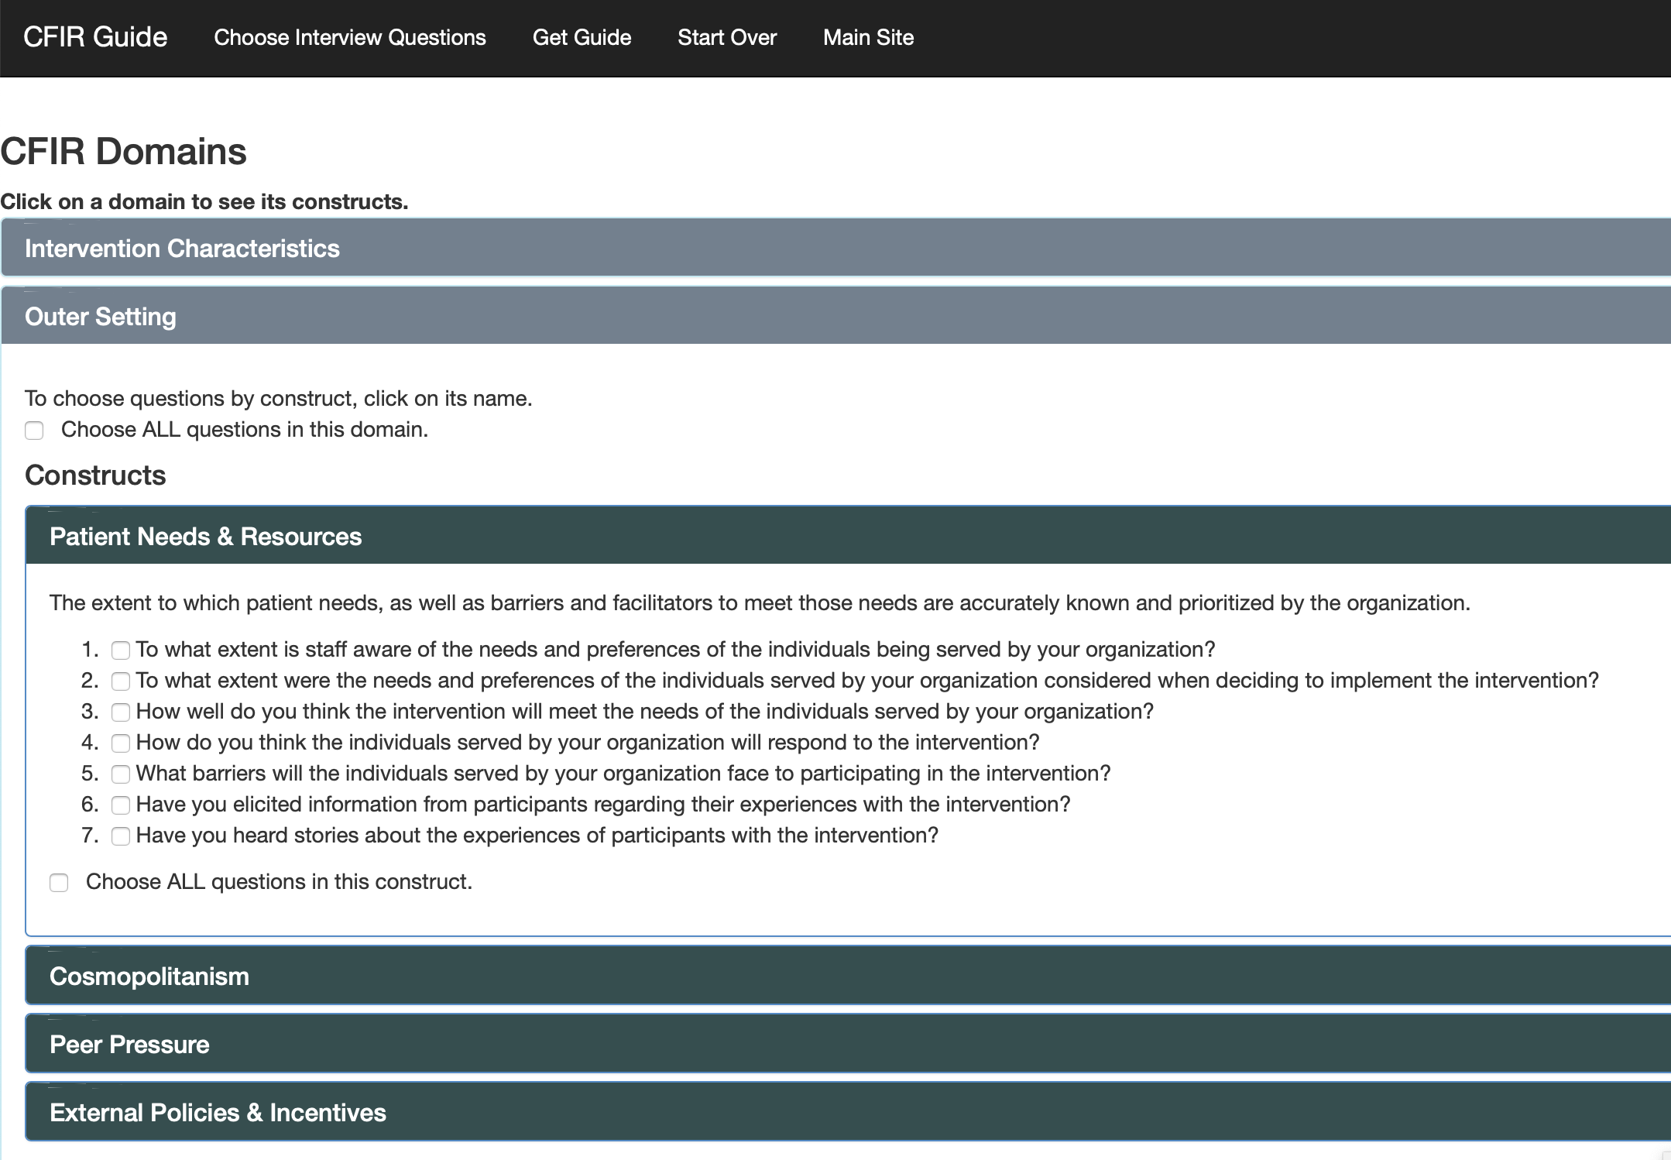
Idées de question
https://cfirguide.org/guide/app/#/guide_select

Slide 61
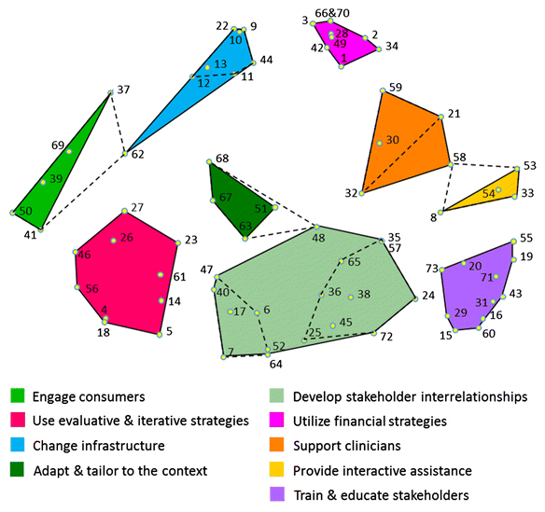
Choice of the implementation strategy
Analyse of 73 strategies
What works:
Support with paper format(flyer)
Education meeting
Onsite education
Local opinion leaders
Audit & feedback
Reminders
Interventions tailored to the context
Waltz et al, Implementation sciences 2015

Slide 62
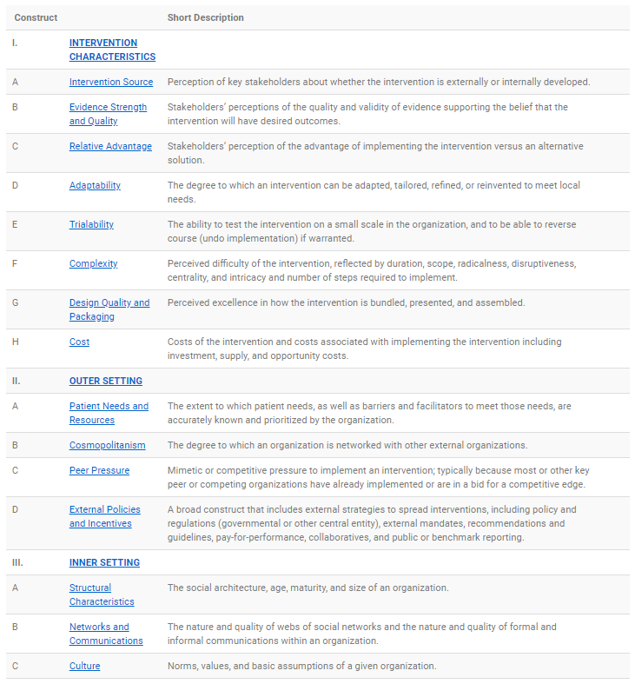
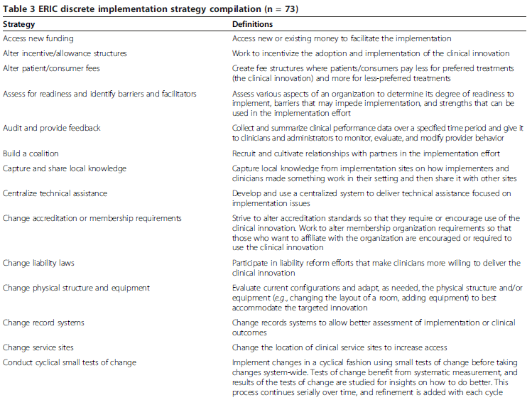
Step n°2: Choice of the implementation strategy
Crossing between CFIR et ERIC (Analyse of 73 strategies)
Barriere or not?
Simulation based on the evaluation of an expert panel
70%
30%
Powell et al, Impl Science. 2015
https://cfirguide.org/choosing-strategies/

Slide 63
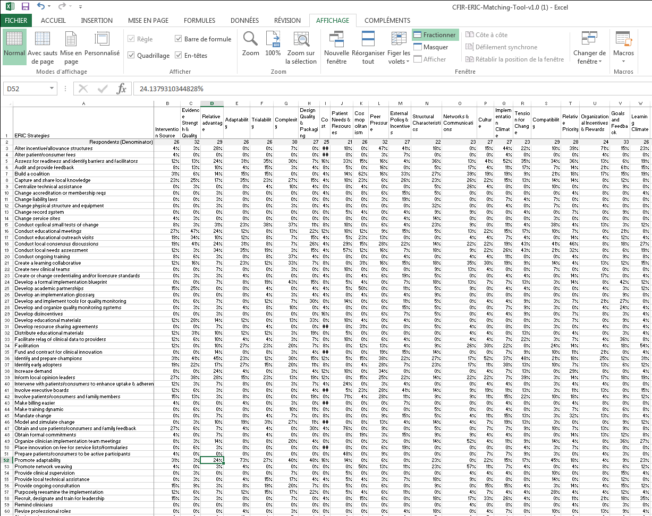
Step n°2: Choice of the implementation strategy
39 Constructs
% of cotation by expert panel
73 Strategies
Powell et al, Impl Science. 2015
https://cfirguide.org/choosing-strategies/

Slide 64
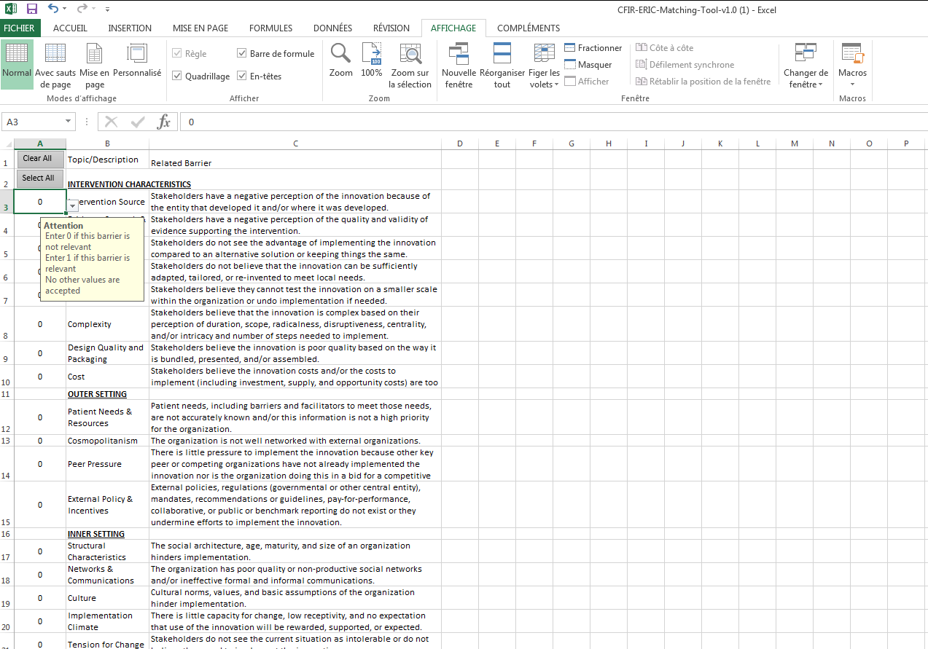
Step n°2: Choice of the implementation strategy
Powell et al, Impl Science. 2015
https://cfirguide.org/choosing-strategies/

Slide 65
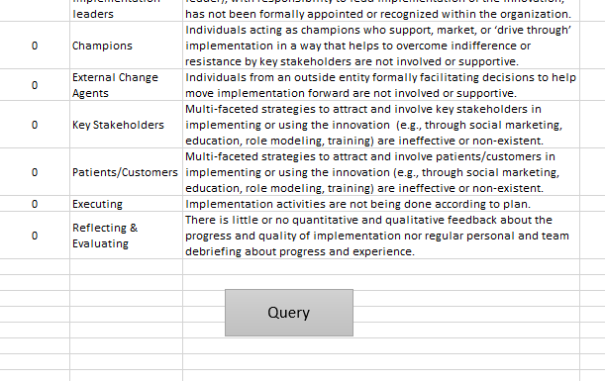
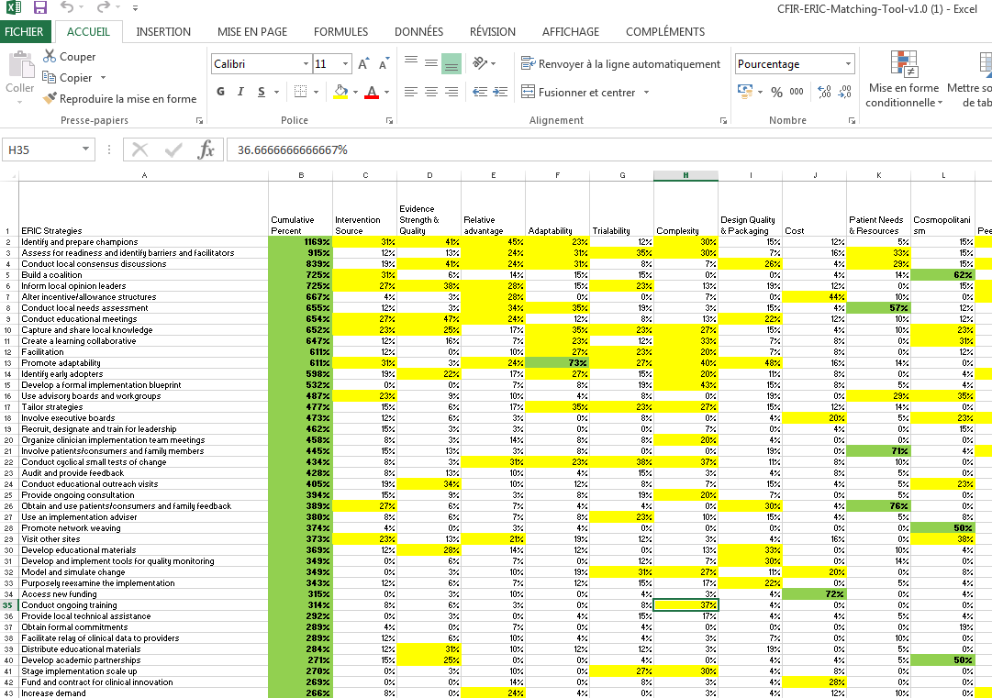
Step n°2: Choice of the implementation strategy

Slide 66
Step n°3: Evaluate the impact of your implementation strategy
Clinical outcome critical but not sufficient
to evaluate the impact of the strategy
Implementation outcome | Definition
Acceptability | Perception amongst stakeholders new intervention is agreeable
Adoption | Intention to apply or application of new intervention
Appropriateness | Perceived relevance of intervention to a setting, audience, or problem
Feasibility | Extent to which an intervention can be applied
Fidelity | Extent to which an intervention gets applied as originally designed / intended
Implementation costs | Costs of the delivery strategy, including the costs of the intervention itself
Coverage | Extend to which eligible patients/population actually receive intervention
Sustainability | Extent to which a new intervention becomes routinely available / is maintained post-introduction

Slide 67


Thank you
@EUCIC1

Slide 68
Supplement

Slide 69

References

Slide 70





Slide 71
Example of Implementation: The Surgical Safety Checklist
Meet the Expert session
ECCMID 2024, Barcelona

Slide 72
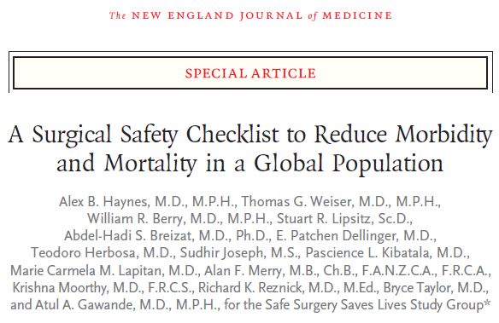


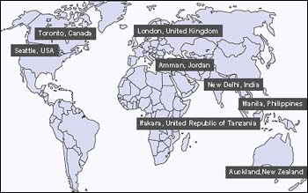

Evidence for checklists
Major complication rate decreased 36%
Mortality decreased 47%
Post-op infection decreased 48%

Slide 73
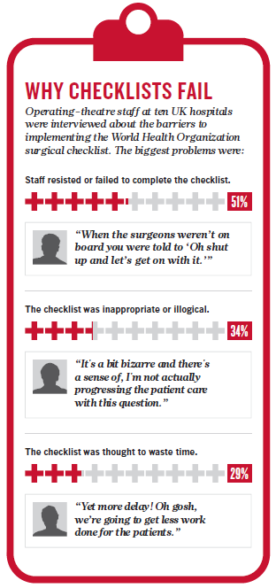
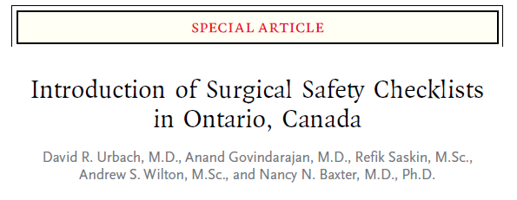

Implementation of checklists
“It just appeared…”
“We’re already doing all of this.”
“There was no discussion or introduction or anything. Typical.”
101 hospitals | Pre-checklist (N=109,341) | Post-checklist (N=106,370)
30-day mortality | 0.71% | 0.65%
Complications risk | 3.86% | 3.86%
“Our chief exec had a bee in their bonnet and it was
‘no you will do this’…”
“The likely reason for the failure
…is that it was not actually used”
Russ, J Am Coll Surg. 2015 Jan;220(1):1-11.e4.
Anthes, Nature 2015

Slide 74
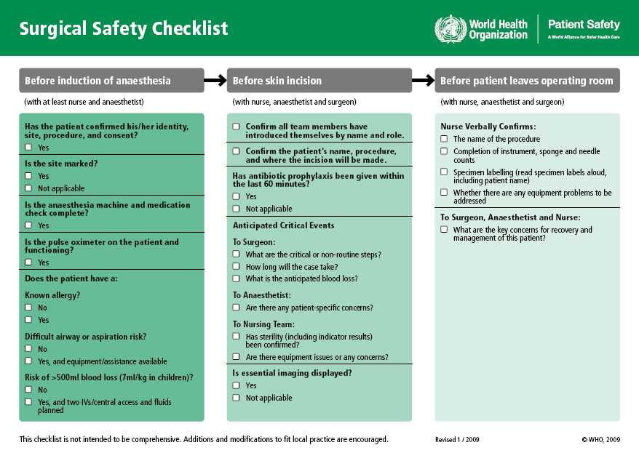
WHO Surgical safety checklist
You want to implement the surgical safety checklist in the OR of your hospital
How would you proceed?
By which action/step will you start?

Slide 75
PHASE 1: Prepare
Understanding the checklist tool, how it works, what is going on currently in your facility, committing to the work required
Step 1: Build a multidisciplinary team
Planning, executing, establish roles, expectations, and process
Be representative, include champions, think political to get commitment
Step 2: Team understanding of SSC benefits and effective implementation

Slide 76

WHO Surgical safety checklist
You’ve created your implementation team, well done!
What is the critical step to perform before thinking about the implementation strategy?

Slide 77
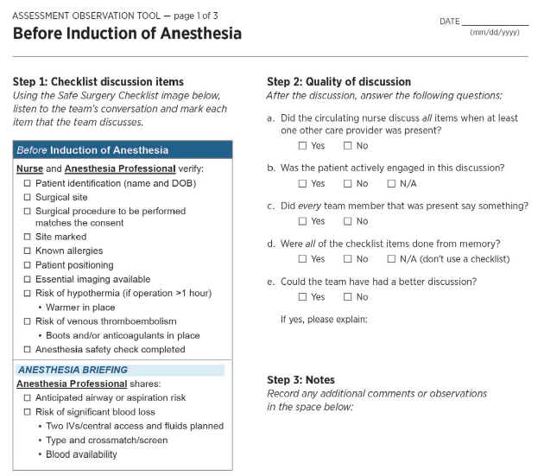
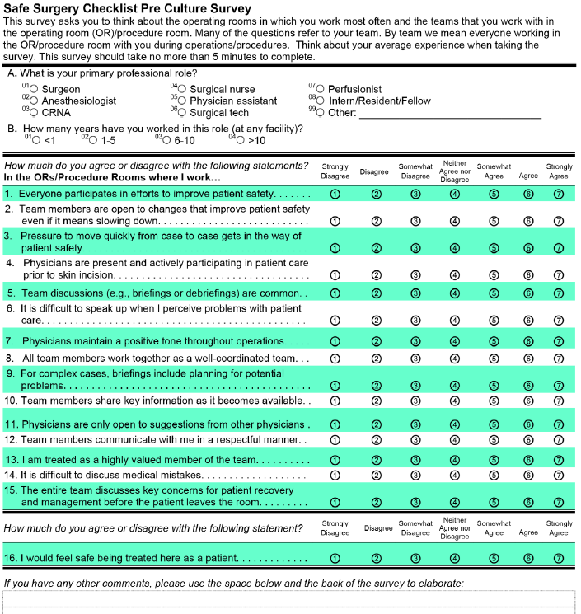
PHASE 1: Prepare
Understanding the checklist tool, how it works, what is going on currently in your facility, committing to the work required
Step 3: Assess existing practices, and Safe Surgery Culture
Observing current practices
Assess your culture
Focus groups, semi-structures interviews, meeting notes…

Slide 78
PHASE 1: Prepare
Understanding the checklist tool, how it works, what is going on currently in your facility, committing to the work required
Step 4: Are We Ready?
Success administering culture survey
Prior successes in surgical safety
Strong implementation lead
Recruitment physician champions
Strong organizational support
Robust Time Out process
Go
Build a better foundation
Go, but focus

Slide 79
WHO Surgical safety checklist
We are prepared to move forward as planned. It’s a good point, but can we come back to one of the major barrier identified in studies for the implementation of the SSC?

Slide 80
WHO Surgical safety checklist
We are prepared to move forward as planned. It’s a good point, but can we come back to one of the major barrier identified in studies for the implementation of the SSC?
“There was no discussion or introduction or anything. Typical.”
“It just appeared…”
Not relevant, unproven, too cumbersome, not “for us”…
Ideas for change that come from outside anorganization are often treated as suspect — which makes those ideas easy to ignore or dismiss.

Slide 81
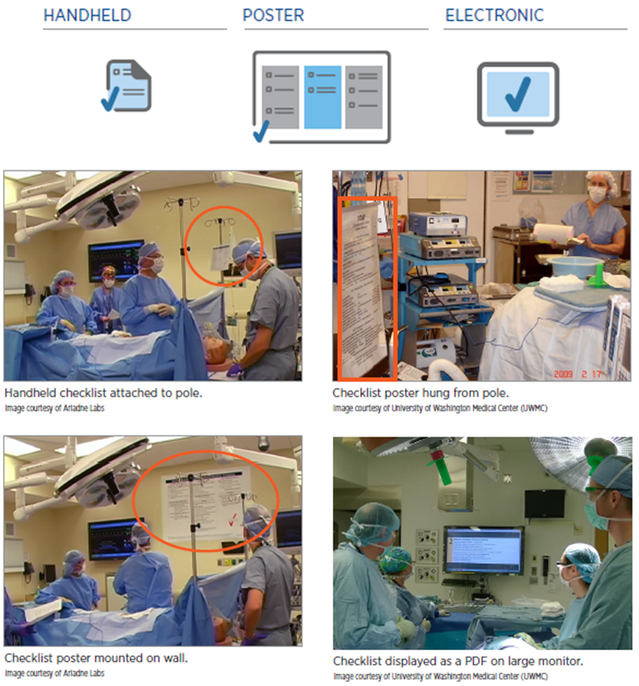
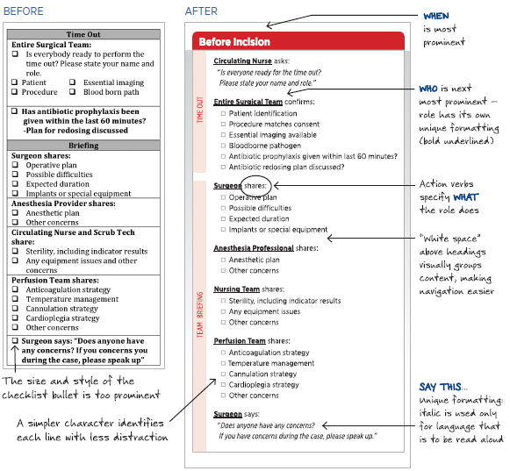
PHASE 2: Own
Make checklist initiative driven within facility, by teams, supported by leadership
Step 5: Customize your checklist to address institution-specific issues
Making your checklist easy to use
Customizing: Process checks, Conversation prompts
Testing your checklist

Slide 82
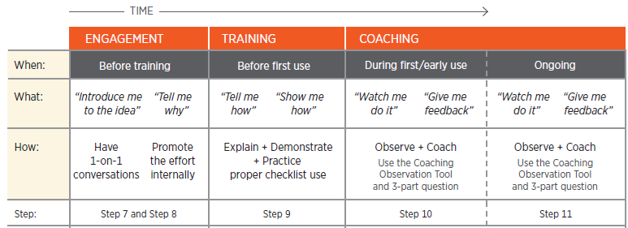
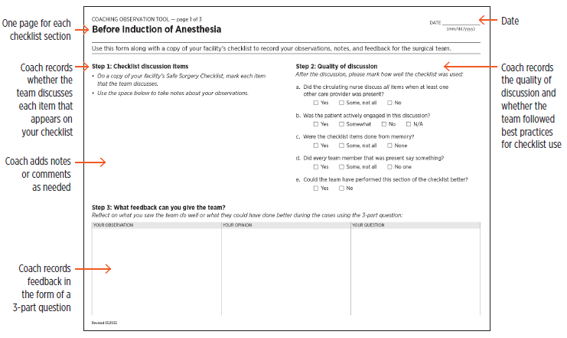

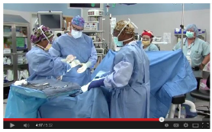
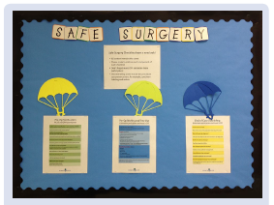
PHASE 3: Expand
Plan your expansion
Internal promotion:
Demonstration videos, bulletin boards, badges, e-mails, collecting stories
and newsletters
Coaching Observation Tool

Slide 83
WHO Surgical safety checklist
The last step for a good implementation of an intervention is crucial but often missed…
Any idea?

Slide 84
PHASE 4: Continually improve
Never stop looking and talking to surgical team members about the work
Step 11: Make periodic revisions (checklist and team members), use debriefing, Celebrate your progress
Criteria | Definitions
Acceptability | Perception amongst stakeholders new intervention is agreeable
Adoption | Intention to apply or application of new intervention
Appropriateness | Perceived relevance of intervention to a setting, audience, or problem
Feasibility | Extent to which an intervention can be applied
Fidelity | Extent to which an intervention gets applied as originally designed / intended
Implementation costs | Costs of the delivery strategy, including the costs of the intervention itself
Coverage | Extend to which eligible patients/population actually receive intervention
Sustainability | Extent to which a new intervention becomes routinely available / is maintained post-introduction
Post-op complication rates are critical
but not sufficient to assess the impact of the strategy

Slide 85
Keys for success
Structure your project with a step by step process
Choose an existing framework (ex: CFIR, 4E’s) or build your own one
Plan, engage
Adaptation to context
Evaluation phase is key → Needs time
Choice and design of the intervention
Choose the right implementation strategy
Execute & evaluate continuously
Don’t be too ambitious… start simple

Slide 86
Thank you
@EUCIC1

