Slide 1



Usage des antibiotiques en soins primaires et implication sur les programmes de BUA
Brecht Ingelbeen (Institut de Médecine Tropicale, Anvers, Belgique)
Daniel Valia (Unité de Recherche Clinique de Nanoro, Burkina Faso)
Séminaire BUA and les PRFI, SPILF, 13 Janvier 2026

Slide 2
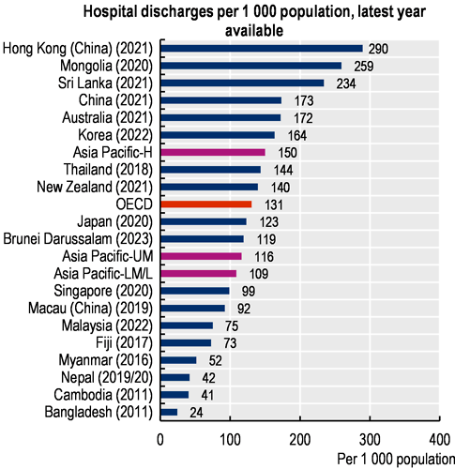
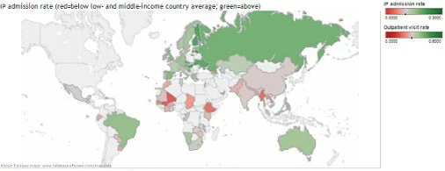
L’access aux soins en PRFI
Pays OCDE: 128 sorties de l’hôpital pour 1000 habitants par an
>200 en Allemagne, Autriche
<100 au Mexique, Costa Rica, Pays-Bas, Chili, Italie
Kimpese, RDC (2019): <10 par 1000 habitants
OCDE (2025), Panorama de la santé 2025 : Les indicateurs de l'OCDE, Éditions OCDE, Paris, https://doi.org/10.1787/2f564c6c-fr.

Slide 3
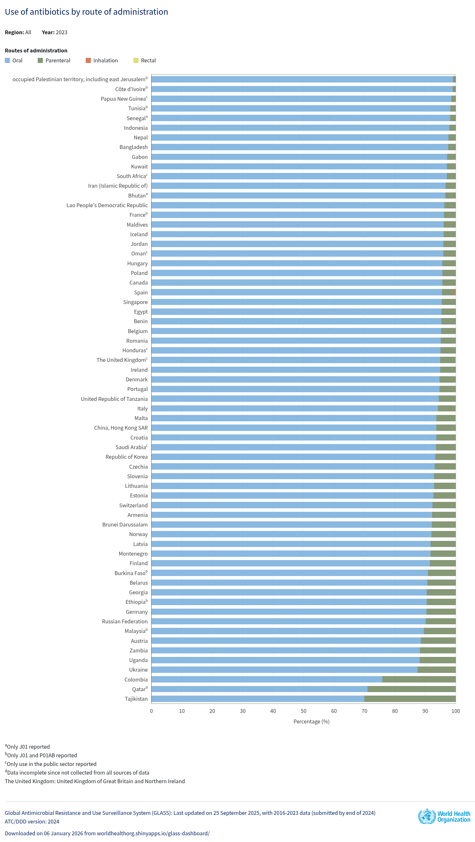
Usage d’antibiotiques
GLASS, données 2022: median 18.3 DDD pour 1000 habitants par jour
Range: 5.7 DID (Honduras) à 65.5 DID (Iran)
Plus élevé en Asie Sud-est: 26.6 DID
>90% ambulatoire mais pas de proportion par pays en PRFI

Slide 4
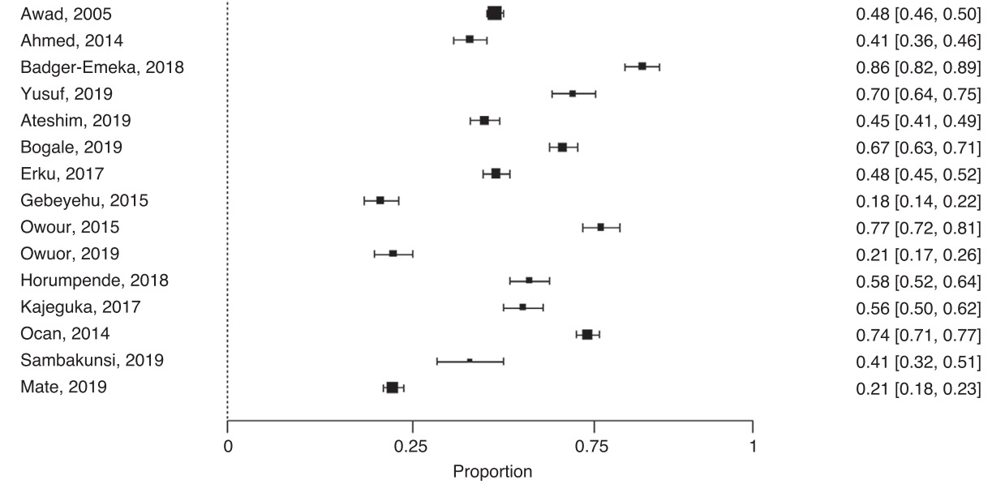
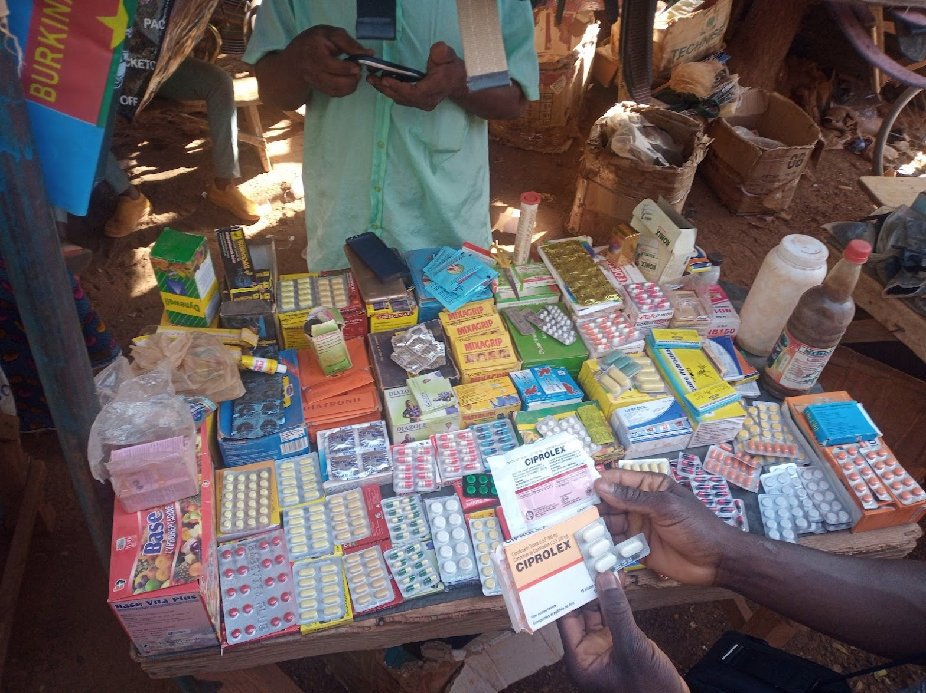
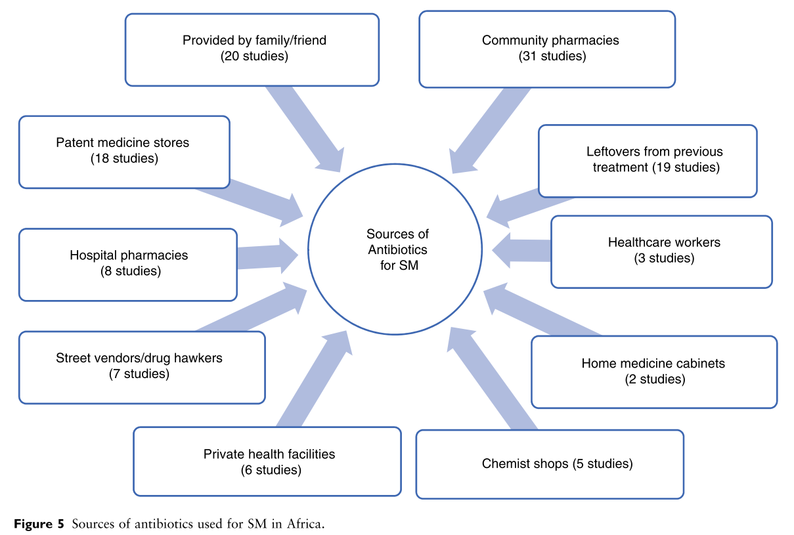
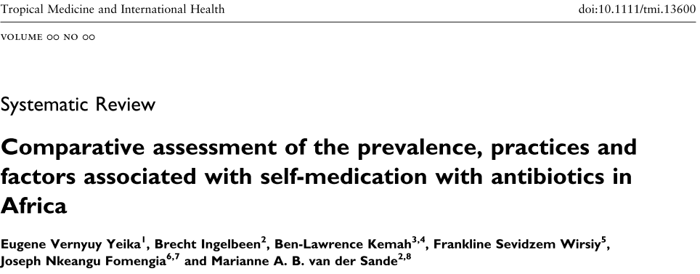
Auto-médication par antibiotiques
Pooled prevalence of self-medication with antibiotics: 52%

Slide 5
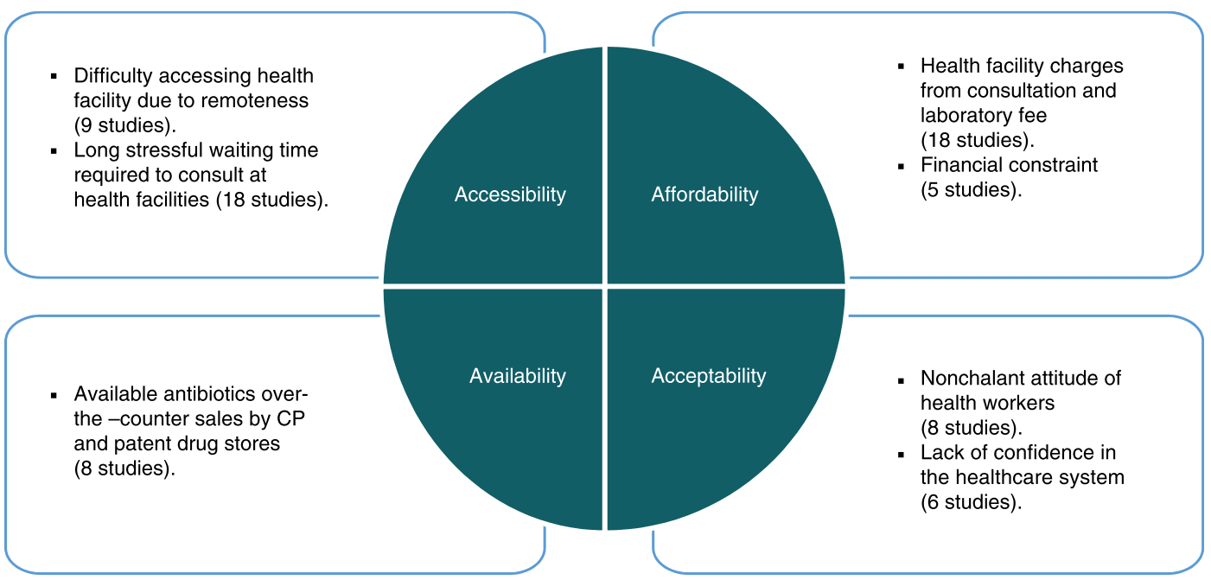
Causes d’automédication
Yeika et al, Trop Med Int Heal, 2021, doi.org/10.1111/tmi.13600

Slide 6
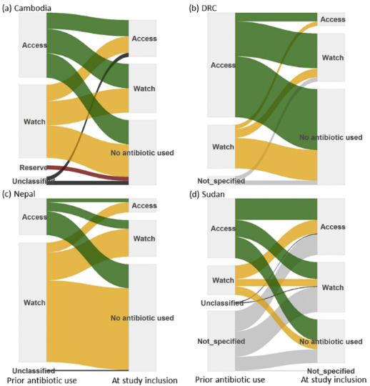
Usage d’antibiotiques au niveau communautaire en PRFI
Cambodge : 6% des cas de fièvre persistante ont rapporté une utilisation antérieure d’antibiotiques, dont 51% Watch
Népal : 36%, dont 82% Watch
RDC : 10%, dont 24% Watch
Soudan : 25%, dont 31% Watch
Ingelbeen, Koirala et al, CMI, 2021
Notes:
la moitié de l’usage d’antibiotiques était arrêtés au moment d’un diagnostique clinique élaboré à l’admission à l’hôpital, ce qui indique que ces antibiotiques auraient pu être évités.

Slide 7
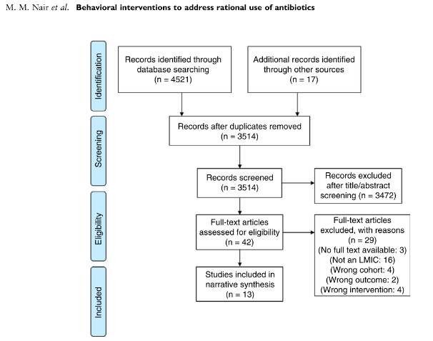
Interventions de BUA
Vietnam (n=5), Soudan (n=2), Tanzanie (n=2), Inde (n=2) et Kenya (n=2)
Dans les centres de soins primaires (n=8), les cliniques privées (n=2) et les pharmacies (n=3)
Catégories d'interventions comportementales :
Persuasives : audits de prescription et conseils
Facilitatrices : formation ou recommandations sur l'utilisation des antibiotiques (n=2)
Restrictives : approbation d'un expert avant l'utilisation de certains antibiotiques (n=0)
Structurales : nouveau test diagnostique ou algorithme clinique pour guider les prescriptions (n=2)
Combinées : association de différentes interventions (n=9)
Nair et al. Trop Med Int Heal. 2021
Notes:
Systematic review of 2021. Conclusion:
“enabling or educational interventions alone may not be sufficient to overcome the ingrained incentives to link revenue generation to sales of antibiotics, and hence, their inappropriate prescription or misuse”

Slide 8
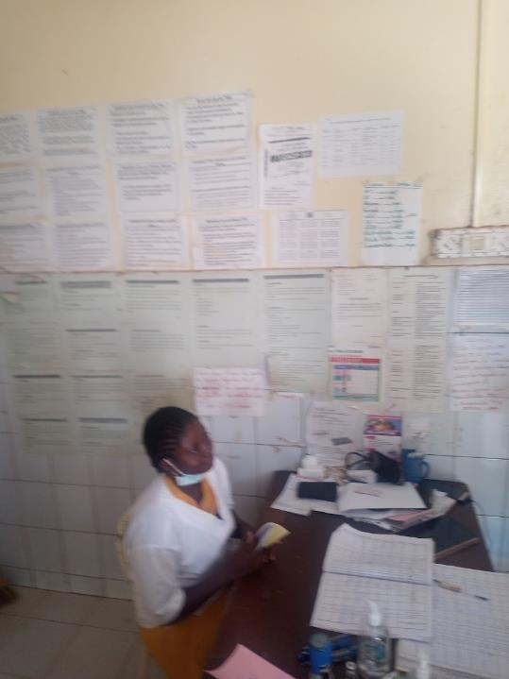

Slide 9
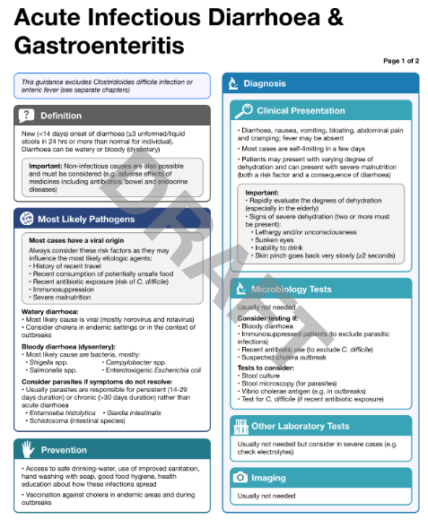
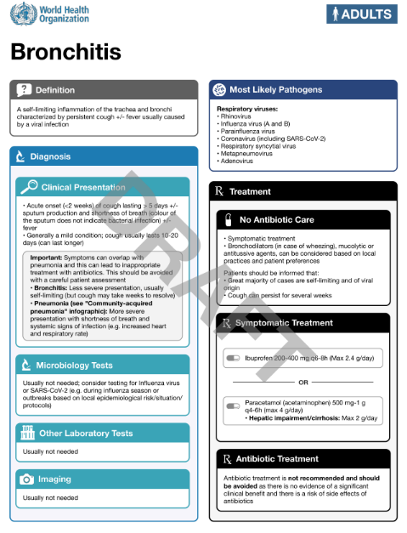
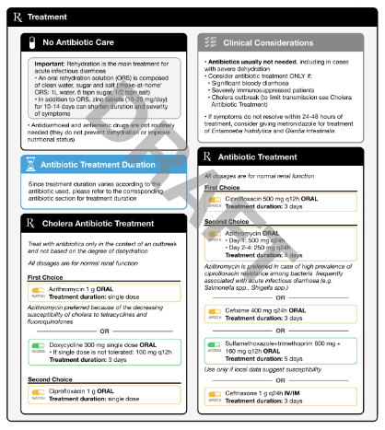
Notes:
We have to focus though on a few clinical presentations in particular where the largest gains can be made in terms of optimizing antibiotic use.

Slide 10
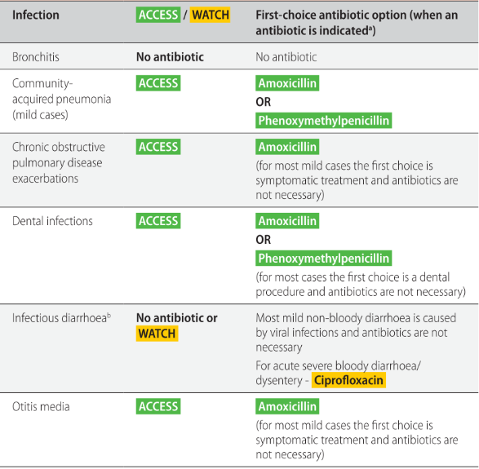
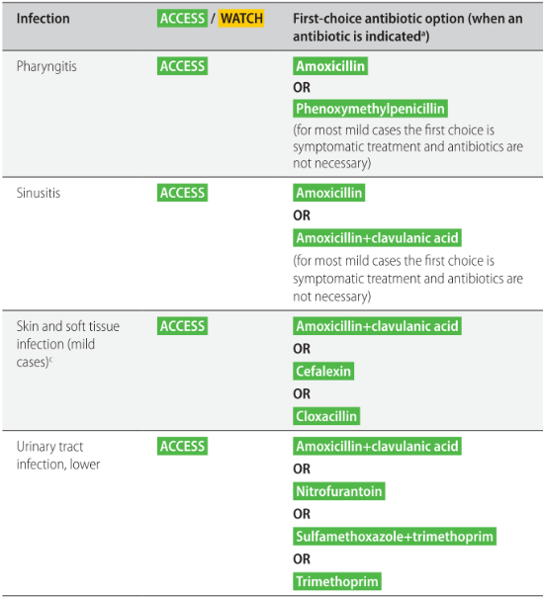
WHO AWaRe Antibiotic Book
Notes:
In training sesssion, and personal dispensing feedback sessions with dispensors, we’ll use the AB book, published December 2022

Slide 11
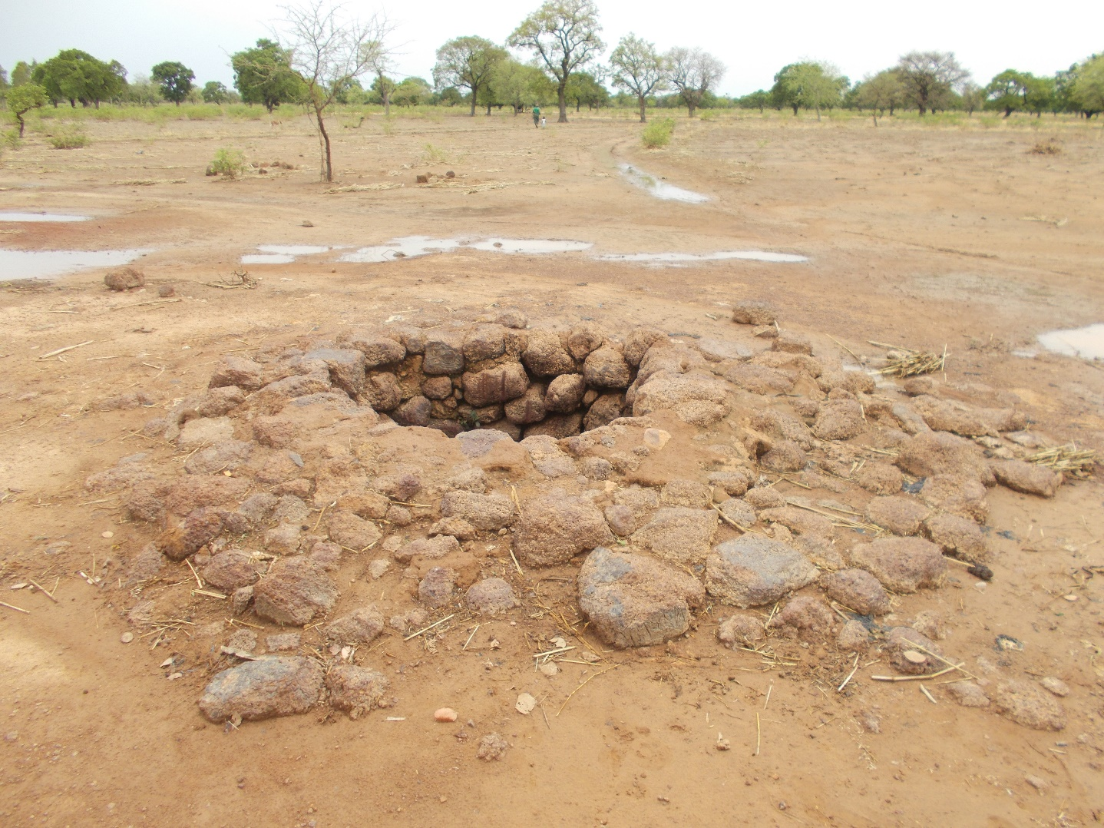
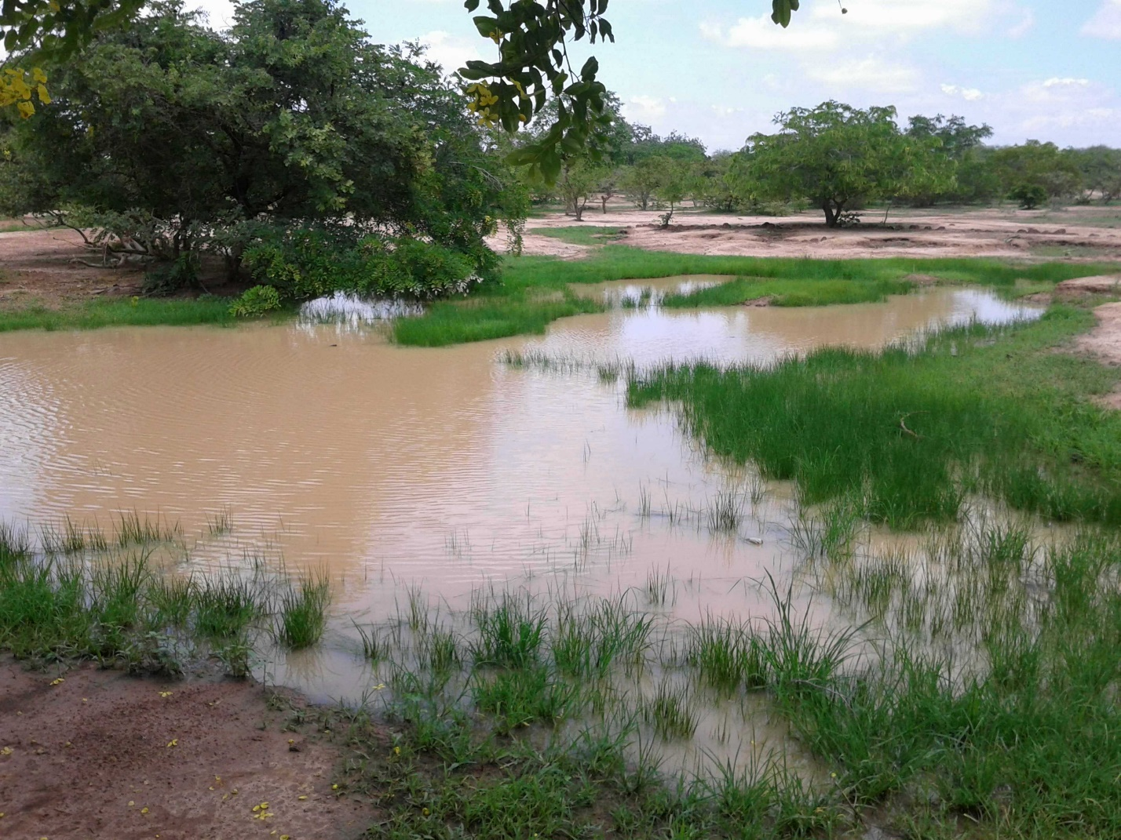
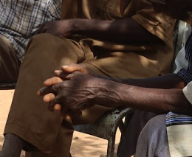
Étendue des bactéries résistantes (ESBL-EC OU ESBL-KP) chez des individus sains dans la communauté
Association of faecal colonisation with:
Lowest Socioeconomic status 71.1% ( vs the highest 61.0%)
Hand-washing without soap (62.5%) vs using soap before meals ( 49.0%)
Rainy season (70.2%) vs dry season (53.6%)
21.3%
Prevalence of
ESBL-colonisation 61.3% (ESBL-EC or KP)
75.1%
No association of faecal colonisation with:
Drinking water sources: Tap water + borehole, protected well, unprotected well
Sanitation use: open air defecation, unimproved latrines, improved latrines
90.8%

Slide 12
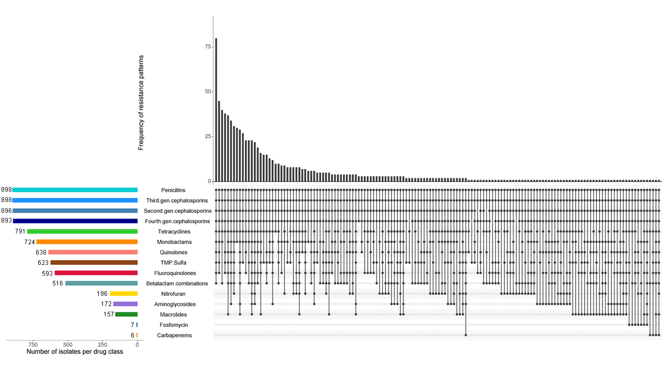
Étendue des bactéries résistantes (ESBL-EC OU ESBL-KP) chez des individus sains dans la communauté
Antibiotic susceptibility testing results for ESBL-E. coli
E.coli is the most frequent agent of UTI
High level of multi-resistance
Co-resistence to fluoroquinolones-cotrimoxazole-nitrofuran
No oral options for UTI treatment !!
Emergence of carbapenem resistance in rural community

Slide 13
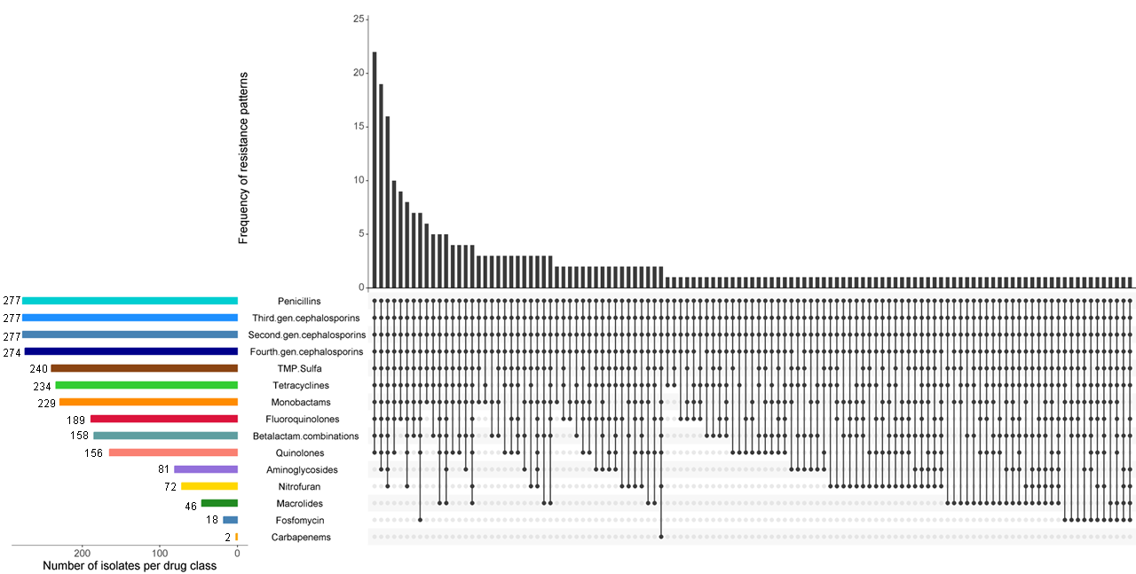
Étendue des bactéries résistantes (ESBL-EC OU ESBL-KP) chez des individus sains dans la communauté
Antibiotic susceptibility testing results for ESBL- K.pneumoniae
K. pneumoniae Very important agent involved UTI
High level of multi-resistance
Co-resistence to fluoroquinolones-cotrimoxazole-nitrofuran
No oral options for UTI treatment !!

Slide 14


Rôle des différents prestataires de soins de santé et autres pourvoyeurs d’antibiotiques dans la communauté
Places of care seeking
Healthcare facilities 66.5%
Outside healthcare facilities: 33.5%
Reasons for seeking healthcare outside healthcare facilities:
Financial limitations
Difficult geographical access
HC centers: long waiting time, the unprofessional attitude of healthcare workers toward patients

Slide 15


Rôle des différents prestataires de soins de santé et autres pourvoyeurs d’antibiotiques dans la communauté
Knowledge of antibiotics:
Community: Perceived as similar to painkillers
Informal vendors: vague knowledge based on pictures on the packaging and cannot tell whether medicines are antibiotics or not
Formal pharmacy vendors: antibiotics can be used to kill microbes and treat infection diseases
Healthcare professionals: answer including antibiotics ability to fight against bacterial infections

Slide 16
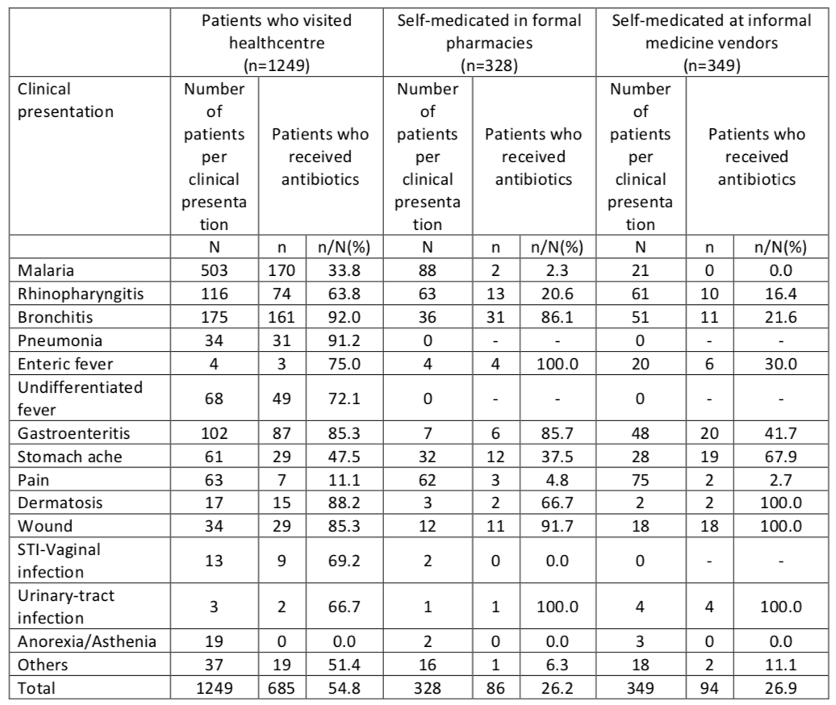
Pratiques de dispensation d’antibiotiques selon le type de pourvoyeur de soins

Slide 17
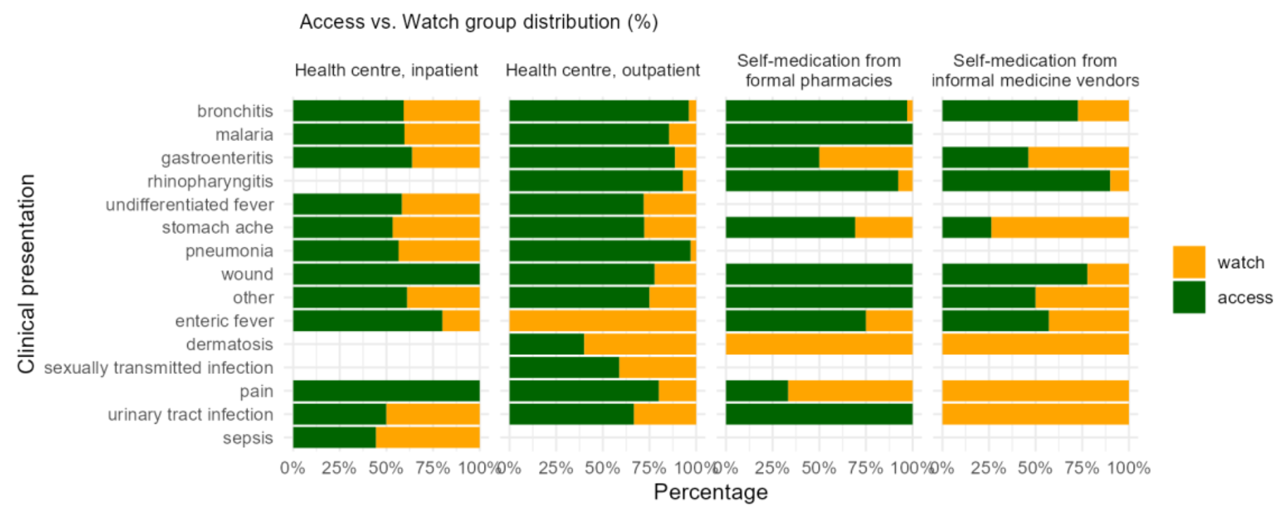
Pratiques de dispensation d’antibiotiques selon le type de pourvoyeur de soins
Compliance with WHO AWaRe guidance could have averted at least 68.4% of all Watch antibiotic use in outpatients at health centres

Slide 18
Summary of findings
The high prevalence of fecal colonization with ESBL-E.coli or ESBL-Klebsiella is a significant reservoir of resistant bacteria in the community.
Could fueling the increase of community-onset invasive infections with R- bacteria
R- bacteria showing MDR pattern, reducing treatment options
Incorrect antibiotic use and poor WASH conditions likely contributed to the emergence and spread of R- bacteria, as suggested by links with hygiene and seasonal variation.

Slide 19
Implications for AMS
Interventions targeting:
Healthcare workers in PHC facilities: multifaceted interventions including
dedicated education and awareness on AMR
improve diagnostic tools to differentiate bacterial from non- bacterial infections in PHCs
include in PHCs, patients’ management algorithm based on the latest WHO recommendations for antibiotic prescription (AWaRe Book)
National Pharmaceutical Regulation Agency of Burkina Faso
Formal pharmacy vendors
promote regular AMR awareness activities including dispensing Watch antibiotics following medical prescription only
Informal medicine vendors
promote regular AMR awareness activities
stress the harm of the misuse of Watch antibiotics
Community
health literacy: awareness of risk behaviours leading to emergence and spread of resistant microorganisms in their community

Slide 20
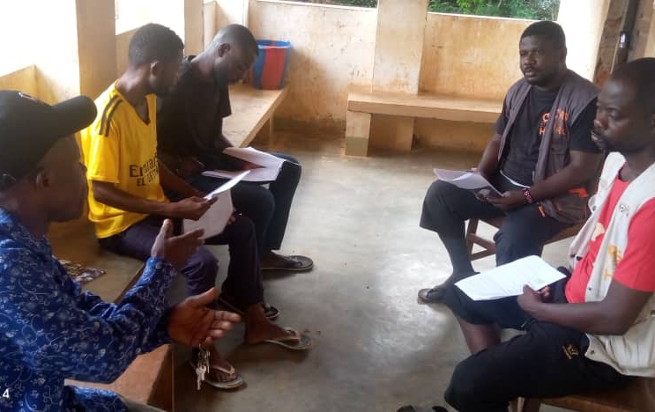
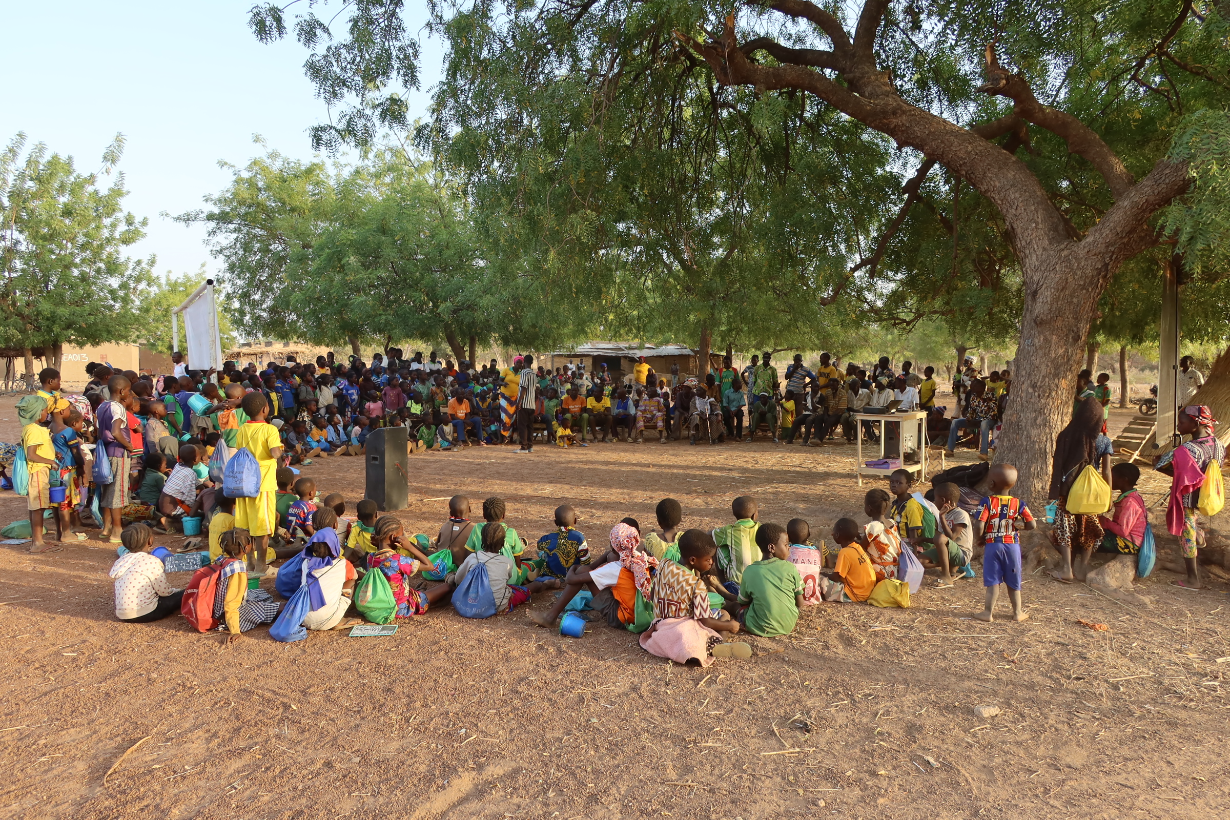
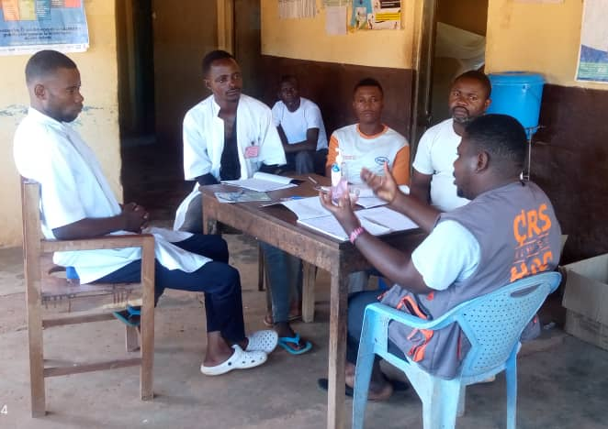
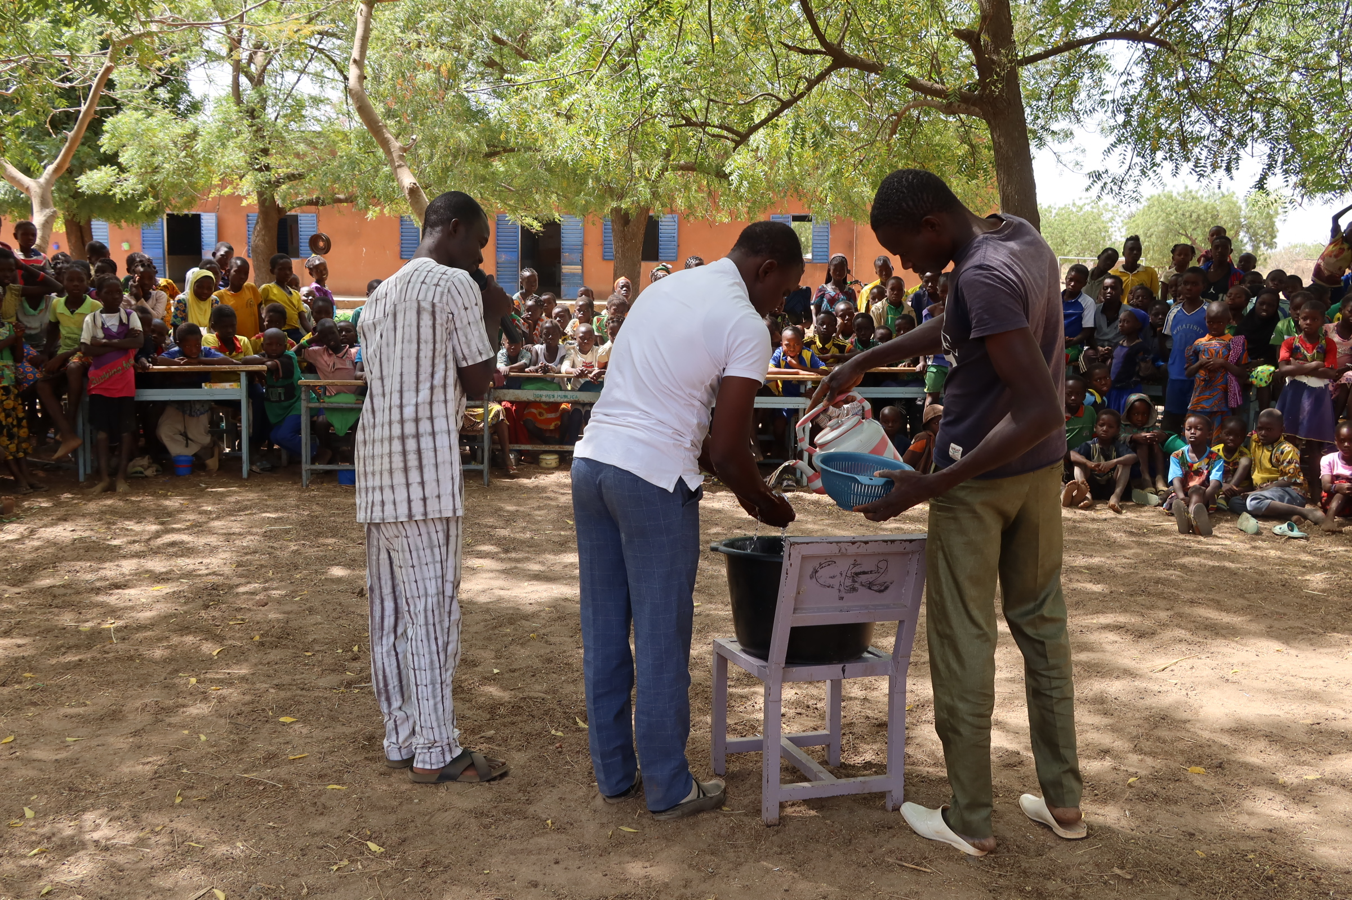
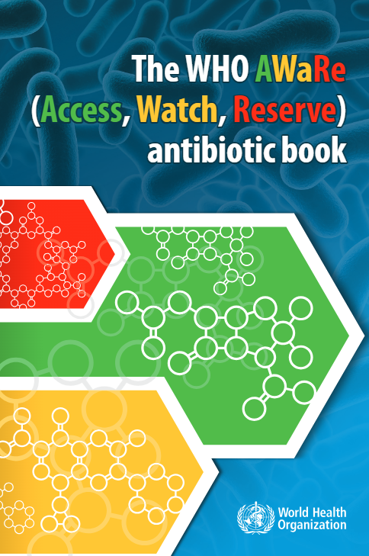
AMS intervention
Formal and informal dispensers
General community
Development of an intervention bundle improving antibiotic use, WASH and health literacy
Targeting both dispensers (supply) and general community (demand)

Slide 21
AMS intervention
22 village/neighborhood clusters per site randomly assigned to intervention or control arms
Three rounds of intervention activities during one year, each round for 4 days per cluster
Before and after interventions (one year later):
1. patient exit surveys to record (Watch) antibiotic use during primary healthcare/pharmacy/informal medicine vendor visits → prevalence of antibiotic use
2. household surveys to record healthcare utilisation and water/sanitation/ hygiene practices → rate of healthcare seeking, prevalence of WASH practices
3. simulated patient visits assessing correct patient management using validated checklists
Estimate and model the effect of the intervention bundle on AMR transmission focusing on ESBL-E.coli

Slide 22
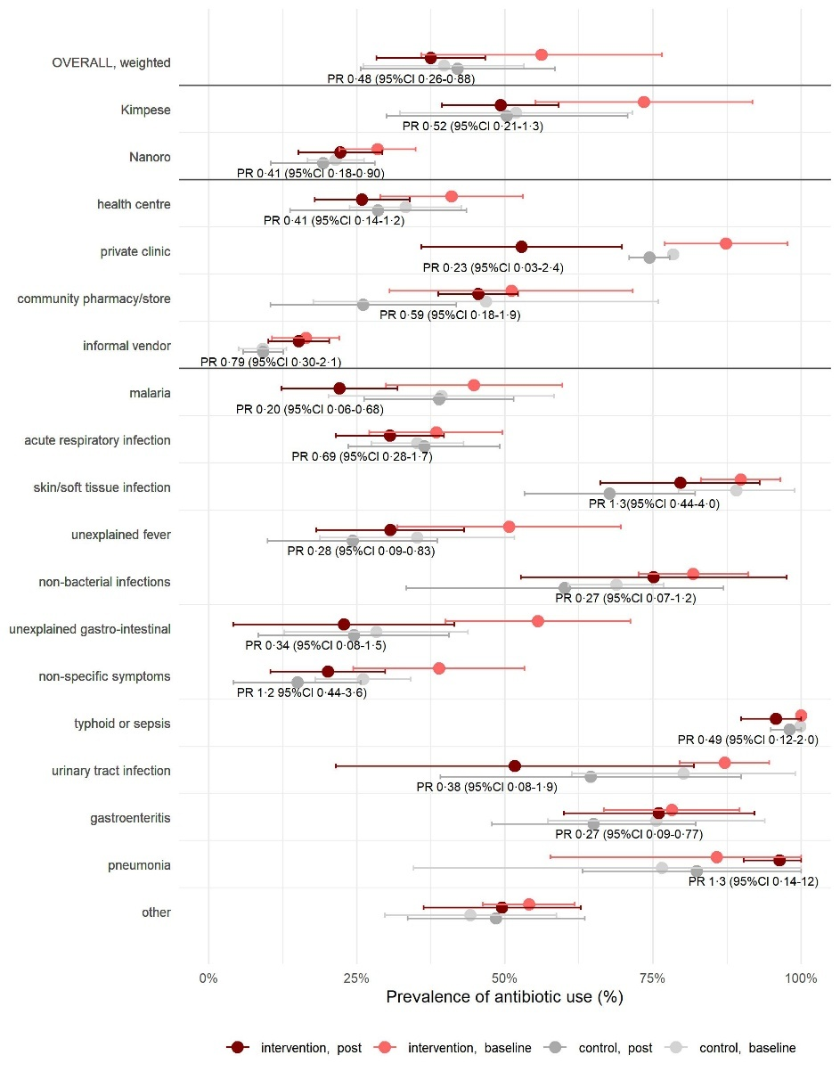
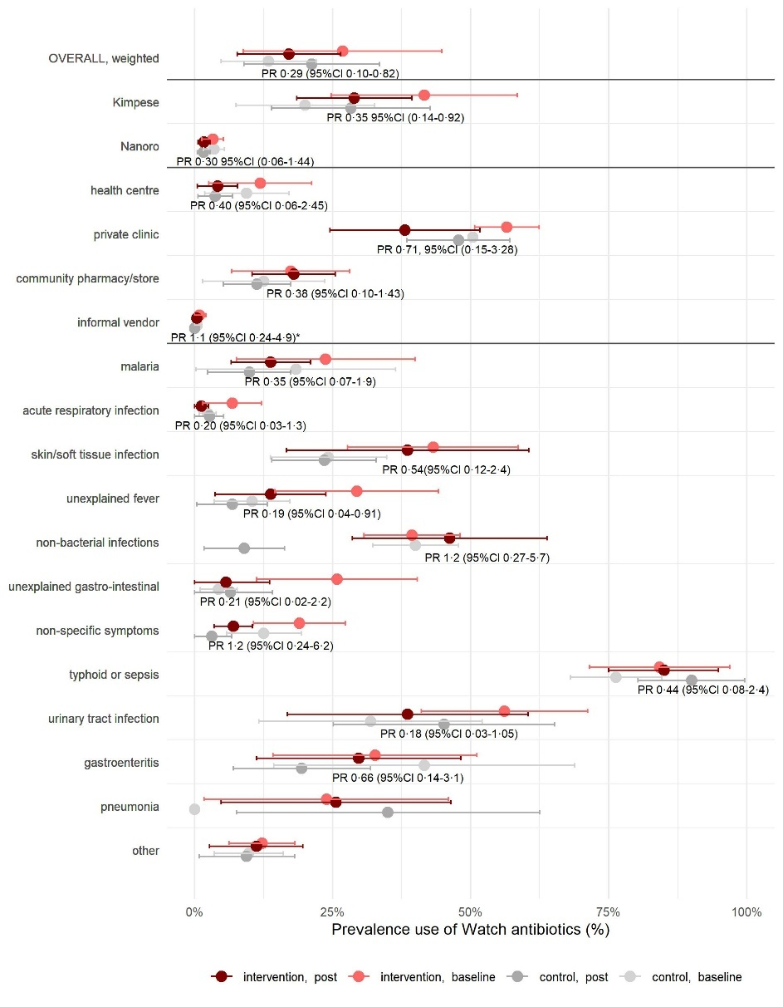
Interventions effect on the prevalence of Watch antibiotic use
Réduction de l’usage d’antibiotiques Watch par 70% (prevalence ratio 0·29, 95%CI 0·10-0·82)
RDC (Kimpese) : de 42 à 29% des patients
BF (Nanoro) : de 3·3 à 1·7% des patients

Slide 23
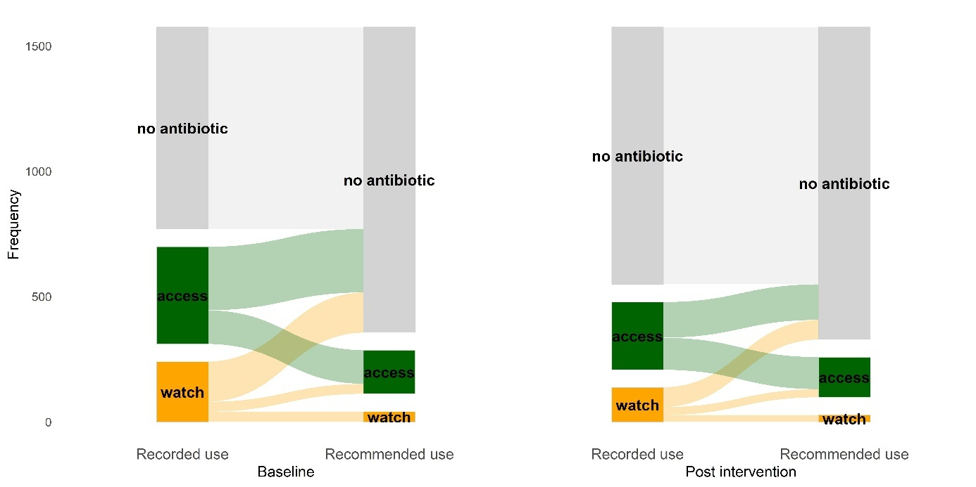
Intervention effect on the appropriate treatment choice
En suivant les recommandations AWaRe, 66% des prescriptions antibiotiques à l’inclusion et 54 % après l’intervention auraient pu être évitées.
Les antibiotiques Watch représentaient 38% des prescriptions à l’inclusion, dont 83% pouvaient être remplacées par des antibiotiques Access ou par “Pas d’usage d’antibitique”

Slide 24
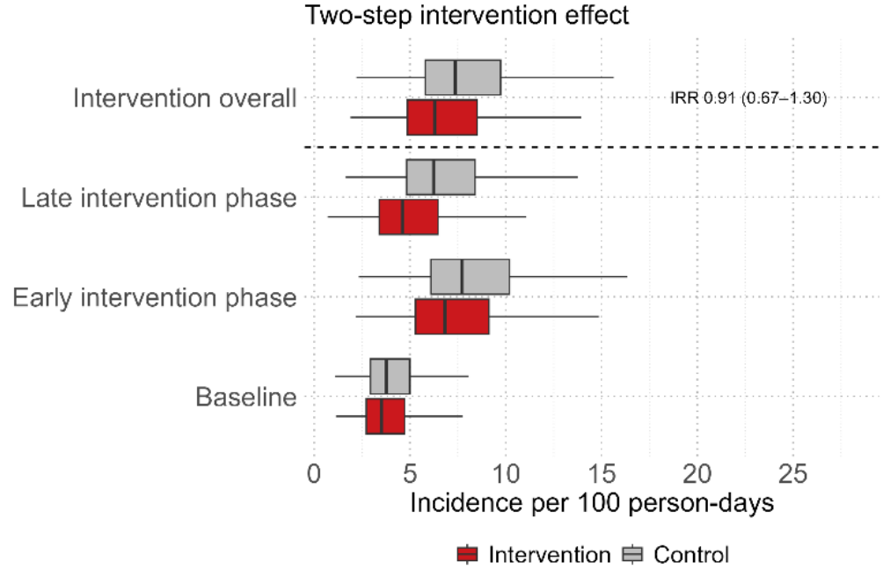
Interventions effect on AMR transmission
Baseline ESBL-E. coli colonization: 47.2% to 56.6%
Baseline incidence ~1.1 acquisitions per household member per month
Months 1–6: hazard ratio [HR] 1·02, 95% CrI 0·78–1·31 -> the intervention did not change the risk of ESBL-E acquisition
Months 6–9: HR 0·82, 95% CrI 0·56–1·14 -> indicative of a modest reduction in incidence
Acquisition higher in the rainy season: peak HR 1·73 (95% CI 1·49–2·00)
Improved sanitation associated with lower risk: HR 0·77 (95% CI 0·59–1·00)

