Slide 1
MSF AND AMR:
A STRATEGIC APPROACH
Dr Rupa Kanapathipillai
Antimicrobial Stewardship Lead
Médecins Sans Frontières
Dr Anna Farra
Antimicrobial resistance MSF platform coordinator
Médecins Sans Frontières

Slide 2
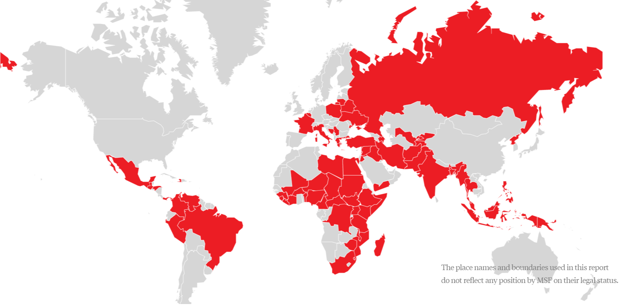

MEDICAL ACTIVITIES IN OVER 70 COUNTRIES
Notes:
In 2023: 35% armed conflict; 26% internal instability; 36% stable contexts, 2 % post conflict

Slide 3
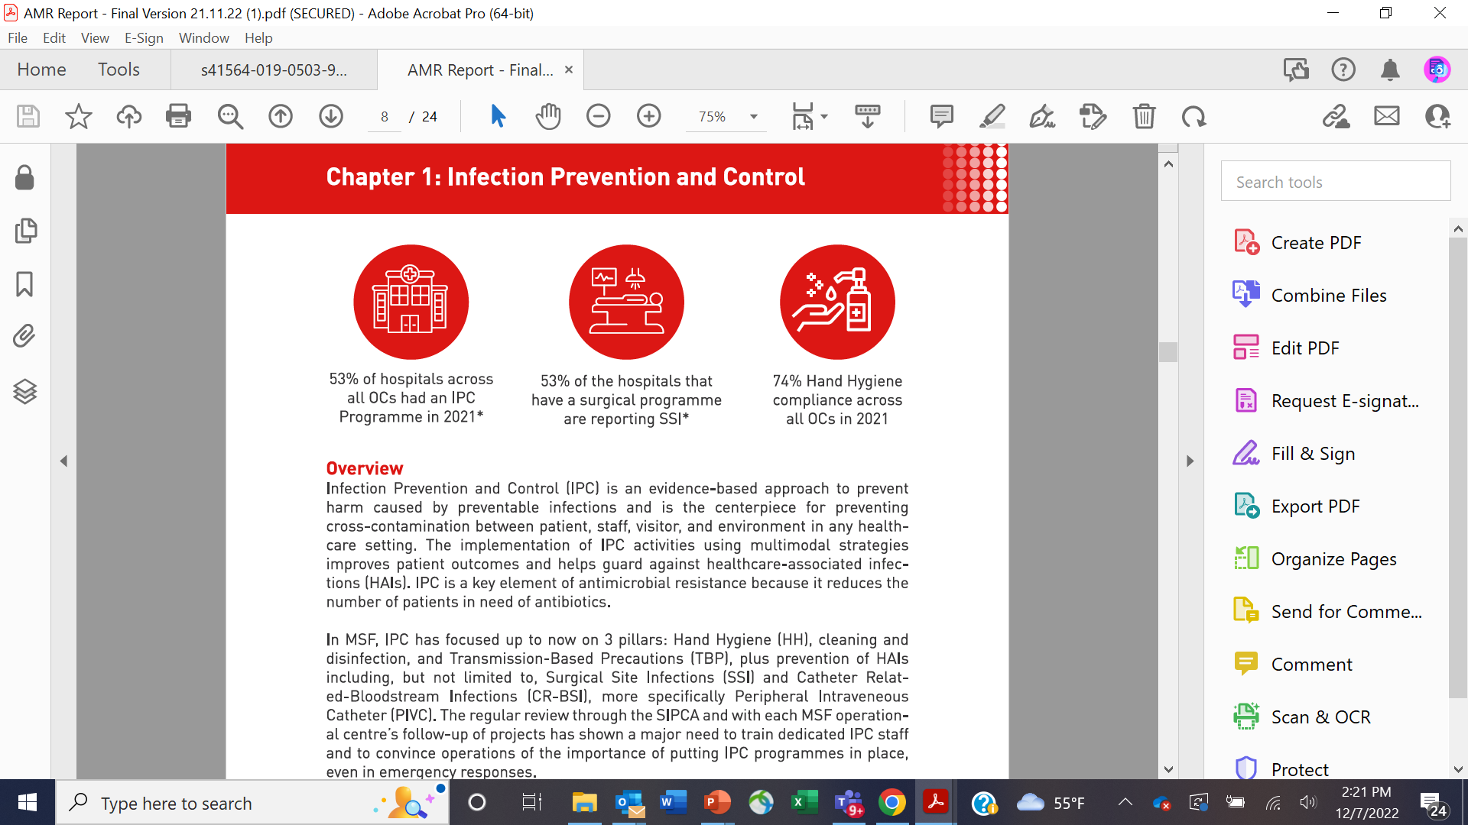
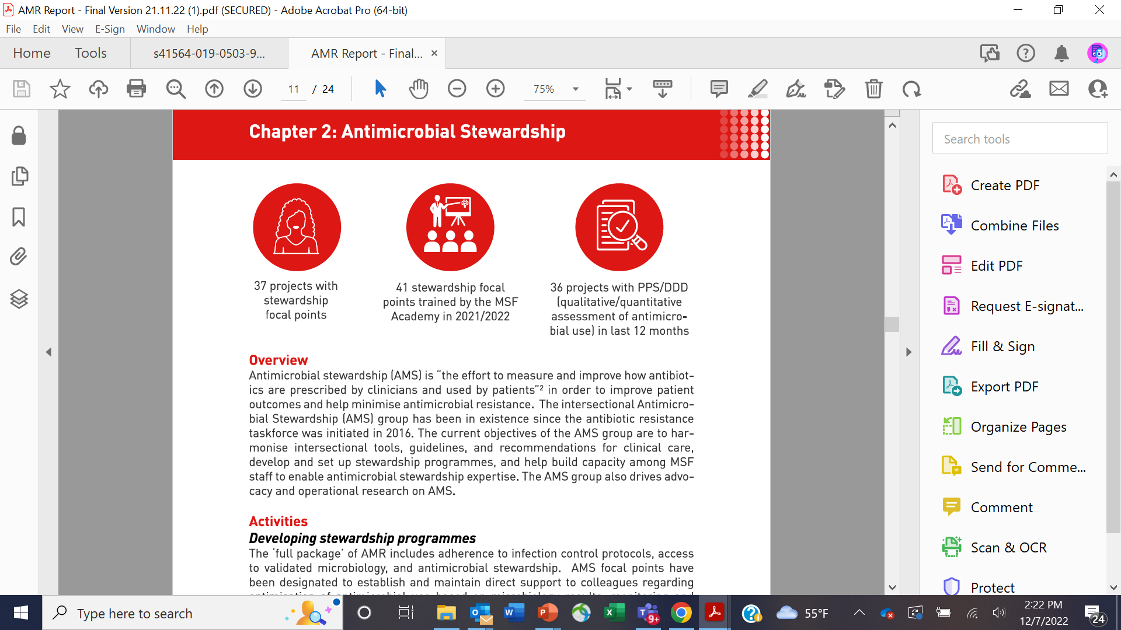
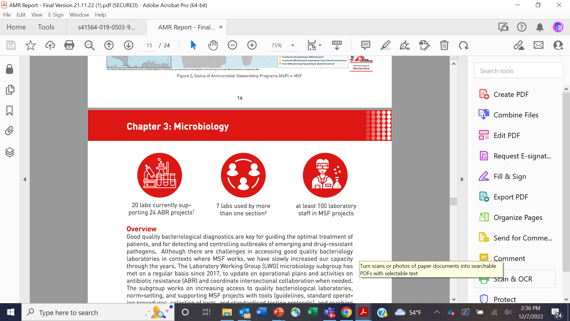
AMR ACTIVITIES IN MSF

Slide 4
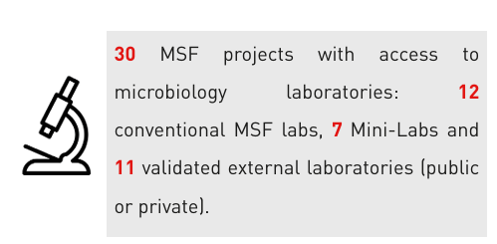
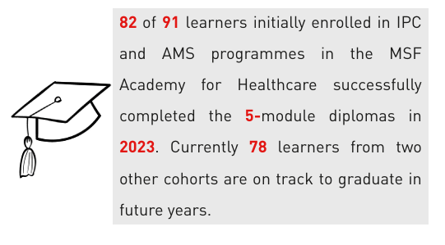
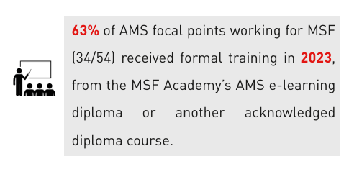

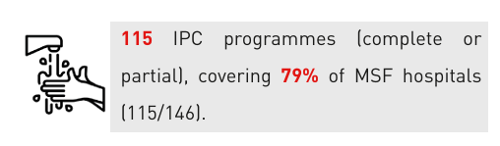
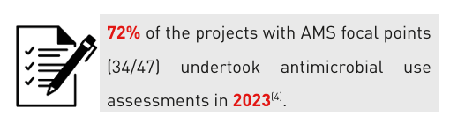
AMR ACTIVITIES IN MSF in 2023

Slide 5
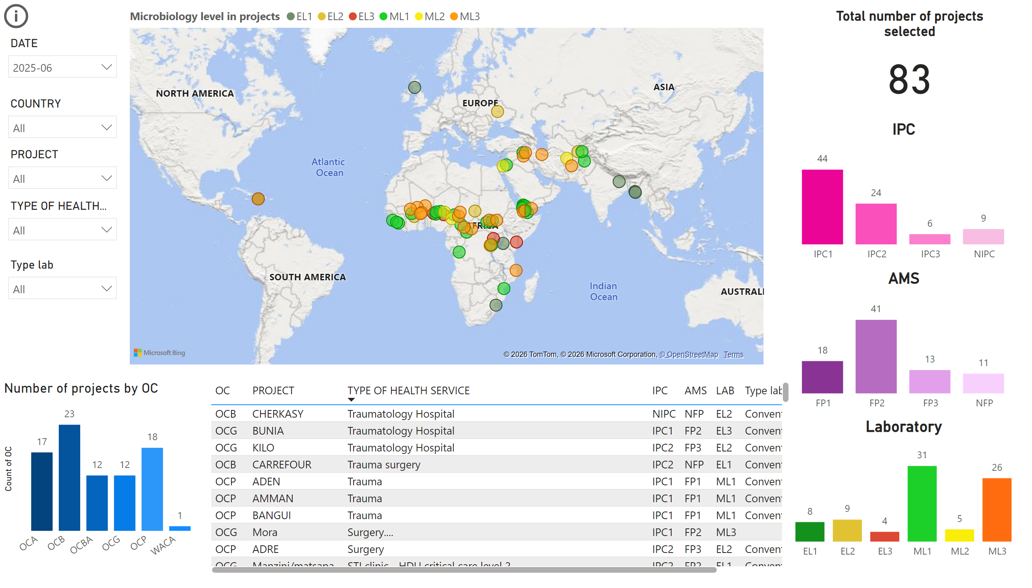
Dashboard
Notes:
map
No alt text provided
IPC
No alt text provided
AMS
No alt text provided
Laboratory
No alt text provided
DATE
No alt text provided
tableEx
No alt text provided
Number of projects by OC
No alt text provided
slicer
No alt text provided
slicer
No alt text provided
slicer
No alt text provided
Total number of projects selected
No alt text provided
slicer
No alt text provided
actionButton
No alt text provided

Slide 6
HOW DID WE GET HERE?

Slide 7
AMR PACKAGES
Microbiology
FULL PACKAGE
Note: Microbiology cannot be implemented without strong IPC & AMS in place
Includes all components
Antibiotic Stewardship (AMS)
BASIC PACKAGE
All projects should include Antimicrobial Stewardship and IPC components
Infection, Prevention, & Control (IPC)

Slide 8
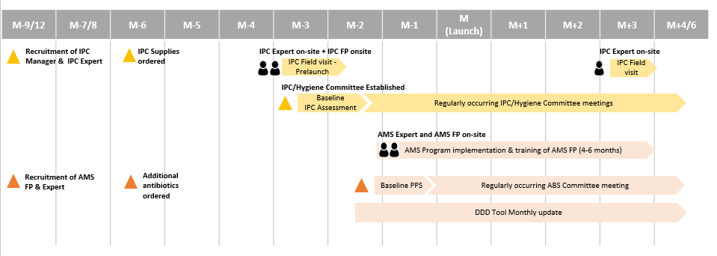
IMPLEMENTATION OF FULL PACKAGE

Slide 9
Model of care MSF
AMS pillar
AMS referent
ID “flying”
Intersectional platform
Headquarters
Project level
MAM/PMC
Hospital level
AMS FP

Slide 10
AMR TOOLS DEVELOPED BY MSF
Knowledge and Capacity Building
Monitoring and Evaluation

Slide 11
Infection Prevention and Control
Microbiology & Surveillance
Antimicrobial Stewardship
Learning and Development
Analysis & Advocacy
Operational Research
IEC/Awareness

Slide 12
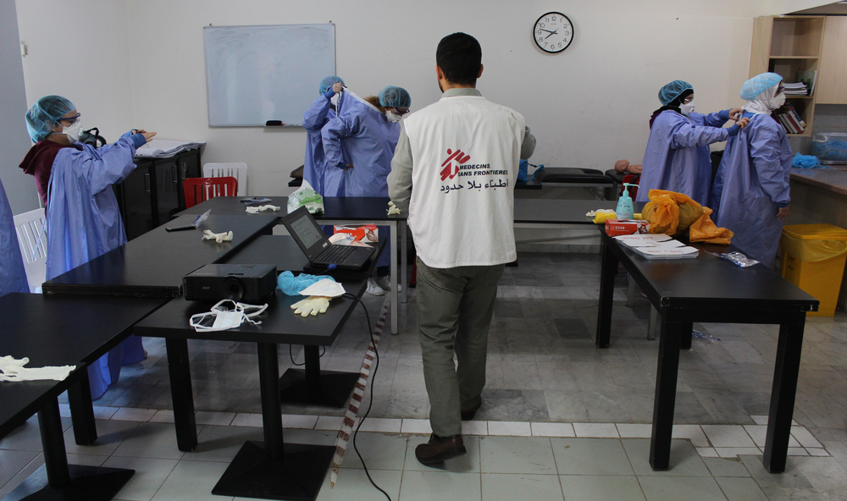
INFECTION PREVENTION AND CONTROL

Slide 13

IPC
“MSF’s approach to IPC is grounded in the WHO Global Strategy on IPC (2023–2030), which emphasises the need for IPC to be institutionalised, implemented through evidence-based strategies, integrated into broader health priorities, and continuously strengthened through monitoring, feedback and action, and innovation and research.”

Slide 14
MULTIMODAL IMPLEMENTATION STRATEGY
System Change: Ensuring the availability of infrastructure (including WaSH), supplies, and organisational arrangements necessary to support good IPC practices. This includes the design of suitable facilities, adequate ventilation, safe patient-to-staff ratios, and essential IPC materials and equipment.
Education and Training: Providing regular IPC training tailored to the roles and local context of all healthcare workers. Sensitisation initiatives aim to enhance understanding of HAIs, improve compliance with IPC measures, and foster sustainable behaviour change.
Monitoring, Surveillance, and Feedback: Establishing robust systems to track IPC implementation using structural, process, and outcome indicators. Surveillance systems should measure infection rates, and regular feedback should be shared with healthcare workers and leadership through IPC committees.
Reminders and Communication Tools: Utilizing visual cues and workplace reminders (e.g., posters, checklists) to reinforce best practices and maintain IPC visibility across healthcare facilities.
Promoting a Safety Culture: Strong leadership and staff engagement are critical. IPC role models and informal leaders within clinical areas are encouraged to drive local ownership and commitment to IPC goals.

Slide 15
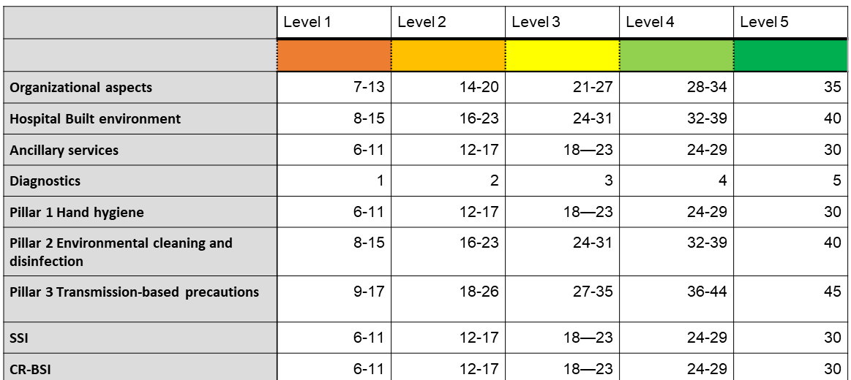
INNOVATIONS IN IPC:
STEPWISE IPC IMPROVEMENT APPROACH

Slide 16
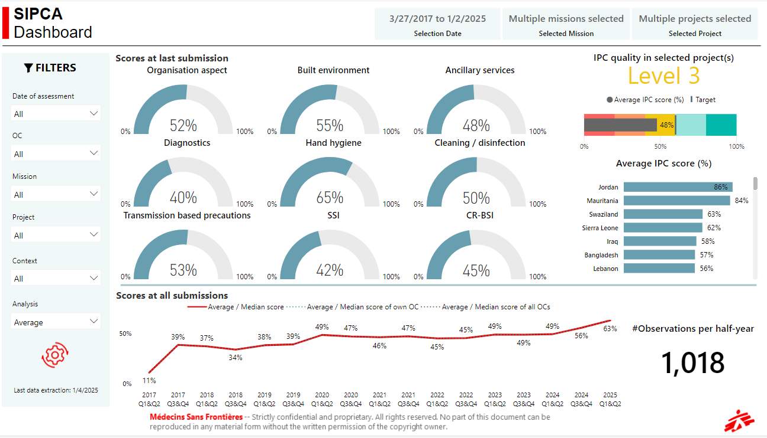

Slide 17
IPCAF
(IPC assessment framework)
Purpose: WHO tool for self-assessing IPC programs in health facilities
Structure: 8 core components, 80 indicators
    IPC Program
    Guidelines
    Education & Training
    HAI Surveillance
    Multimodal Strategies
    Monitoring & Feedback
    Staffing & Occupancy
    Built Environment & Materials
Scoring: 0–800 → Levels: Inadequate, Basic, Intermediate, Advanced
Benefits: Identifies gaps, guides action plans, tracks progress

Slide 18
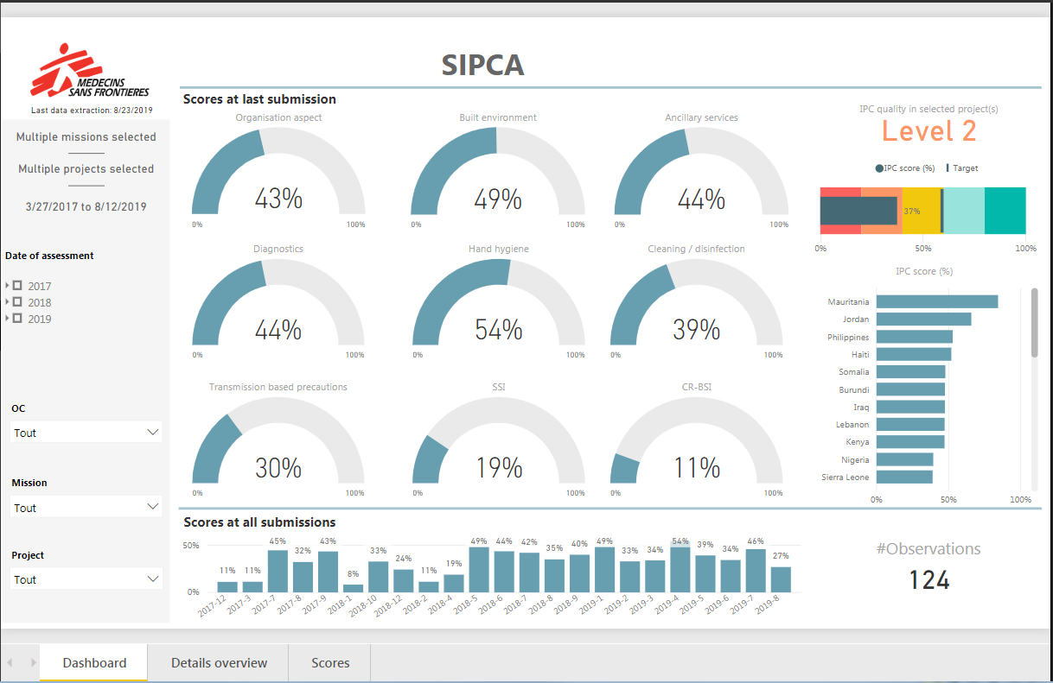

Slide 19
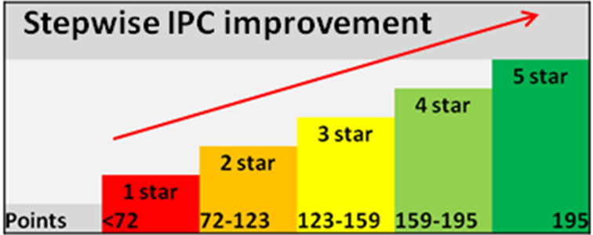
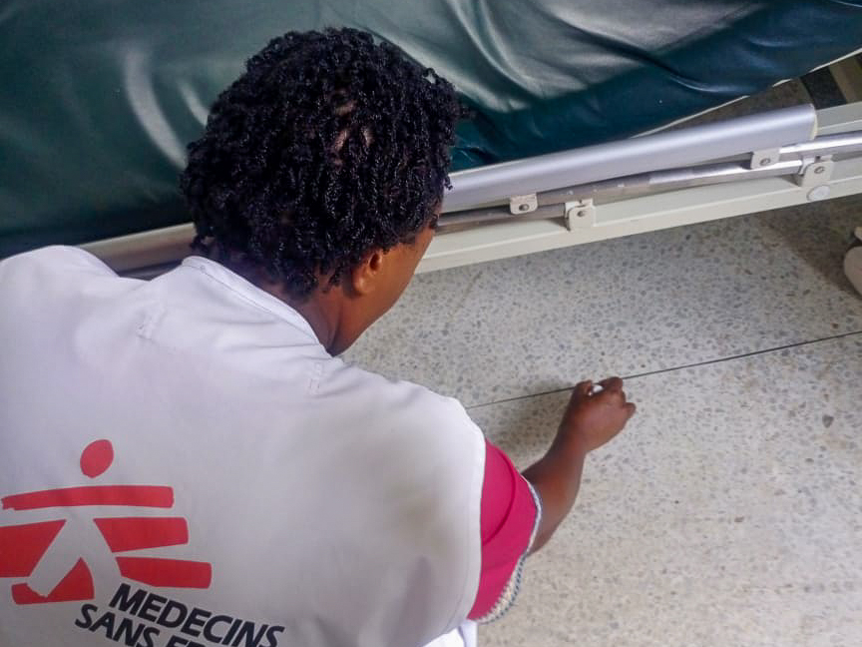
SIPCA
Local context
Annual assessment

Slide 20
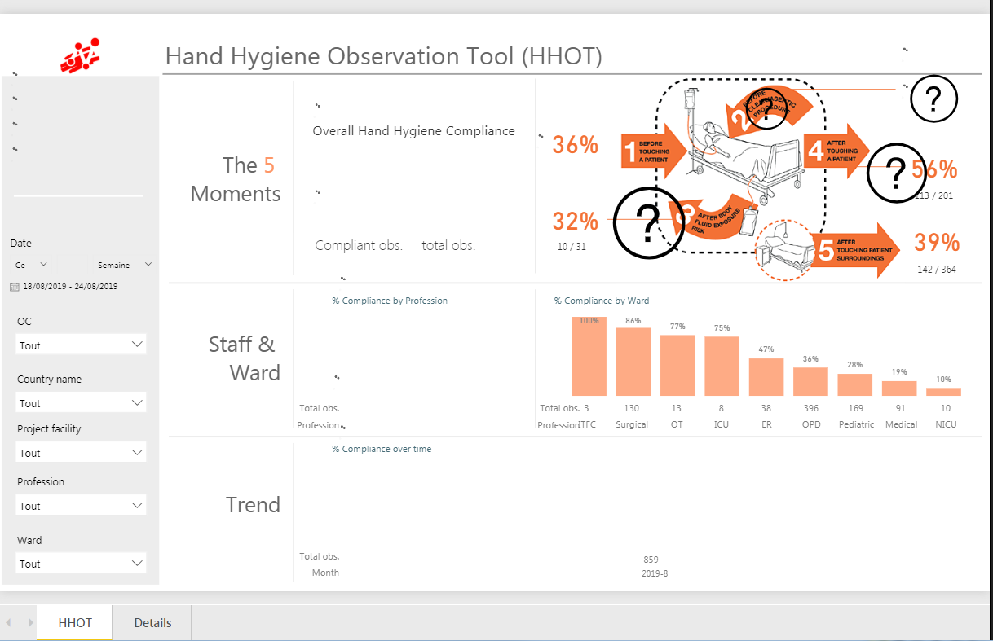

Slide 21
Knowledge + Capacity Building | Monitoring and Evaluation
MSF IPC Policy and Strategic Framework | - Stepwise IPC improvement Approach (SIPCA)
IPC/Hygiene guideline | - Hand Hygiene Observation tool
MDRO Outbreak management guide | Monthly audits + report: hospital hygiene/sterilization
 | Surgical Site infection surveillance form+CR-BSI surveillance form
MSF
IPC TOOLS

Slide 22

ANTIMICROBIAL STEWARDSHIP

Slide 23
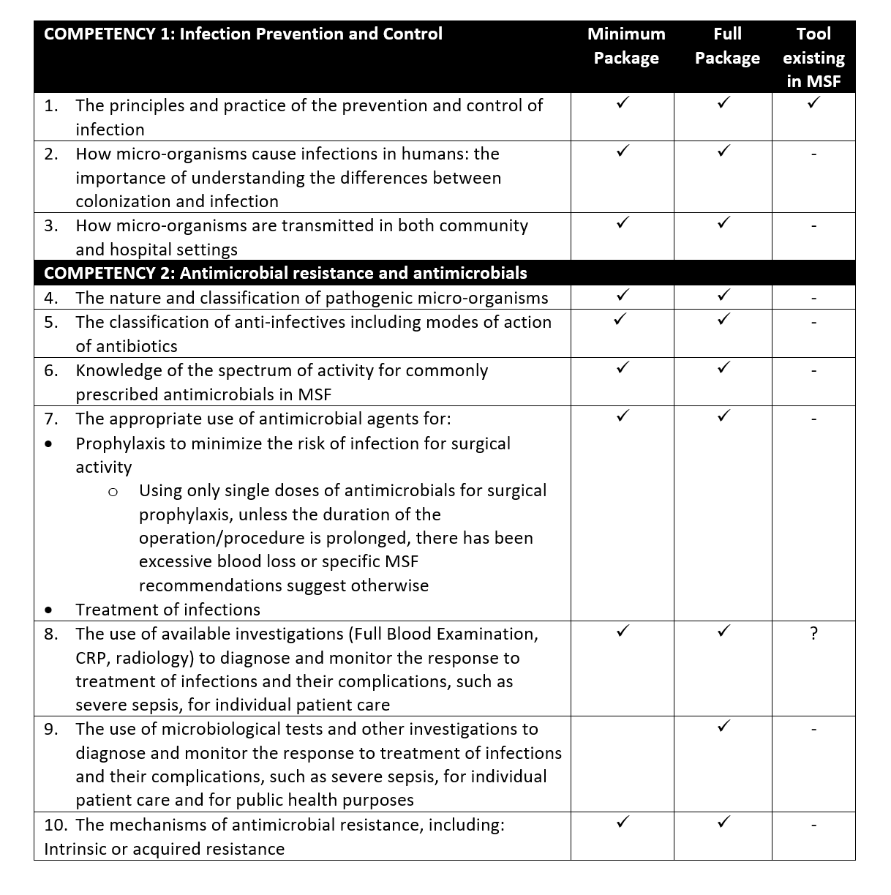
ANTIBIOTIC STEWARDSHIP IN MSF
Led by non-specialized doctors
Trained by e-learning (MSF academy course) + infectious diseases physicians
Tools developed to standardize implementation
  Context-adapted guidelines given heterogeneity of AMR
  Surveillance systems to facilitate local cumulative antibiograms
Minimum implementation time 6 months

Slide 24

ANTIBIOTIC STEWARD/FOCAL POINT
Leads Stewardship Committee
Bug-drug match
Dosing
IV → PO switch
Adverse events: drug interactions, allergies, C. difficile infection
Reserve antibiotics: AMR referent validation non-acute cases
  Eg. Linezolid, colistin, tigecycline
Acute severe cases: commencement as per MSF MDR protocols + AMR referent

Slide 25
ANTIBIOTIC STEWARDSHIP COMMITTEE
v
Pharmacist
Infection Prevention & Control (IPC) Officer/Manager
Health promoter
Antibiotic Steward
(MD or pharmacist)
Project Medical Referent/Advisor(PMR)
Microbiologist/lab technician
Nurse manager

Slide 26
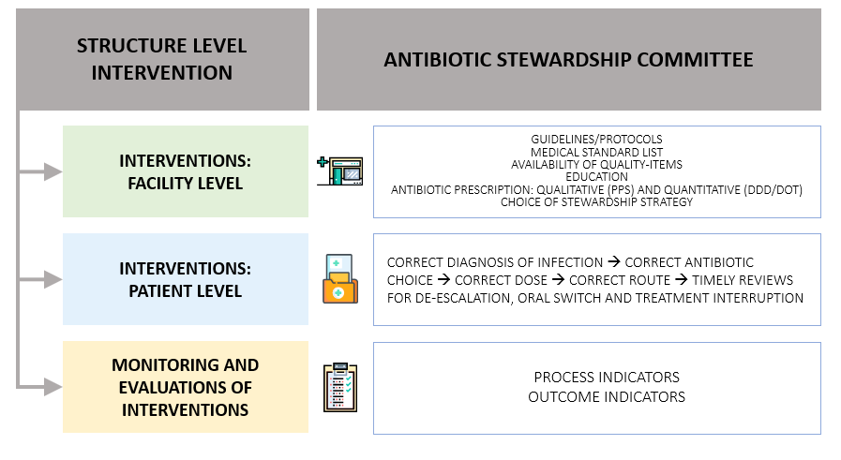
Notes:
Committees coordinate activities that occur at the patient level (affecting direct care and treatment) as well as at the health facility level (creating a culture of responsible antibiotic use through structural changes).
Overall Function
Oversee development, implementation + ongoing review AMS program
Employ systematic approach optimizing antibiotic use
Response to MDR infections & hospital acquired MDR outbreaks
Deal with conflicts: formulary restrictions and/or performance measures
Responsibilities and Activities
Baseline assessment: appropriate antibiotic prescription practices and consumption
Develop stewardship action plan from baseline assessment
Specific strategies to improve antimicrobial prescribing in project
Regular meetings to follow implementation of action plan
Monitor and evaluate stewardship program with feedback

Slide 27
SHORT TERM APPROACH: RESTRICTIVE
Step Two
Switch to a persuasive method
Step One
Start with a restrictive method
Antibiotic prescription within MSF guidelines/MSF protocols: service prescribers
Prescription beyond MSF guidelines/protocols: for validation by PMR/AMS focal point
Empiric treatment for difficult cases: for discussion between PMR/AMS focal point and AMR advisor
Targeted treatment for MDR bacteria: for discussion between PMR/AMS focal point and AMR advisor

Slide 28
LONG TERM APPROACH: SEMI-PERSUASIVE
Step Two
Switch to a persuasive method
Step One
Start with a restrictive method
Antibiotic prescription by service prescribers (e.g.. surgeons, GPs, internists, pediatricians)
Antimicrobial Stewardship focal point:
  Reviews prescriptions daily, discusses treatment choices with medical team, adjusts when necessary
  Works in team with AMS committee

Slide 29

ANTIBIOTIC RESTRICTIONS
Reserve Group
Watch Group
Access Group

Slide 30
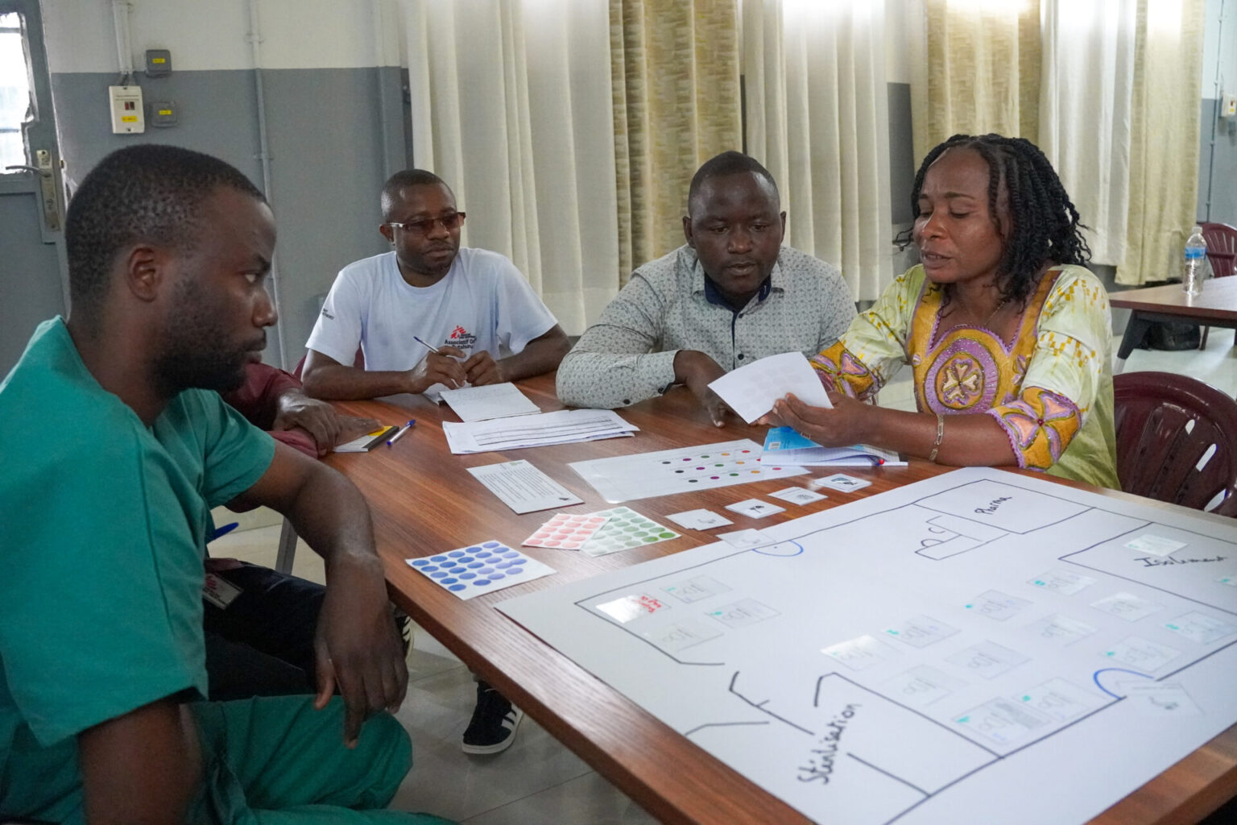

Knowledge + Capacity Building | Microbiological testing: -Blood Cultures -Bone/Tissue Sampling | ↑ use of microbiology results -Lab: Antibiogo Clinicians: Case discussion with referents Field-based coaching Dawaa game Telemedicine
 | Tools for antimicrobial prescription: -MSF Pathogen Specific Treatment Guide -MSF Surgical Prophylaxis Guide | Improve use of microbiology results: -Lab: Antibiogo Clinicians: Case discussion with referents Field-based coaching Dawaa game Telemedicine
 | Standardized training tool for AMS: -MSF Academy e-learning | Toolkits for AMS implementation -Minimum Package -Full Package
Monitoring & Evaluation | Antimicrobial Prescription Quantitative: DDD tool Qualitative: PPS | Project-level AMS activity: -Chart review Template -Monthly report template
MSF
AMS TOOLS

Slide 31
Epicentre/Microbiology/AMS
Procedures for local cumulative antimicrobial susceptibility test report from WHO-NET database
HOSPITAL-BASED CUMULATIVE ANTIBIOGRAMS

Slide 32
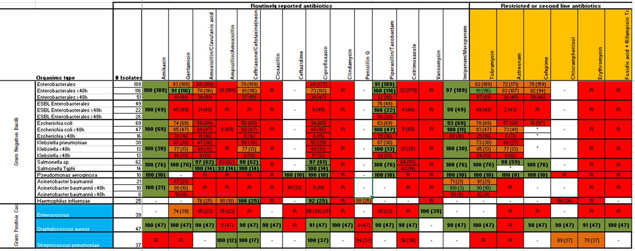
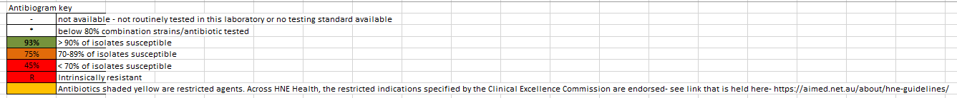

Slide 33
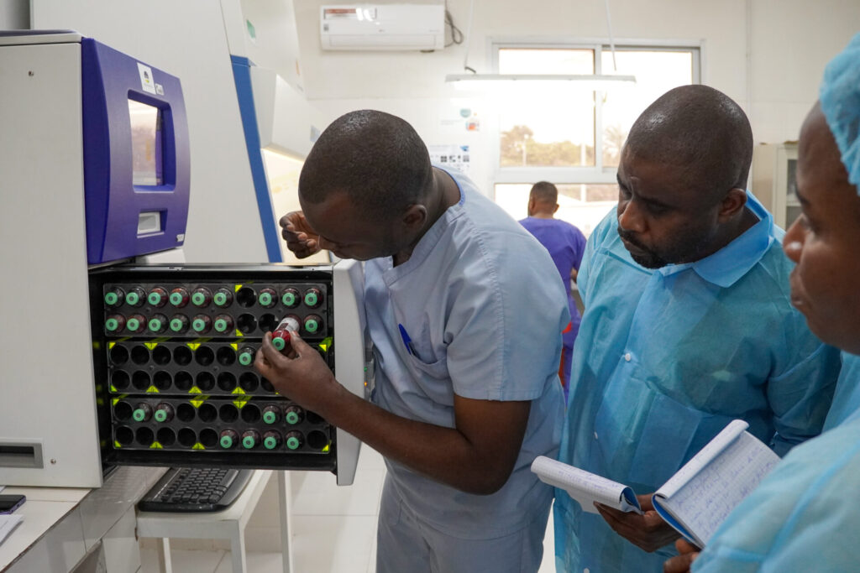
MICROBIOLOGY

Slide 34
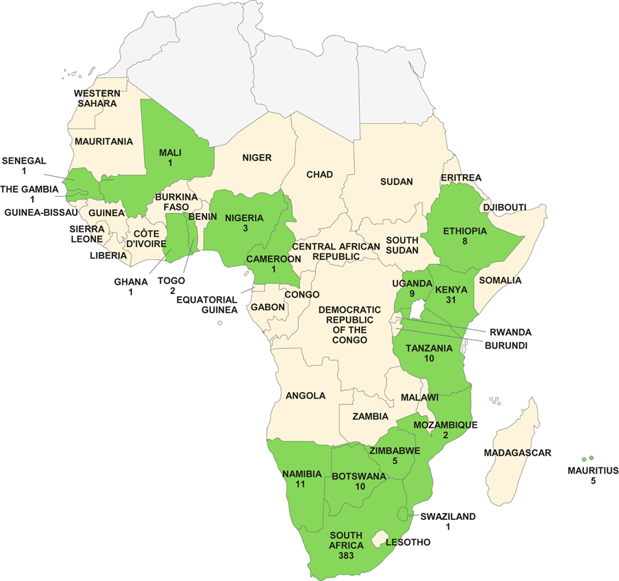
MICROBIOLOGY ACCESS: RELIABILITY
Clinical Microbiology and Infection 2017 23, 426-433
Notes:
Map of sub-Saharan Africa showing countries with medical laboratories that have been accredited to internationally recognized standards by April 2017. Numbers below countries' names refer to number of accredited laboratories in that country.

Slide 35
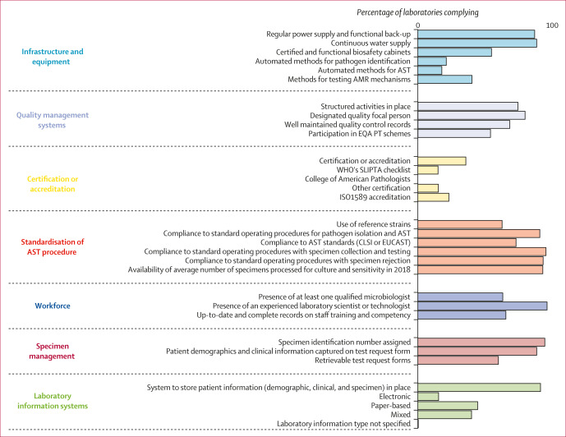
Only 1% of laboratories in the region deliver bacterial testing, of which at least 14% are not capable of conducting AST.
The geographical distribution of these laboratories translated into between 29% (Sierra Leone) and 82% (Kenya) of the total population having access to AST services, with below 50% of the total population having access in seven of the 11 countries.
In total, more than 136 million people across the 11 countries were estimated to be deprived of access to AST services.
Bacteriology testing and antimicrobial resistance detection capacity of national tiered laboratory networks in sub-Saharan Africa: an analysis from 14 countries
Ondoa, Pascale et al.
The Lancet Microbe, Volume 0, Issue 0, 100976
Notes:
In 11 of the 14 countries, more than two-thirds of the laboratories (19 [100%] of 19 in Cameroon, 64 [69%] of 98 in Ghana, 56 [87%] of 64 in Kenya, 27 [77%] of 35 in Tanzania, 22 [71%] of 31 in Senegal, 20 [67%] of 30 in Uganda, 23 [92%] of 25 in Burkina Faso, 22 [96%] of 23 in Zambia and Zimbabwe, seven [100%] of seven in Sierra Leone, and three [100%] of three in Eswatini) invited to participate in the survey returned the questionnaire and served as a reference to estimate the proportion of the total population with access to collective AMR detection services. The geographical distribution of these laboratories translated into between 29% (Sierra Leone) and 82% (Kenya) of the total population having access to AST services, with below 50% of the total population having access in seven of the 11 countries (appendix p 10). In total, more than 136 million people across the 11 countries were estimated to be deprived of access to AST services.

Slide 36
MICROBIOLOGY ACCESS: PRIORITY REGIONS
High rates of resistance based on available data:
WHO GLASS reports
CCDEP (Center for Disease Dynamics Economics and Policy) data
MSF data
Literature review
Middle-East: Iraq, Yemen, Syria, Jordan and Lebanon
Asia: Afghanistan, Pakistan and Bangladesh
Sub-Saharan Africa: CAR, Mali, Sudan, DRC, Sierra Leone, Nigeria

Slide 37
MICROBIOLOGY ACCESS: PRIORITY POPULATIONS
Invasive procedures:
Acute trauma
Elective /reconstructive surgery
Burns
ICU
Immunocompromised:
Neonates
Advanced HIV
Paediatric Malnutrition

Slide 38
MSF APPROACH TO ACCESSING MICROBIOLOGY
Microbiology Labs Assessed
Validated with MSF
Not Validated
Validated
Conventional MSF Lab
MiniLab
Project defines need for microbiology
Notes:
Once a project defines the need for microbiology access, an assessment of existing labs in country should be done; if these labs could not be validated, a decision is then made regarding setting up a conventional MSF lab or a minilab.

Slide 39
Conventional Lab
Trauma/Burn projects
Blood culture, urine, CSF, bone + tissue
No limited capacity
Longer implemention phase
Better trained personnel
Less expensive
MICROBIOLOGY ACCESS:
TYPE OF LABORATORY
MiniLab
Blood culture, urine + CSF
Limited capacity
Easier + faster implementation
Standardized/easier to learn
More expensive
Notes:
Broadly, minilab is an option for projects requiring blood culture samples (eg. Pediatric sepsis), conventional lab is for projects needing blood cultures or bones/tissue analysis for traumatic injuries.

Slide 40
Standardized sampling and transportation procedures
Rejection criteria
Blood culture, Urine, CSF, Pus aspiration, Bone and Tissue biopsies
Standardized SOP from inoculation to Antibiotic Susceptibility Testing (AST)
Quality control procedures using ATCC strains
Manual culture and phenotypic identification with manual biochemical tests
WHAT DOES AN MSF MICROBIOLOGY LAB PROVIDE?

Slide 41
Disc diffusion and MIC E-test (Conventional Lab)
MIC broth dilution (Mini-Lab)
International recommendations: EUCAST/CLSI
MSF Pathogen Specific Treatment Guide list of antibiotics
Interpretation of results using expert rules
Contamination protocols per type of sample
ANTIBIOTIC SUSCEPTIBILITY TESTING

Slide 42
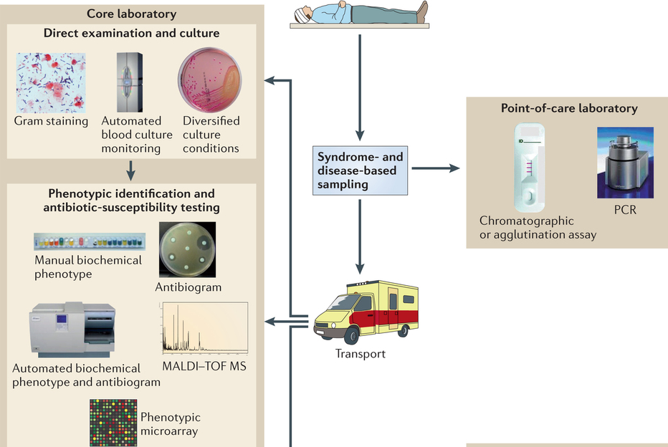
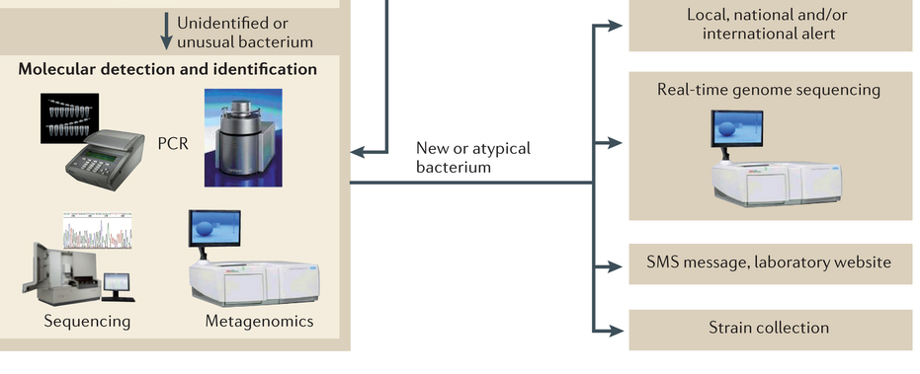
Available at
Reference laboratory
Available at
Reference/research laboratory
Raoult et al. 2013 Nature Reviews Microbiology
Notes:
Manual culture and phenotypic identification with manual biochemical tests remain THE MOST USED METHODS
For automated biochemical phenotype and antibiogram: (ex Vitek) can be available at reference level but most of time shortage of reagents/cartridges
Lack of maintenance
PCR can be also available at reference level but very rarely used for diagnostic of bacterial infection. It’s mainly used for outbreak investigation or for research

Slide 43
Standardized Laboratory Procedures | Monitoring and Evaluation
Laboratory assessment and validation: standardized procedure/questionnaire | Microbiology Data collection: WHONET
Standard MoU and MTA | Monthly Laboratory MDRO reporting for possible outbreaks
MSF Bacteriology Laboratory catalogue | Internal + External Quality control
MSF Manual of Nursing Care Procedures for samples collection
Sample Collection and Transportation
Standard MSF SOP from reception to results
MSF MICROBIOLOGY TOOLS

Slide 44












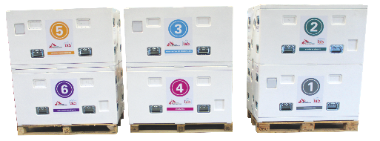


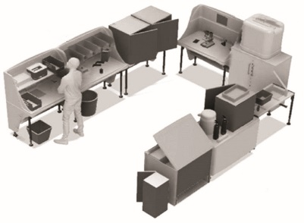
MINI-LAB:
Providing simplified bacteriology laboratory for LRS
Reagents and Consumables
Equipements
Documentation and training
MSF has decided to work on the development of a quality-assured, cost efficient, all-in-one and transportable clinical bacteriology laboratory.
Enabling diagnosis of sepsis, antibiotic susceptibility testing and surveillance of antibiotic resistance
Maximizing ease of use and clinical relevance with harmonized non-expert users, and respond to clinical needs at MSF field sites.
IT and Data management
Laboratory Benchs
Diagnostic and surveillance
Bloodstream infection
Urinary tract infections (integration in progress)
addition: Meningitis

Slide 45


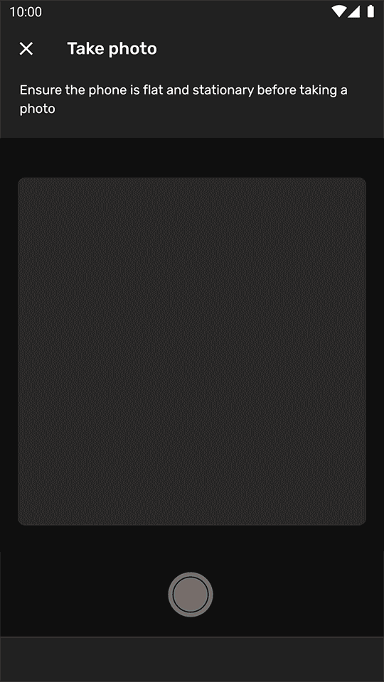
ANTIBIOGO:
Smartphone based app to read and interpret antibiogram tests in LMIC
Picture of the petri dish
Automatic detection of antibiotic discs and inhibition zone using artificial intelligence
Expert System: more than 3000 interpretation rules: disc diffusion+MIC. EUCAST and CLSI
Selective/customized results for clinicians
WHO compendium of innovative health technologies for low-resource settings 2024
Notes:
Antibiogo under clinical evaluation in 3 countries/ CE IVD certification: May 22: FIRST MSF CE MARKED clinical device
In 2022
External and independant clinical evaluation with AMR stakeholders (Merieux Foundation, Pasteur institute networks, MOH Mexico)
Développent of self training and reporting features: training tools for the lab technicians+ automatic analysis of AST data
Implementation in 10 to 15 sites
2023-2024: available for all labs for free
2024: added to WHO compendium of innovative health technologies for Low resource settings 2024

Slide 46
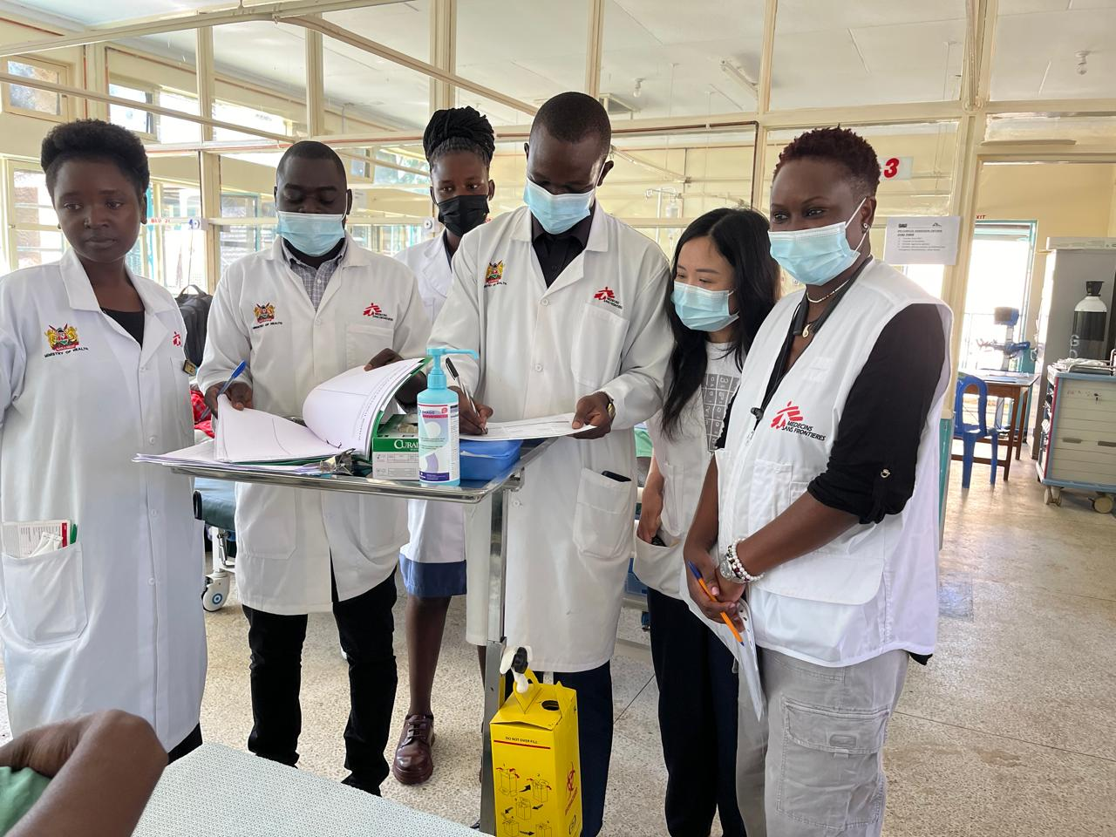

CAPACITY BUILDING

Slide 47
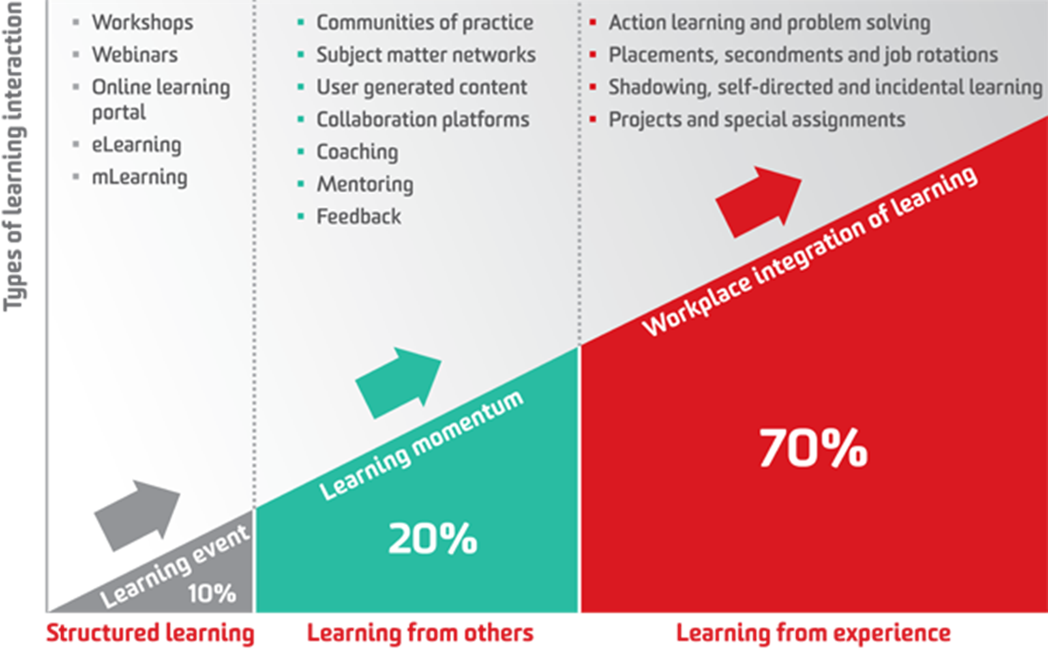

Slide 48
What have we done? (until 2025)
Total enrolled= 153
Total graduate= 99 (up to cohort 4)
Total enrolled= 165
Total graduate= 107 (up to cohort 4)

Slide 49
MSF CAPACITY BUILDING TOOLS @ ESCMID
Research on AMS in LMIC: Epicentre
MiniLab
Antibiogo
Telemedicine
E-learning, MSF academy

Slide 50
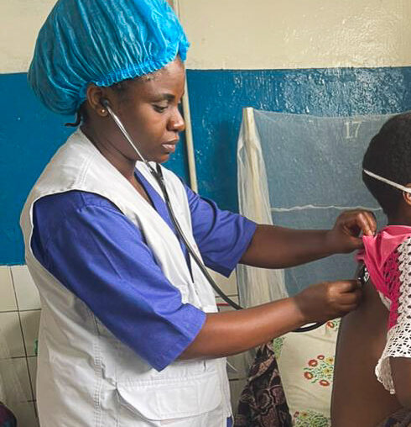
ACKNOWLEDGEMENTS
Patients and staff: MSF Projects
MSF AMR teams: project/coordination/HQ
Minilab team
Antibiogo team
MSF Academy
Telemedicine team
E-Care team
Epicentre
Dawaa team

Slide 51


www.msf.org
Rupa.Kanapathipillai@newyork.msf.org
Anna.farra@brussels.msf.org

