Slide 1


Bon usage des antibiotiques dans les PRFI Défis pour les études épidémiologiques
Bich-Tram HUYNH
MD, PhD-Institut Pasteur
SPILF/SAPI-14 Janvier, 2026

Slide 2


Definition of antimicrobial Stewardship
In human medicine
Antibiotic stewarship is the effort to measure and improve how atb are prescribed and used by patients
Antimicrobial stewardship refers to coordinated interventions designed to improve and measure the appropriate use of antimicrobials by promoting the selection of the optimal antimicrobial drug regimen, dose, duration of therapy, and route of administration.

Slide 3
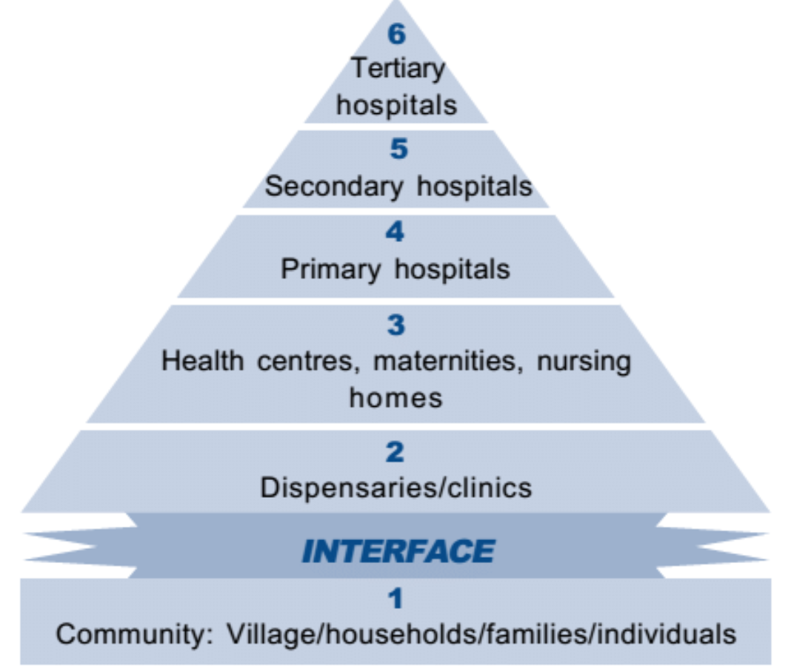
Measure in low- and middle-income countries
Settings
Rural/urban?
Primary care/hospital?
Public/private
Health system in Kenya
© Paul Maccharia

Slide 4
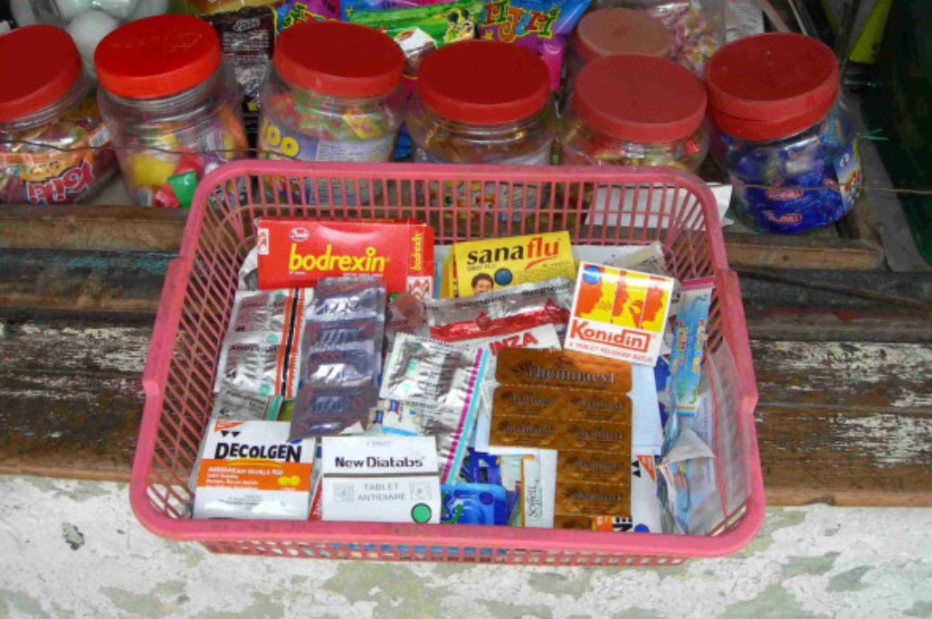
Measure in low- and middle-income countries
Settings
Acces to antibiotics: formal/informal+++++
-Street vendors
-Open markets
-Relatives
-Dispensing from pharmacists
© Usman Hadi

Slide 5

Measure in low- and middle-income countries
Antibiotic exposure data sources
-Global sales of antibiotics
-Medical records, prescription audit
-Provider/patient interview
-Point prevalence survey
-Demographic Health Surveys
-Simulated client method
Van Boeckel et al., Lancet Infect Dis , 2014
Hsia et al., Lancet Infect Dis , 2019
Sulis et al, 2020 PloS Med
Browne AJ et al., Lancet Planetary health, 2021
Versporten A, et al. Lancet Glob Health. 2018
Define target population
Provider
Patient

Slide 6
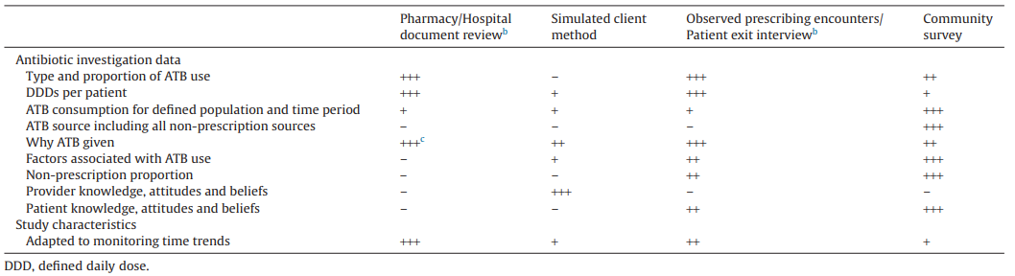
Table 1. Ability of four study types in responding to antibiotic (ATB) consumption investigation needs in low-income countries (LICs).ª
DDD, defined daily dose.
a
+, poor; ++, moderate; +++, good; –, not applicable.
b
Using non-exhaustive sample of centres/pharmacies.
c
If including patient records.
Measure in low- and middle-income countries
Ability of 4 study types in responding to atb consumption investigation needs in LICs
Padget el al. Int J Antimicrob Angents, 2016

Slide 7
Measure in low- and middle-income countries
Antibiotic exposure data sources
Patient interview: the most challenging question!
Did you take an antibiotic in the last (3) months?
Recall biais
No awareness of what an antibiotic is++++
-Try to find the blister
-Try to find the prescription
-Pill identifier

Slide 8
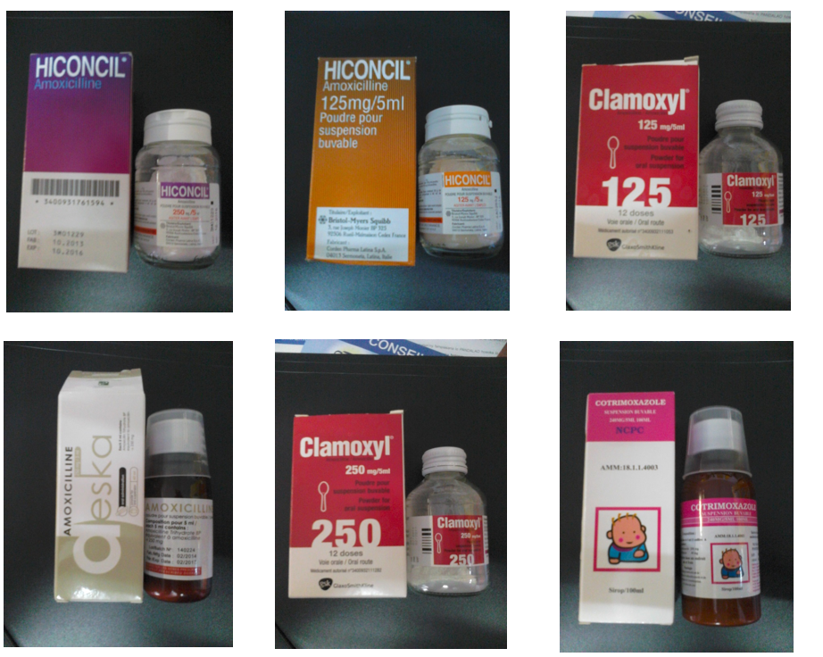
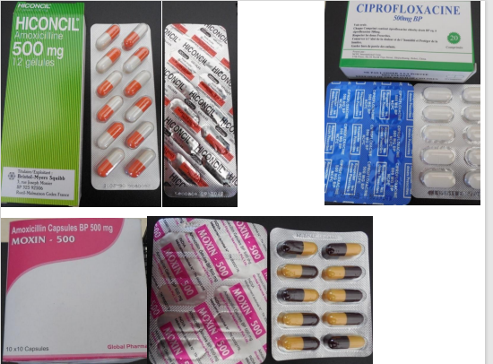
Measure in low- and middle-income countries
Antibiotic exposure data sources
Patient interview: the most challenging question!

Slide 9
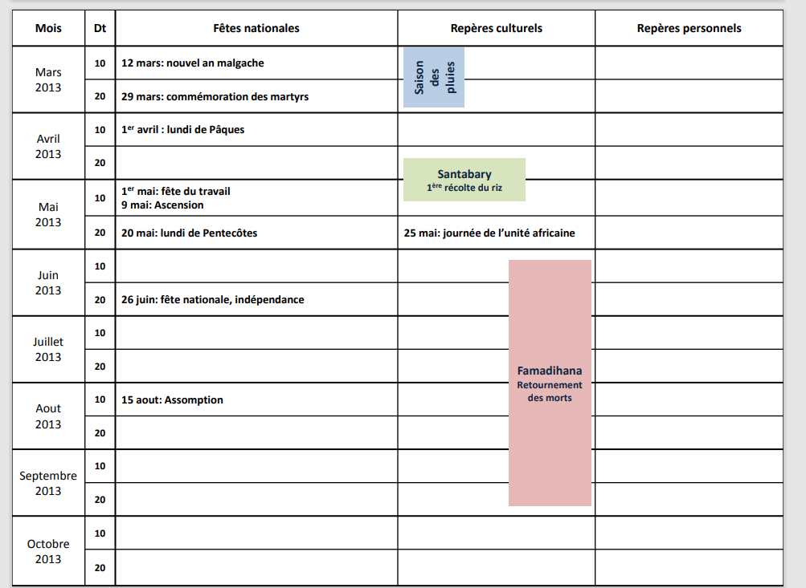
Measure in low- and middle-income countries
Antibiotic exposure data sources
The most challenging question!

Slide 10
Appropriate use
Definition of appropriate use?
-Use of optimal antimicrobial drug regimen
-dose
-duration of therapy
-and route of administration
Need access to
- Final diagnosis, clinical information
- The prescription
- Microbial documentation
NEED TO IMPLEMENT AD HOC STUDIES

Slide 11
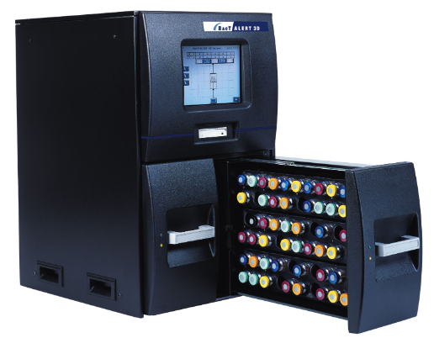
Appropriate use
Definition of appropriate use?
-Use of optimal antimicrobial drug regimen
-dose
-duration of therapy
-and route of administration
Access to microbial documentation
- Financial barrier
- Not widely available
- Prior atb use
- Training+++
- Lab of quality
- Shortage of reagents
- Sample process from bedside to the lab

Slide 12

How atb are prescribed and used by patients
What are the determinants?
How atb are prescribed provided?
Prescribers/informal dispensers
Motivations (perceived patient satisfaction,
access to medical facilities, financial incentives…)
Practices/knowledge (rainy season, lack of Continuing Medical Education…)
Notes:
determinants

Slide 13
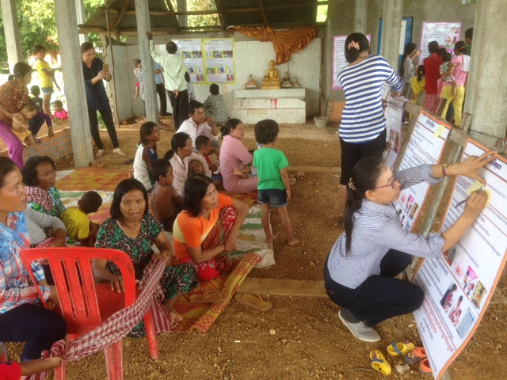
How atb are prescribed and used by patients
What are the determinants?
How atb are prescribed provided?
Patient
Motivations to consult an informal/formal prescribers
Practices (take/buy the full regimen)
Knowledge
Multidiscplinary approaches needed!
Notes:
determinants

Slide 14
Improve …and coordinated interventions
The importance to involve all stakeholders from the beginning
Different targets intervention
-General population
-Patients
-Prescribers
-Providers
-Policy makers

Slide 15
Improve …and coordinated interventions
The importance of evaluating the intervention
Outcome: quantitative reduction in antibiotic prescribing
but also…
-to improve patient outcomes
-decrease antibiotic resistance
- and increase cost‒effectiveness of care

Slide 16

One example of epi survey
Objectives: -to describe and quantify inappropriate antibiotic prescribing
-to identify determinants of inappropriate prescribing
among children in primary-care in LMICs
Why in children? young children in LMICs bear the greatest share of global infectious disease burden
A. Ardillon, master student

Slide 17
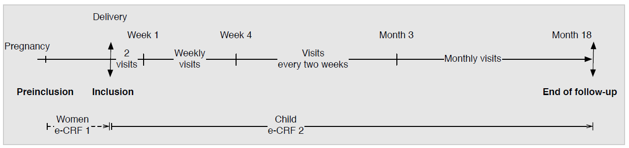
BIRDY program
Main objective of the BIRDY program : to estimate the burden of severe infections with bacteria, resistant or not, in neonates and young children
Population based incidence,
Etiologies and antibiotic resistance patterns
Cohort of children from birth to 18 months
Huynh et al. Plos med, 2021

Slide 18
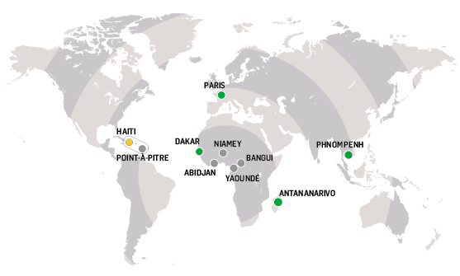



Sites of the BIRDY program
In each country : implementation in urban and rural settings
Cambodia, 2014-2018
794 newborns
Senegal,2014-2018
605newborns
Madagascar,2012-2018
2131 newborns
Total : 3524 newborns followed-up

Slide 19
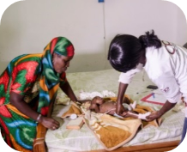
Study design
Active and passive surveillance
In case of health event : evaluation by a physician
- Signs and symptoms
- Diagnosis
If necessary, sampling adapted from WHO recommendations
Antibiotic prescription
Consultation and medication : financially supported by the project

Slide 20
Study population and outcomes
Study population : all children from the BIRDY cohort who had at least one outpatient consultation during their follow-up
Only systemic antibiotics were taken into account : oral, intra-muscular, intravenous
Inappropriate antibiotic prescriptions : antibiotic being prescribed for a child's health event which does not require antibiotic therapy, regardless of the duration of prescription, type of antibiotic and dosage.

Slide 21
Study population and outcomes
Which health events require antibiotics or not ?
- Step 1 : to define diagnoses that do not require antibiotic therapy.
-Step 2: to define criteria to classify the remaining health events which could not be classified solely based upon diagnosis in the first step.

Slide 22
Results
Altogether, 76.5% (95%CI: 75.1-77.9) of all outpatient consultations resulting in antibiotic prescriptions did not require them.

Slide 23
Results
Number of consultations "not requiring antibiotics" stratified by country, associated diagnosis and the share resulting in antibiotic prescription

Slide 24
Results

Slide 25
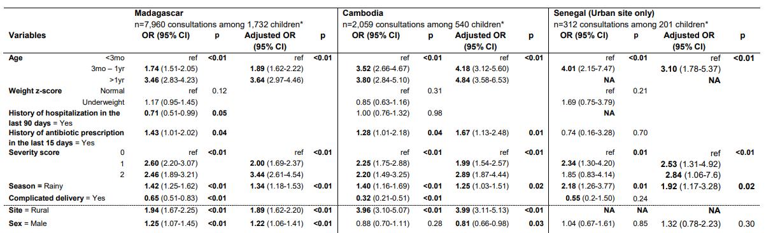
Results
Analysis of the determinants of antibiotic prescription among consultations with a diagnosis
not requiring antibiotic therapy (mixed logistic regression model )

Slide 26
Challenges
75% all outpatient consultations resulting in antibiotic prescriptions did not require them
Bacterial documentation
-Overestimation of inappropriate prescription
Representative of non-study conditions?
- Consultations and antibiotic prescriptions were financially supported by the project
More frequent consultation
More frequent antibiotic prescription
Over-the-counter antibiotic

Slide 27
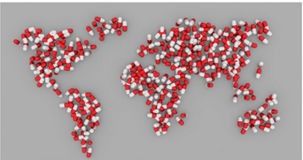
Take home messages
Reduce drug pressure necessitated by the high incidence and prevalence of disease
(vaccination, improved diagnostics, improved hygiene and sanitation, access to clean water supply and better access to healthcare facilities)
Ensuring access to antibiotics while reducing inappropriate use
Antibiotic stewardship needs to be context-specific
Multifaceted and multidisciplinary approach required
© Pixabay

Slide 28
Thanks for your attention
bich-tram.huynh@pasteur.fr
Any question?

