Slide 1
Mini-Lab
Accessible & Affordable Laboratory solutions For All
Jean-baptiste Ronat, MPH, PhD

Slide 2


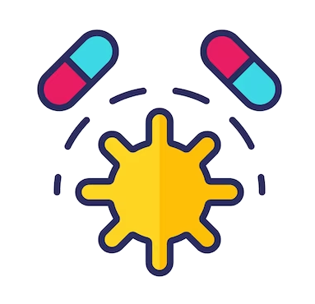
Diagnostic microbiology in LMICs: key challenges
ACCESSIBILITY
In High-Income Countries, 70% of medical decisions relies on laboratory results
In LMICs:
  Cost of laboratory tests is a barrier for patients
  Lack of trained microbiologists and logistic constraints are a barrier
  Contrary to HIV, TB and Malaria, AMR does not benefit from a specific laboratory control program
  Only 1.3%* of clinical laboratories across 14 Sub-Saharan African countries perform bacteriological testing
SEPSIS
Number 1 cause of death in hospitals
Worldwide 11 million deaths per year of which 85% in LMICs
For patients with septic shock, there is an 8% increase in mortality for every hour of delay in appropriate antibiotic administration
In LMICs, symptoms of sepsis can be confused with more common infections (malaria) delaying appropriate treatment due to lack of laboratory diagnostic
ANTIMICROBIAL RESISTANCE (AMR)
1.27 million global deaths in 2019
By 2050:
10 million deaths, mostly in LMICs
Estimated to cause US$ 1 trillion additional healthcare costs
Gaps in surveillance: lack of data in rural areas in LMICs leading to inappropriate AMR prevention and control program
Multifaceted problem: ONE HEALTH APPROACH required
3
* survey by AFRICA CDC and the African Union

Slide 3
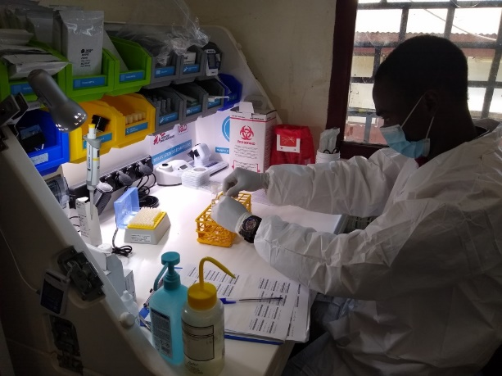
The Mini-Lab is a small-scale microbiology laboratory adapted to LMICs
Médecins Sans Frontières, with academic and commercial partners have developed the Mini-Lab, a small-scale microbiology laboratory adapted to LMICs at the district level
The Mini-Lab is able to: Analyse blood, urine and cerebrospinal fluid Report full pathogen identification and susceptibility testing Configuration for district level: Can be set-up in 15-20m² of space Has a capacity of 10-30 blood cultures and 10 urines per day It is designed for non-expert microbiologists

Slide 4
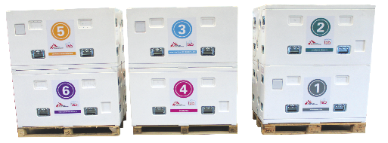


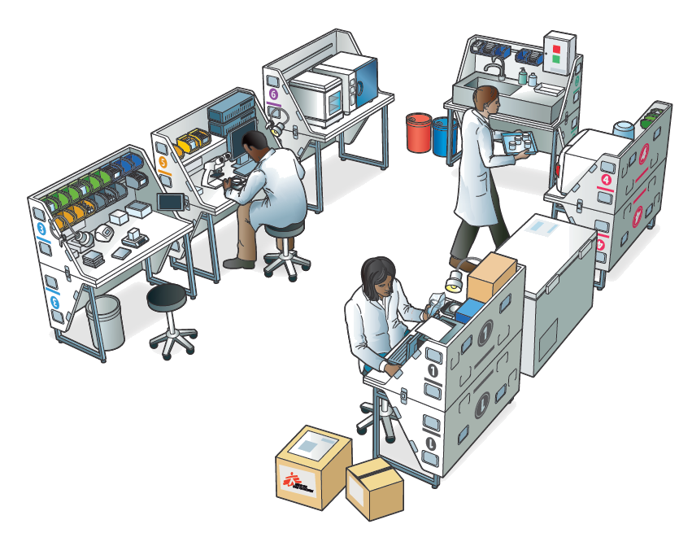
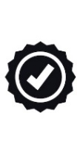


The Mini-Lab is a simplified microbiology laboratory adapted to LMICs
Developed by MSF and academic partners
All in One Solution includes a Laboratory Information System, Quality Management System, Standard Operating Procedures (SOPs) and Training
Transportable in 6 modules containing all required equipment
Easy to deploy it takes no more than 2 Days to unpack and install
Low Maintenance equipment
Easy to Use by lab technicians (2/3) with no microbiology experience
20 Days of on-site training delivered by a microbiologist trained by AALFA on the Mini-Lab SOPs
15 – 20 m² required to install the Mini-Lab in a permanent structure or container
Credit: Richard Palmer
5

Slide 5

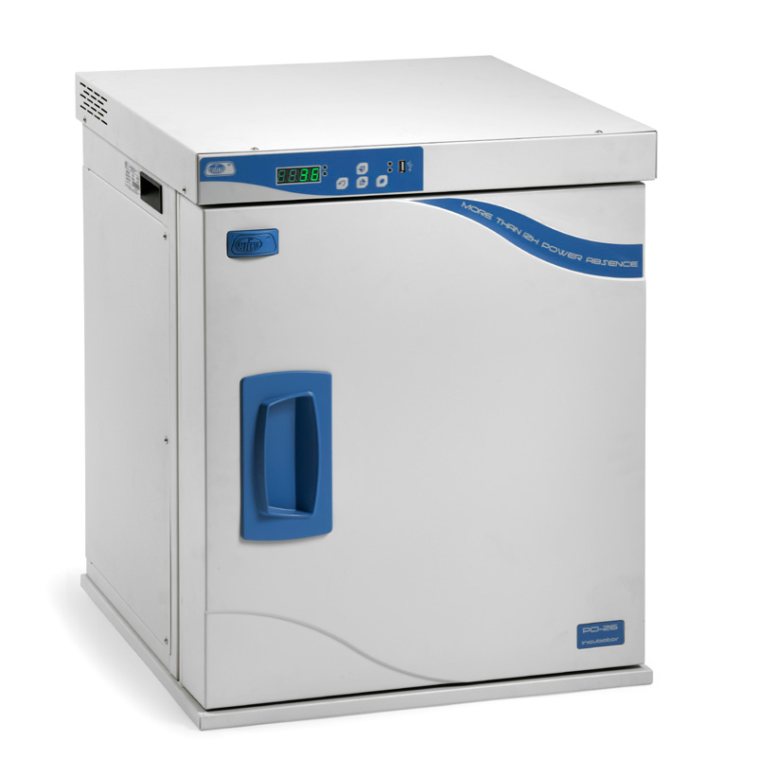
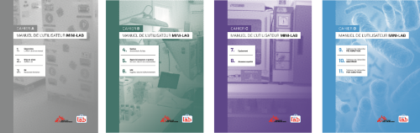




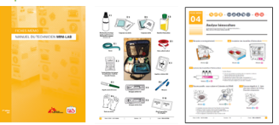









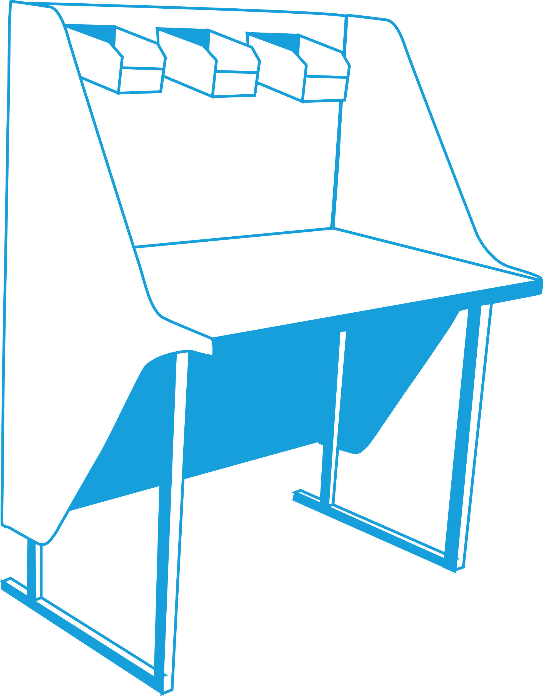

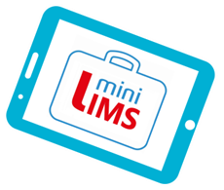
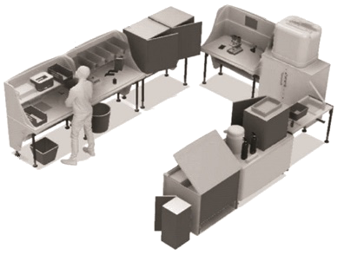

The Mini-Lab characteristics: All in One / turn-key solution
Reagents and Consummables
Sturdy & Low-maintenance
Equipement
Documentation and training
User manuals covering all life cycle of the Mini-Lab, SOPs, QMS etc..
A Laboratory Information System
IT and Data management
Laboratory benches
This facilitates the procurement process and laboratory set-up

Slide 6
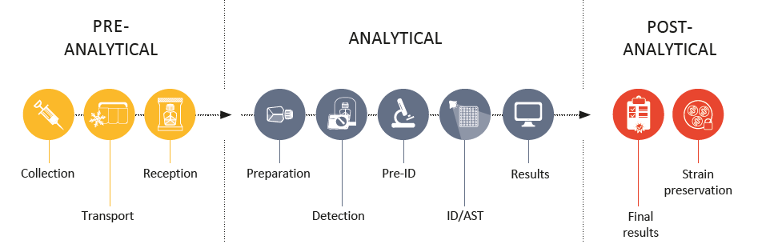

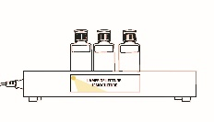
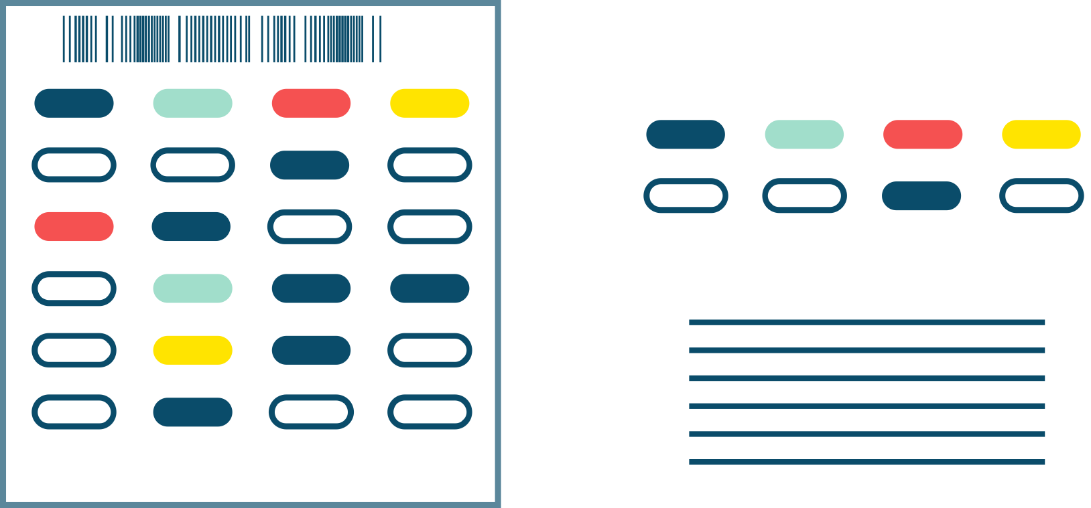
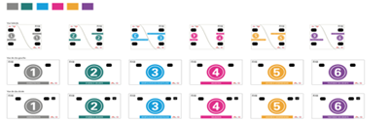

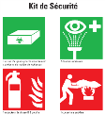


The Mini-Lab characteristics: easy to use by non-expert microbiologists
Simplification process
Use of basic microbiology techniques | Simplification of workflow
 | Use of aiding tools for reading and interpretation
Help follow the process with pictograms, graphical layout

Slide 7
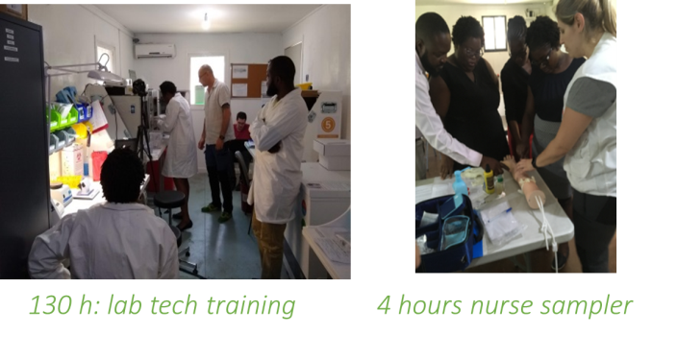
The Mini-Lab characteristics: sustainable
It’s Easy to deploy, it takes no more than 2 Days to unpack and install. However…
Competency assessment shows good progress
94% after training, 98% after 3 months of practice
94% after training, 100% after 3 months of practice
*Scored by 2 lab technicians in two different field evaluation studies
Training of local staff :
1 month training modules for local LabTechs
2 weeks training modules for local supervisor
4h module for nurses on sample collection
4h module for clinicians on diagnostic stewardship
E-Learning 30 hours course

Slide 8
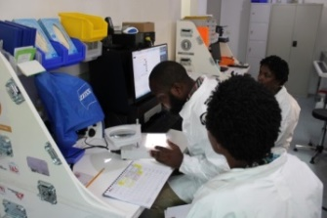
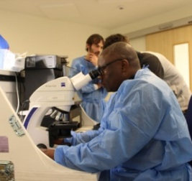
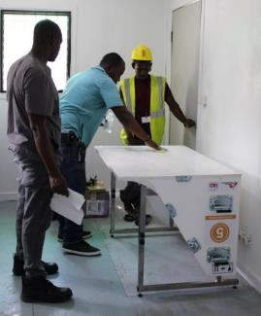
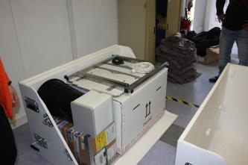

Mini-Lab key figures…
Days of on-site training for the lab techs to be able to run the Mini-Lab
Clinical bacteriology in low-resource settings: today's solutions, Lancet, 2018
Humanitarian and non-state actors' contribution to AMR surveillance in low-resource settings: A case study by Médecins Sans Frontières, CMI, 2021
20
Hour's electricity free incubator
Year shelf-life consumables (average)
12
> 1
kW peak consumption, electricity protection included
Dedicated laboratory technicians of which one is the supervisor (can be the same of other lab services)
2/3
4,85
Modules (initial package), foldable, sturdy transport boxes (~120kg each) transformable into standalone laboratory benches, modular capacity to expend activity
6
m² to install the Mini-Lab (permanent structure or container)
15-20
Validation CE- IVD and ISO standards
10 -20
BCB / Day (average & peak capacity)
CE / IVD
Quality Management System Rated 4 stars out of 5 with WHO SLIPTA ISO 13185 evaluation process
2
Days to install or re-pack the Mini-Lab
4
4-6
Months of initial onsite support and regular follow-up visits
4
4

Slide 9
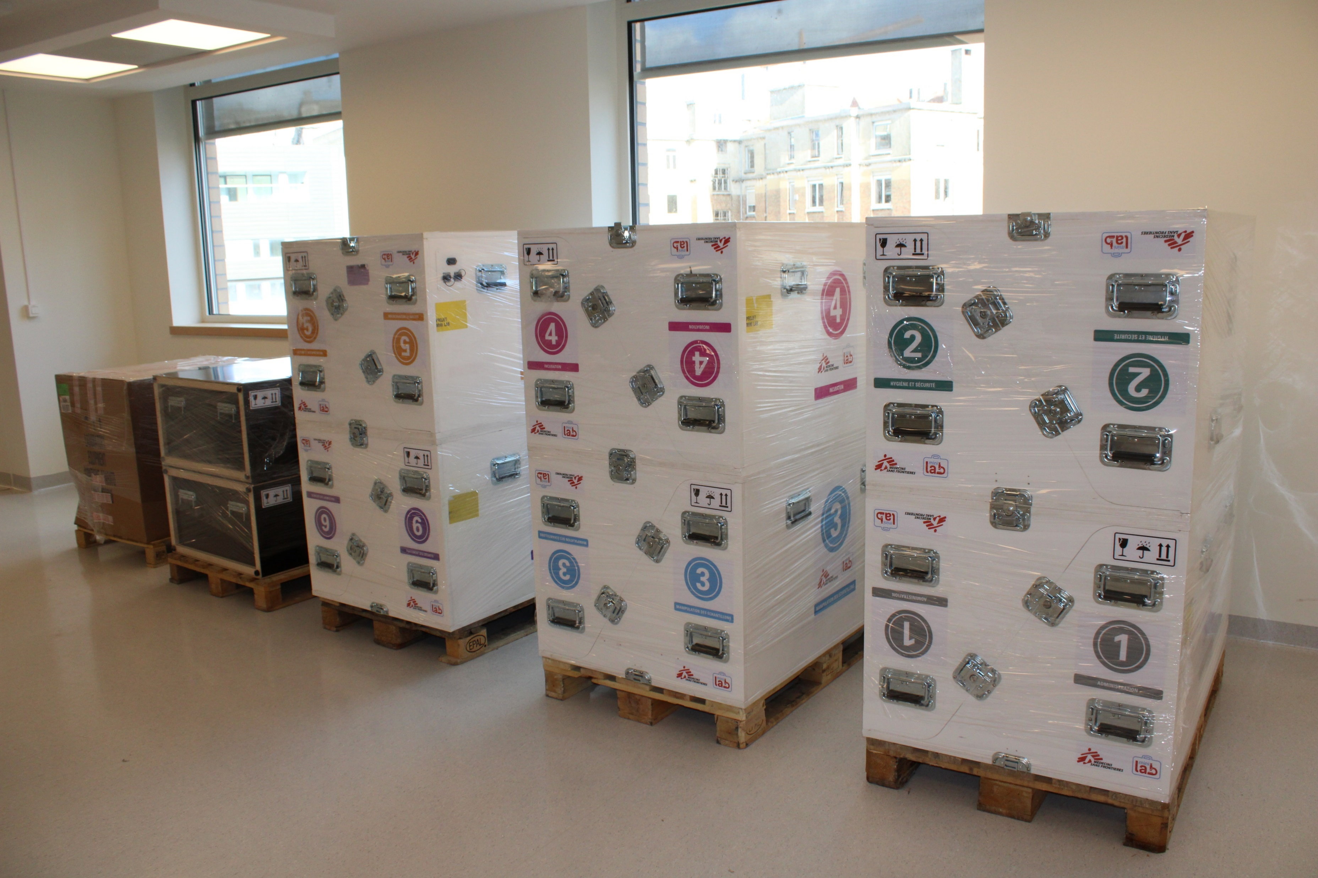
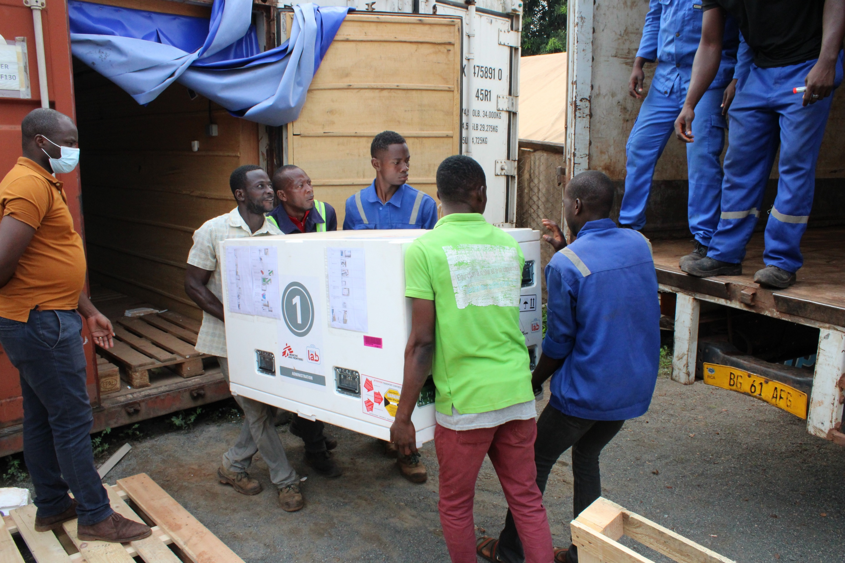
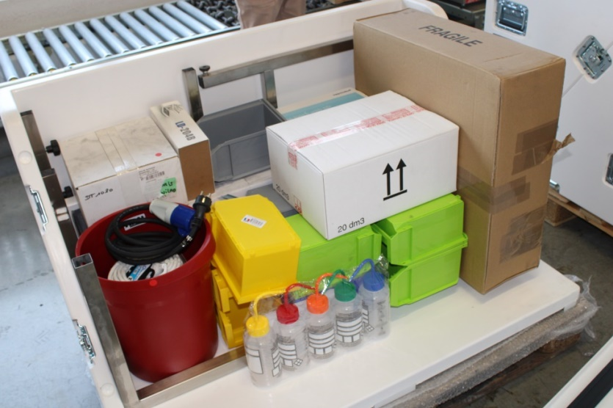
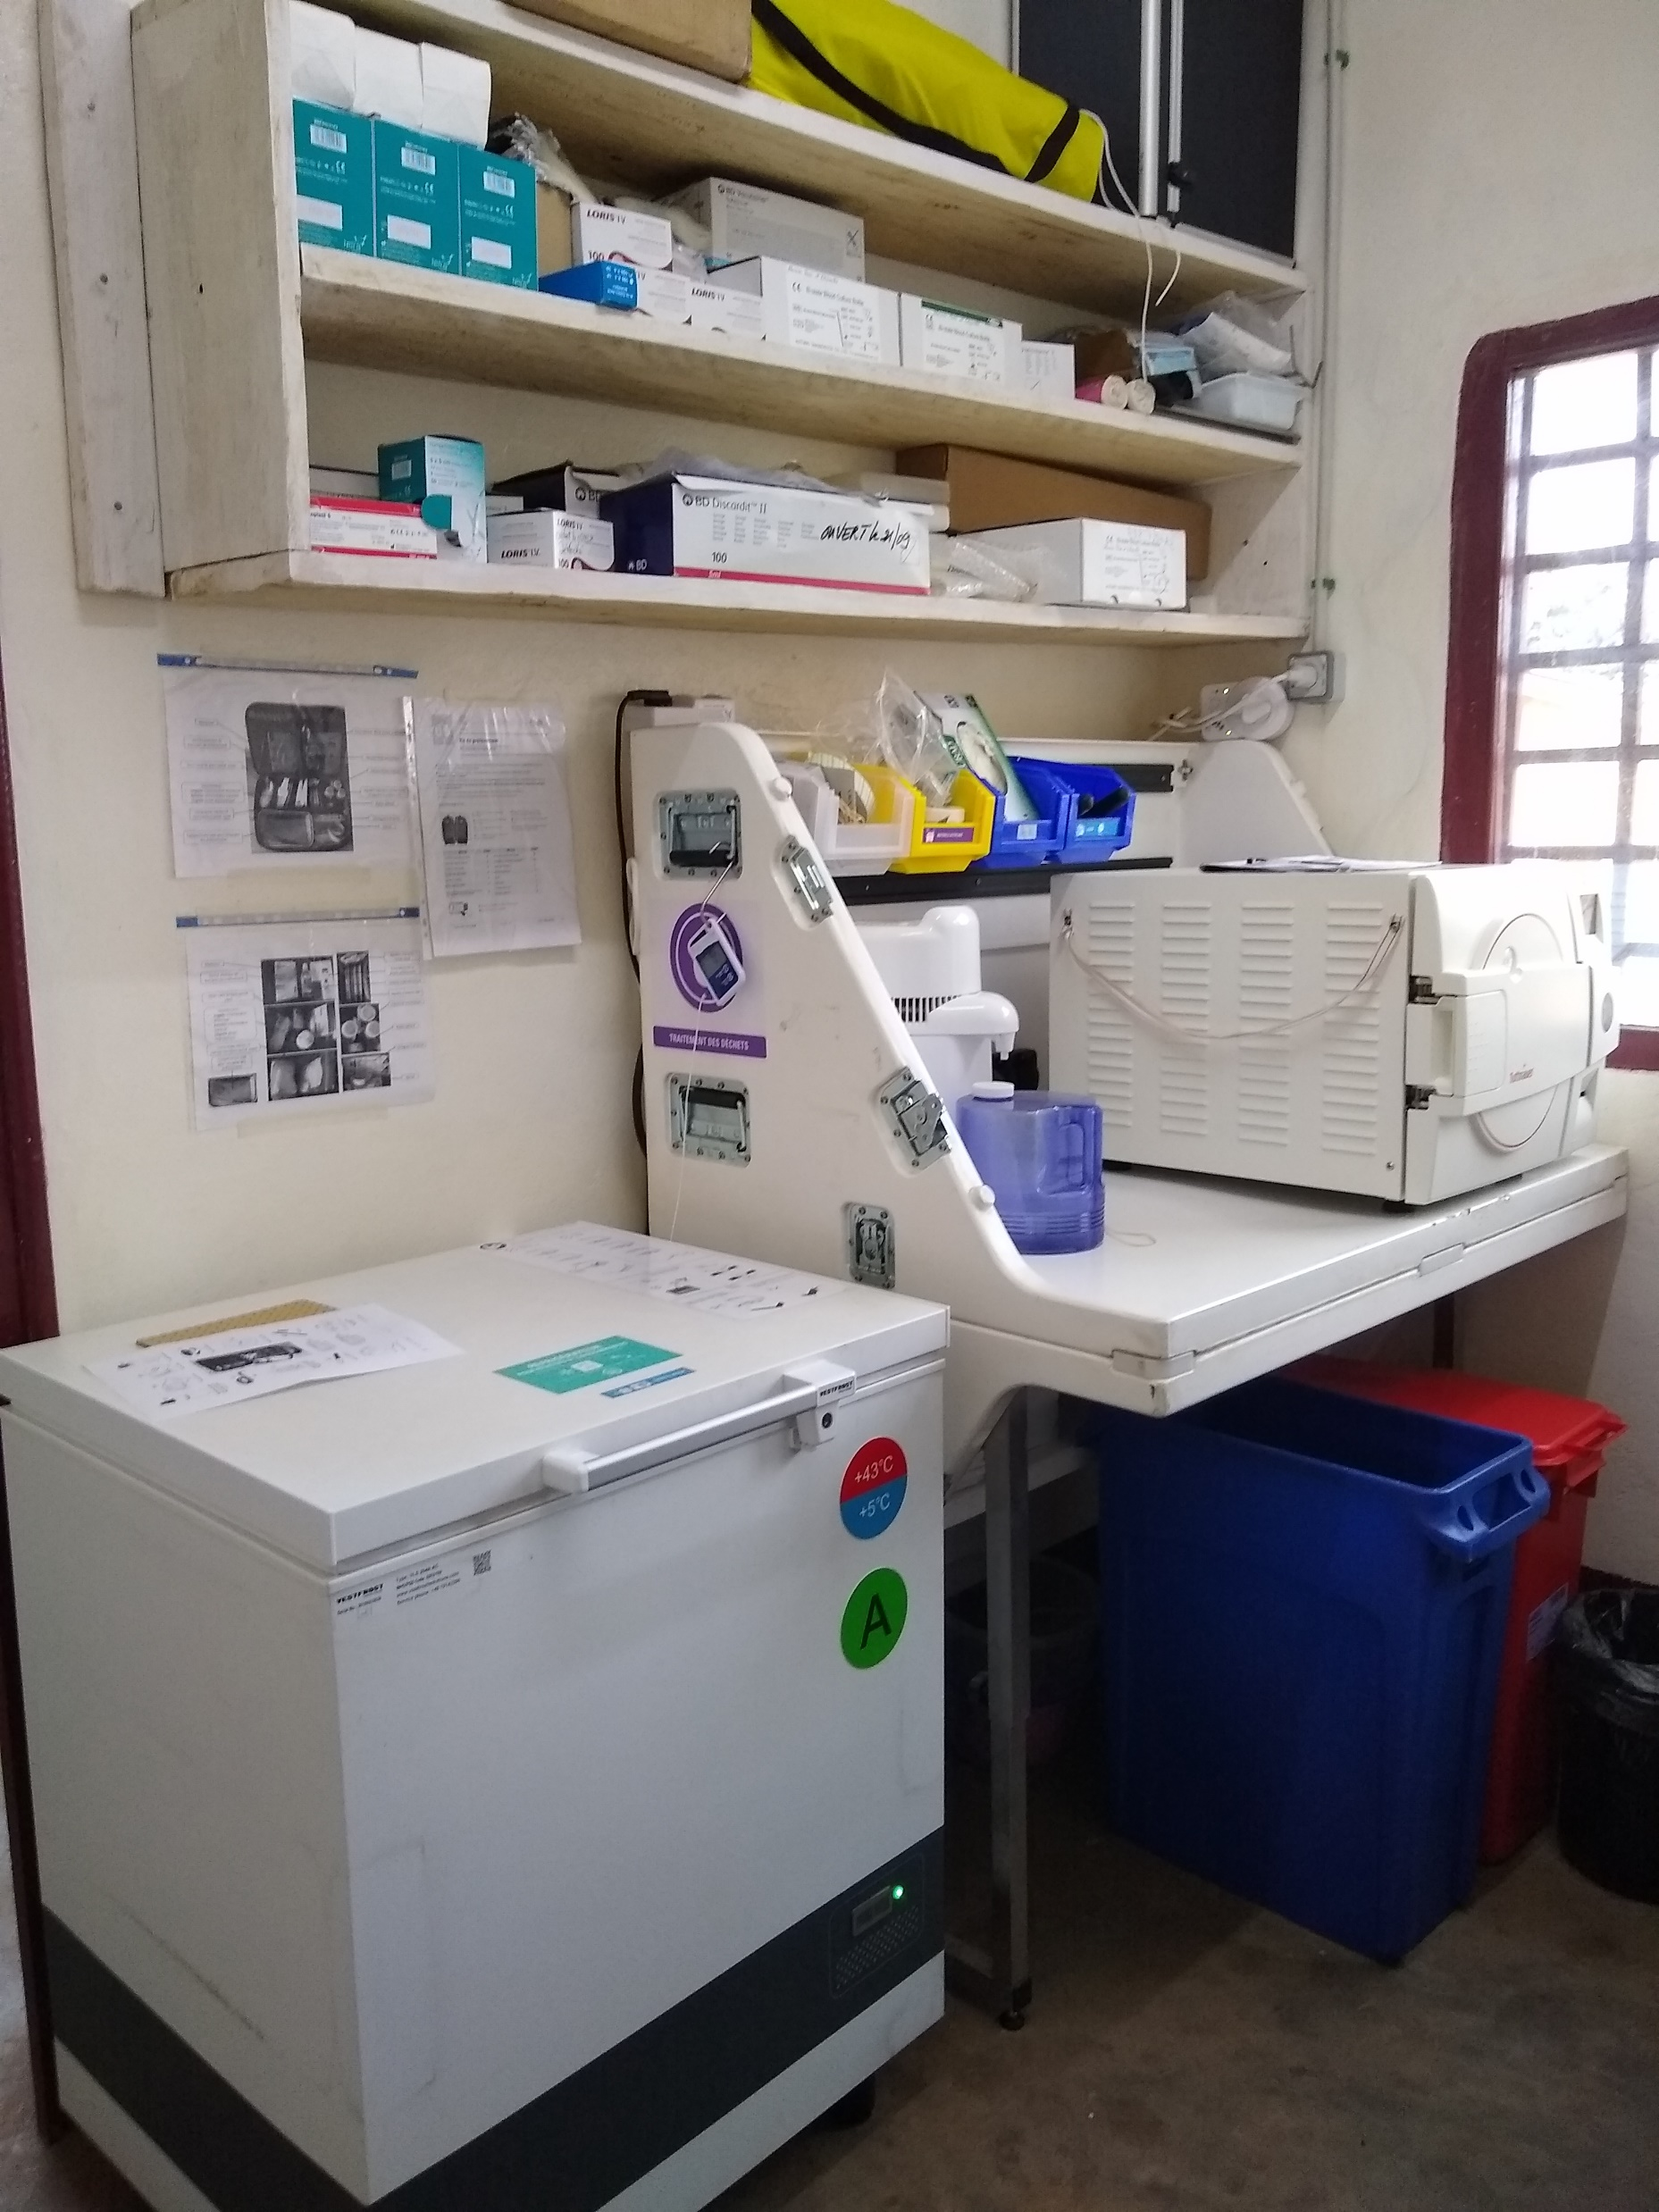
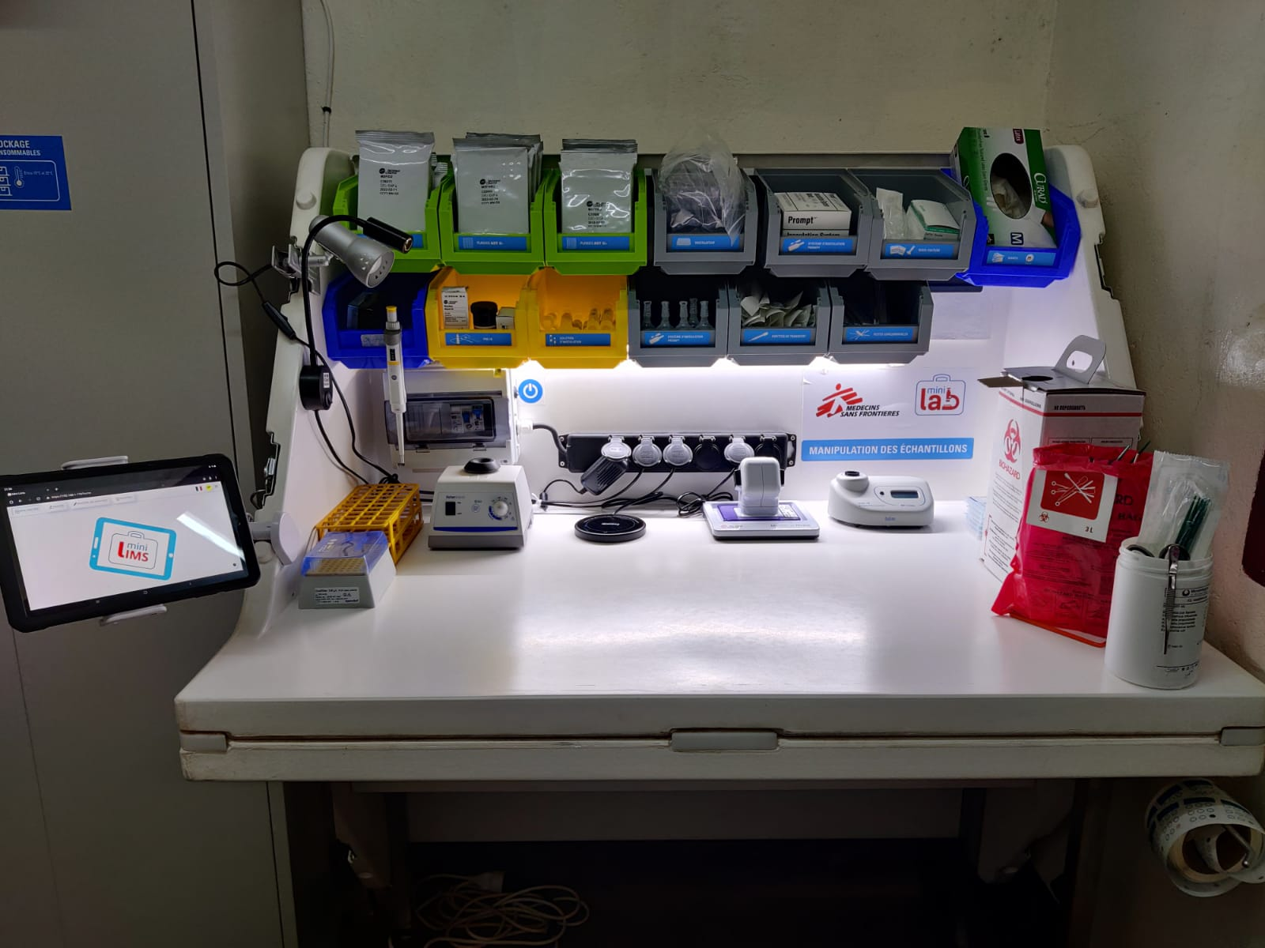
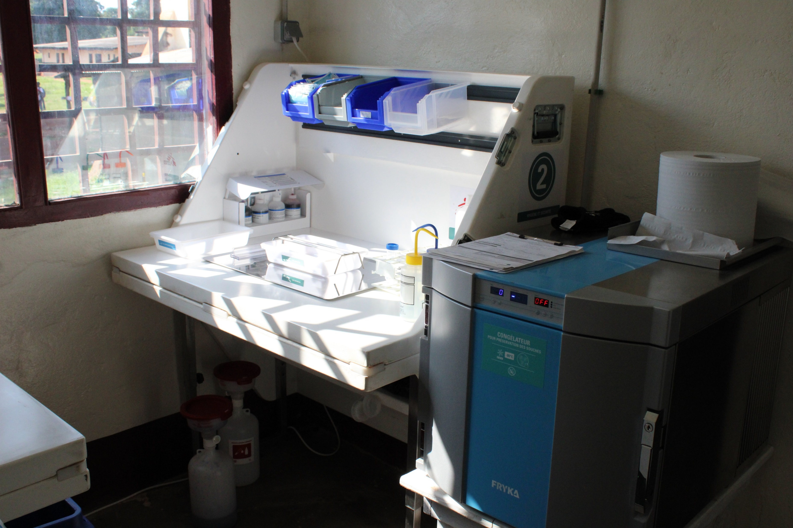

Mini-Lab pictures

Slide 10
Overview of Mini-Lab activity* on MSF sites
* Activity from opening to December 2023
13 500 blood cultures analysed and more than 12 500 patients benefited from it
With % of blood culture positivity between 5% and 21%
1750 pathogenic bacteria isolated
The % of Multi Drug Resistant Organisms (MDRO) isolated varied between 20% and 80%, depending on the context
Mini-Lab PROJECT | Opening date of activities | Nb of patients sampled | Nb of positive blood cultures | % of blood culture positivity | Nb of pathogens isolated | Nb of isolated MDRO
Carnot, CAR | August 2021 | 5168 | 746 | 13,4% | 768 | 162
Aweil, South Sudan | June 2022 | 2905 | 205 | 6,7% | 205 | 44
Mosul, Irak | December 2022 | 924 | 51 | 5,3% | 52 | 41
Maiduguri, Nigeria | January 2023 | 2681 | 595 | 21,0% | 621 | 505
Rutshuru, DRC | June 2023 | 823 | 111 | 11,9% | 109 | 30
8
Unpublished data - Restricted / Confidential use only

Slide 11
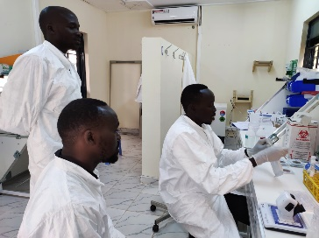

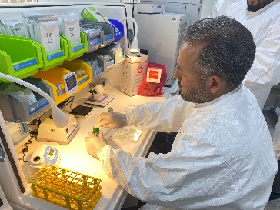



The Mini-Lab: A SUCCESS STORY
Validated by MSF in 2022
10 Mini-Labs have been deployed since
Approximately 11 000 patients living in remote areas have benefited from a blood culture
12% positivity rate observed
Between 20% and 80%, location dependent, of detected bacteria were Multi Drug Resistant (MDR)
Mosul, Irak
MSF
Khost, Afghanistan
MSF
Aweil, South Sudan
Maiduguri, Nigeria
Bentiu, South Sudan
MSF
MSF
MSF
MSF
Xuan Truong, Vietnam
Carnot, Central African Republic
MSF
Rutshuru, Democratic Republic of Congo
Sibiti, Congo Brazzaville
Bukavu, Democratic Republic of Congo

Slide 12

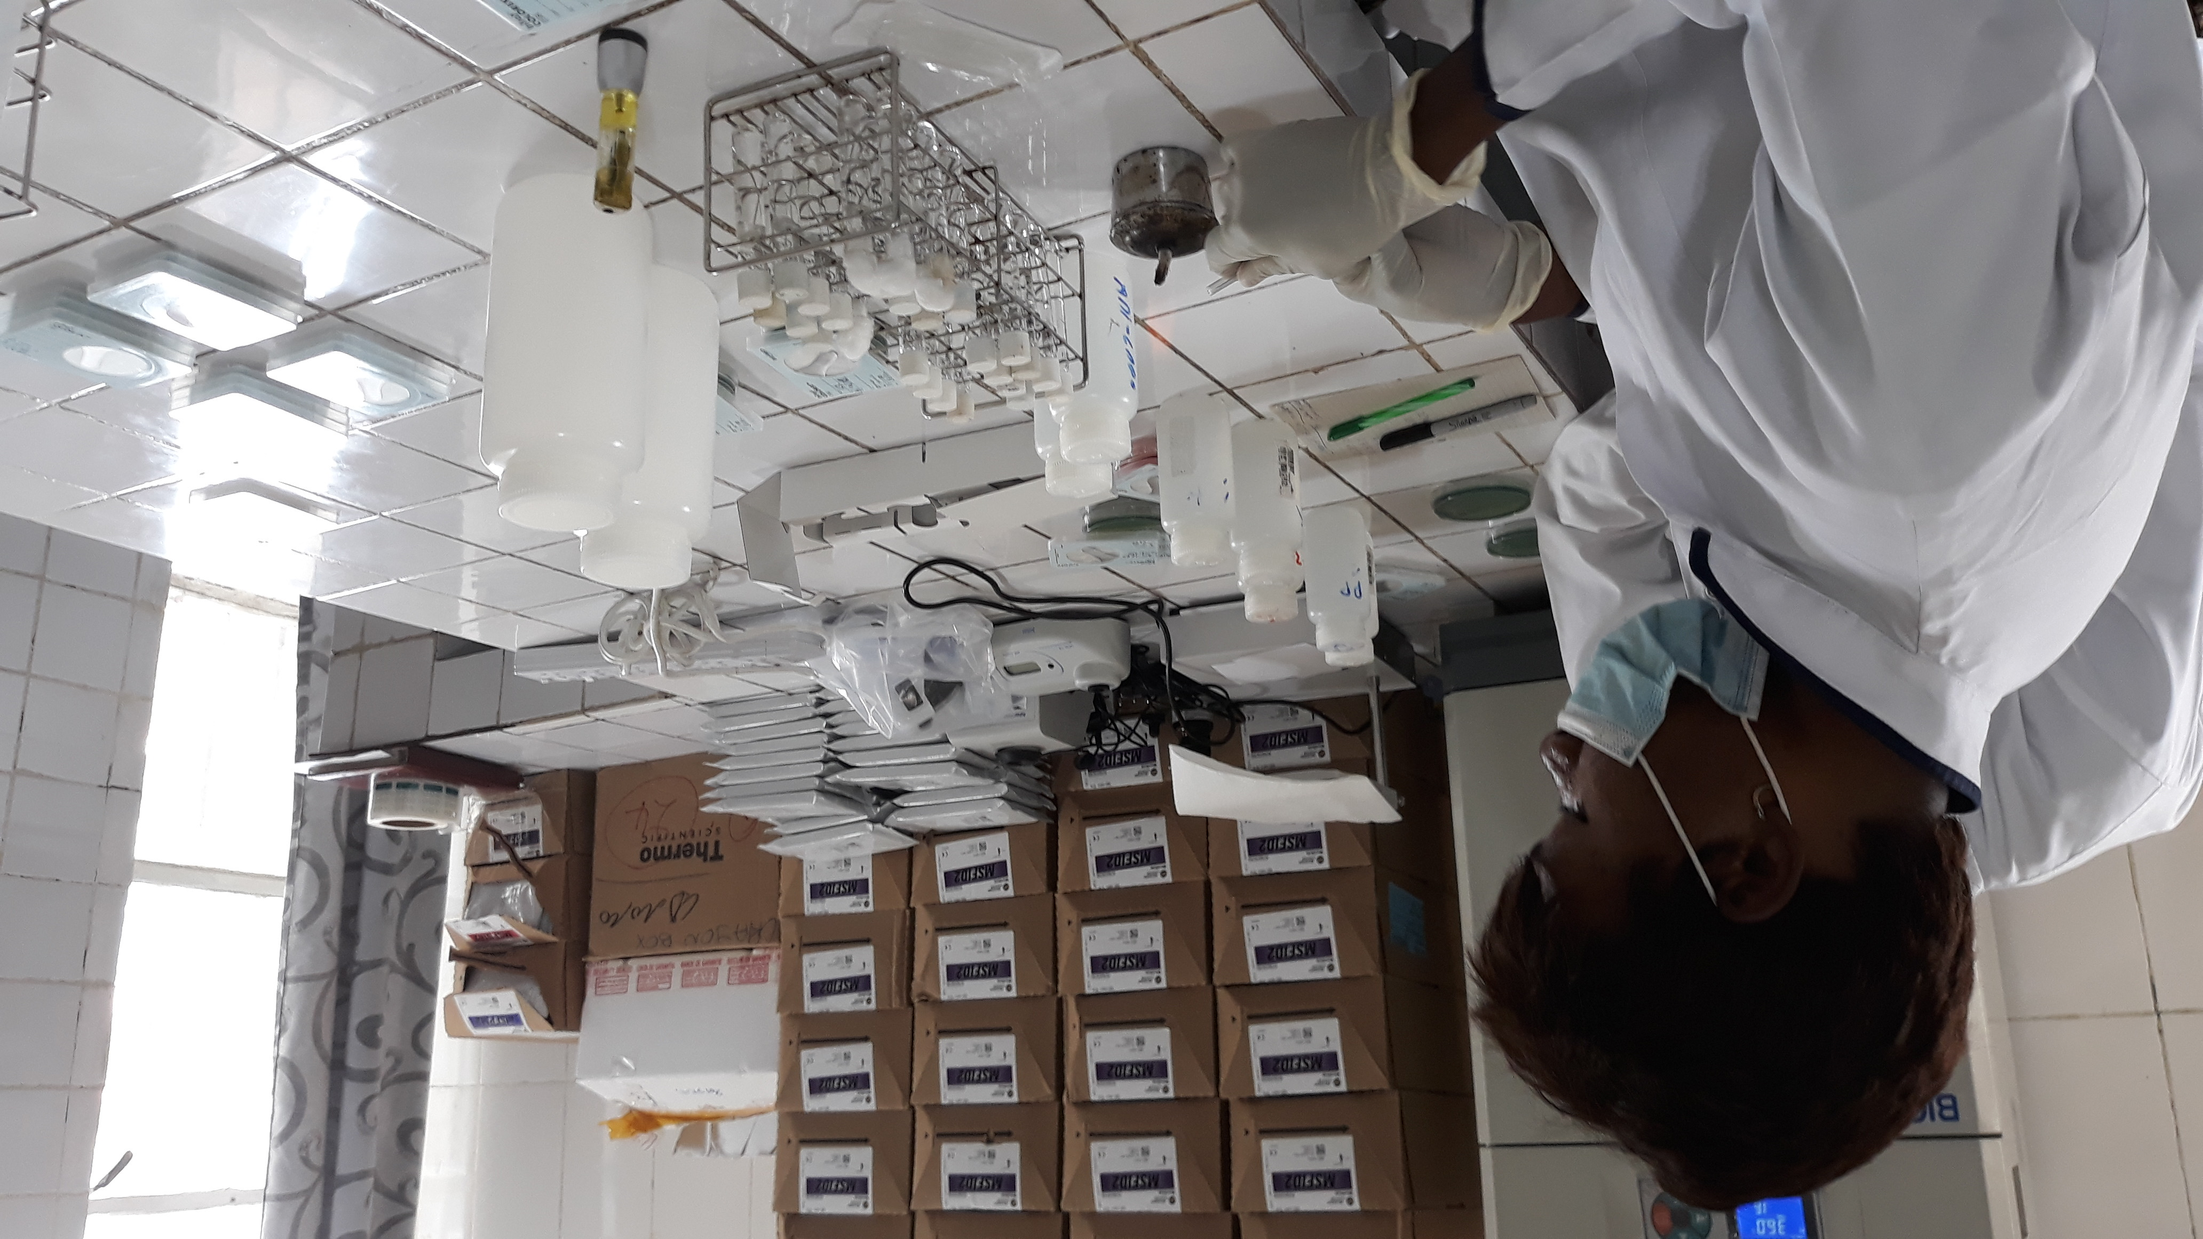

WHO IS AALFA
Accessible & Affordable Laboratory solutions For All
Non-profit organization born in 2024
Created within the Université Libre de Bruxelles (ULB) Ecole de Santé Publique (ESP), Belgium
Founded by former members of MSF Mini-Lab team and ULB academic partners
Supported by Médecins Sans Frontières (MSF), LHUB-ULB, ULB Cooperation and ULB KTO
OUR MISSION
is to make clinical laboratory diagnostics more ACCESSIBLE, SUSTAINABLE AND AFFORDABLE to underserved populations, with focus on Low- and Middle-Income Countries (LMICs)

Slide 13
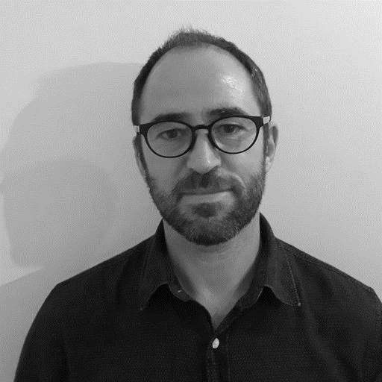
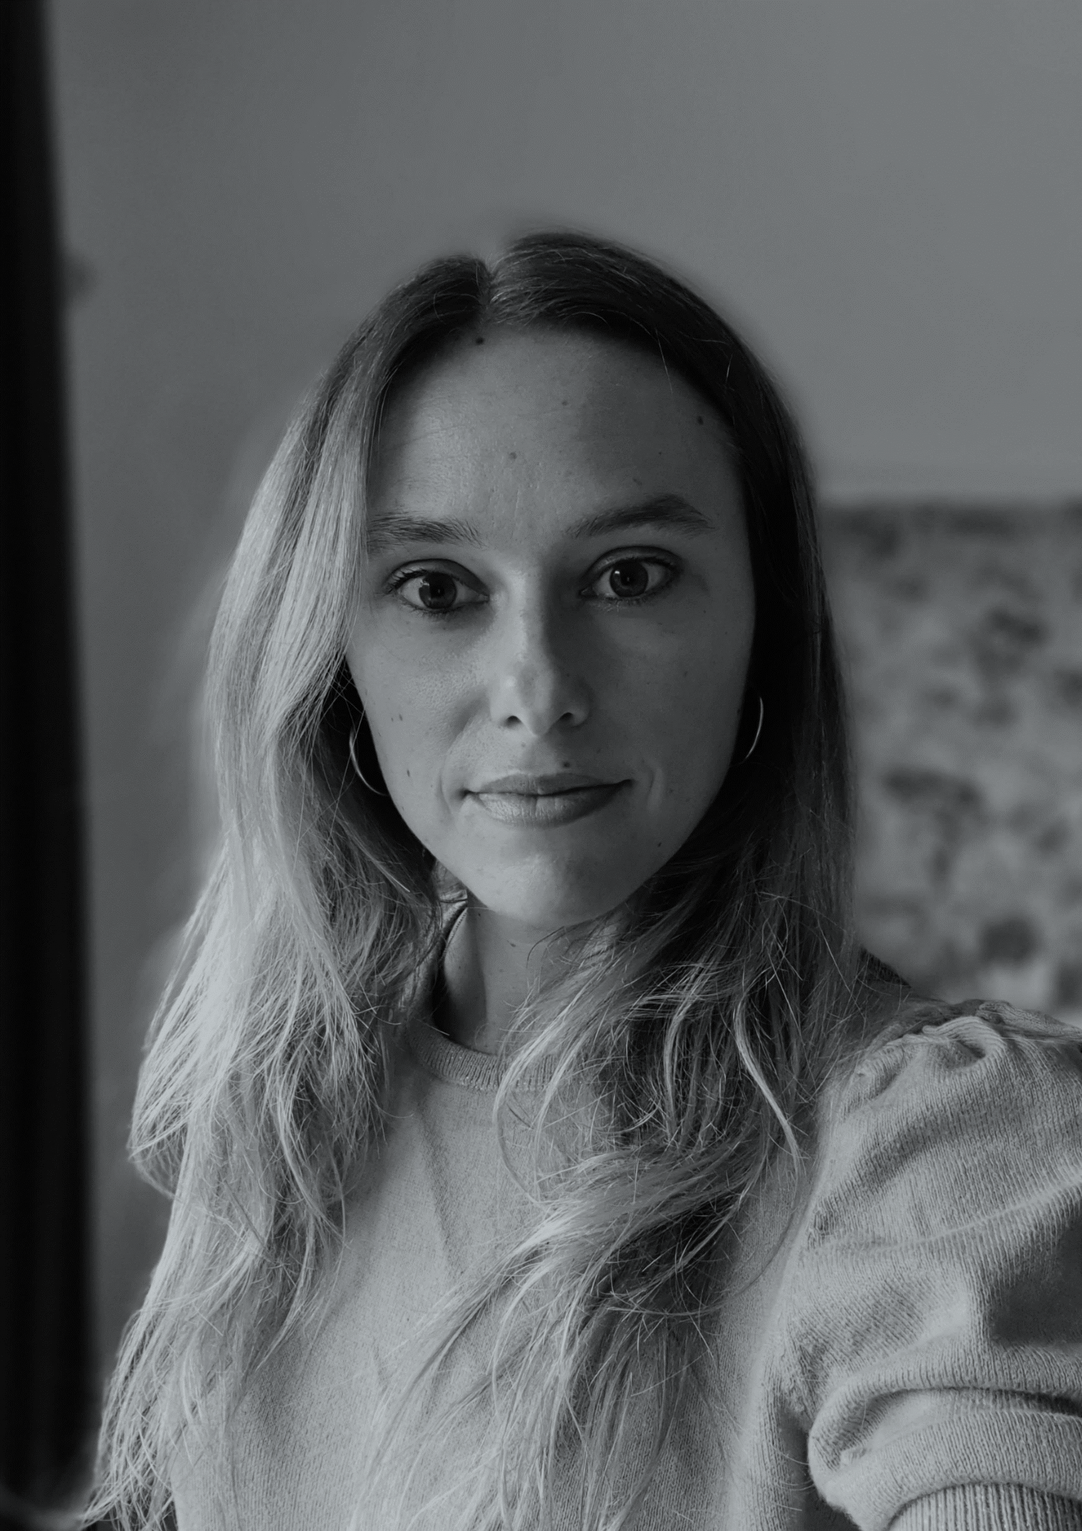
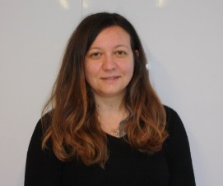
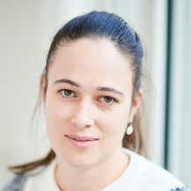

The Team
Prof. Olivier VANDENBERG
MD, MPH, PhD
Administrator, Director
Ex Chair of Mini-Lab Scientific Committee
Céline FRANQUESA
MSc
Chief Operating Officer
Ex member of Mini-Lab Project Team
Alessandra NATALE
MSc, PhD
Scientific & Technical Manager
Ex member of Mini-Lab Project Team
Prof. Marie HALLIN
MD, PhD
Administrator, Microbiology Expert
Involved in mobile lab innovation projects
AALFA is supported by an Administrative Board and a Scientific Advisory Board whose members bring their combined years of experience and expertise in microbiology, diagnostics, laboratories, business and strategy.
9

Slide 14

Thank you
Any questions? contact@aalfa.org
https://www.aalfa.org/

