Slide 1


Exemples d’implémentation en bon usage des antibiotiques
Jeroen Schouten MD, PhD
ICU Department
IQ Healthcare
Radboud University Hospital
Nijmegen, The Netherlands
ESGAP, chair

Slide 2
Examples of implementation projects for appropriate antibiotic use
Jeroen Schouten MD, PhD
ICU Department
IQ Healthcare
Radboud University Hospital
Nijmegen, The Netherlands
ESGAP, chair
Notes:
Voorstellen!!

Slide 3

Conflict of interest

Slide 4
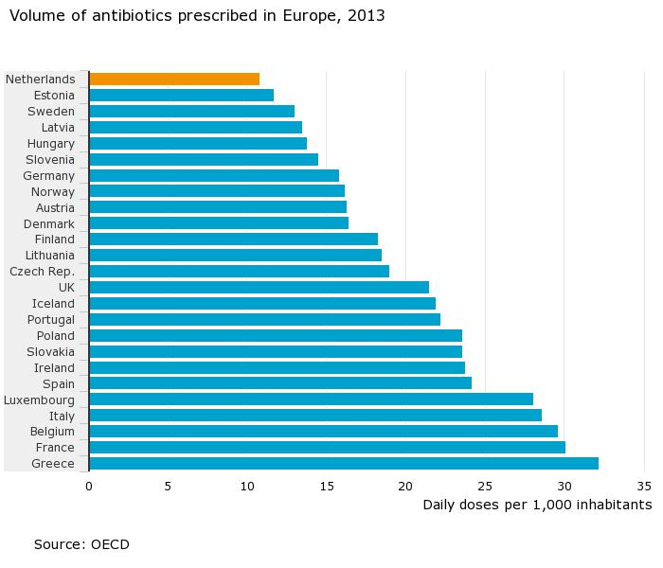
Antimicrobial Consumption Rates
Notes:
We prìde ourselves on the low quantities of use as compared to other EU countries

Slide 5
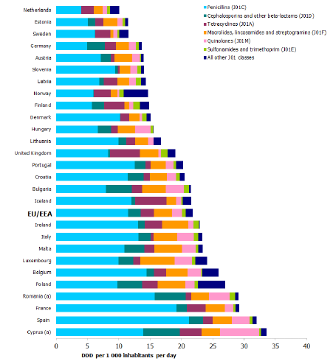
Antimicrobial Consumption Rates
ECDC 2017

Slide 6
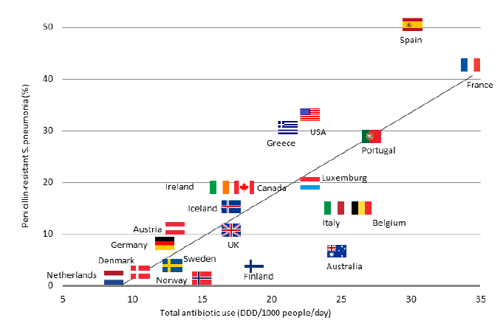
Relation Antimicrobial consumption and AMR
Streamline
Switch
Notes:
Top of the chain

Slide 7



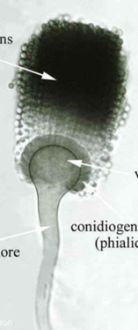
Resistance in A. fumigatus, a One Health problem
Medical triazoles
Propiconazole; tebuconazole; epoxiconazole; difenoconazole; bromuconazole
N
N
N
N
N
N
N
N
N
N
N
C
l
O
H
N
N
H
O
N
N
H
O
O
O
O
O
C
H
l
C
H
O
O
C
l
H
C
l
l
C
C
l
l
TR₃₄/L98H
TR₅₃
TR₄₆/Y121F/T289A
Verweij. Lancet Infect Dis 2009;9:789-95

Slide 8

Acquired azole resistance in A. fumigatus
23.7%
16%
14.6%
%
12.9%
10.6%
www.swab.nl: Netmap 2017:128-31

Slide 9
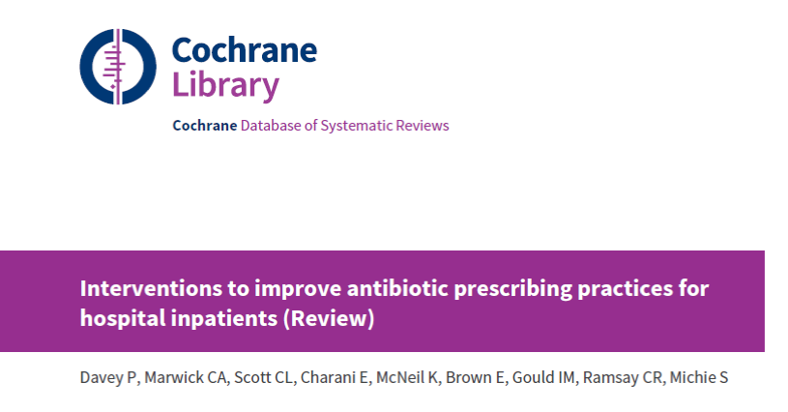
Examples of effective implementation?
Notes:
Now the question was to discuss examples of effective implementation in AMS; here you go! This wellknown Cochrane review studied (at two points in time !)
the evidence for behavioral interventions for in-hospital presecribing. Most of you may have heard about this publication

Slide 10

Davey et al. 2017
221 studies/120 interventions
  Persuasive (enabling) interventions
  Restrictive interventions
Both enablement and restriction are effective
Effect size of e.g. dissemination of educational materials varied between -3.1% and 50,1%
Enabling interventions enhanced the effect of restrictive interventions
Enabling interventions that included feedback are more effective
Notes:
Persuasive interventions (e.g. educational meetings, reminders, audit and feedback etc);
Restrictive interventions (e.g. compulsory order form, expert approval, or financial rewards or punishments etc);
Structural interventions (e.g. computerized systems, or introduction or organization of quality monitoring mechanisms etc)
Effect size of similar interventions, however, also varied between studies
Effect size of dissemination of educational materials varied between -3.1% and 50,1%.
The same phenomenon was seen for reminders, audit and feedback, educational outreach, compulsory order forms, expert approval, removal by restriction, review and make change, and the structural interventions

Slide 11

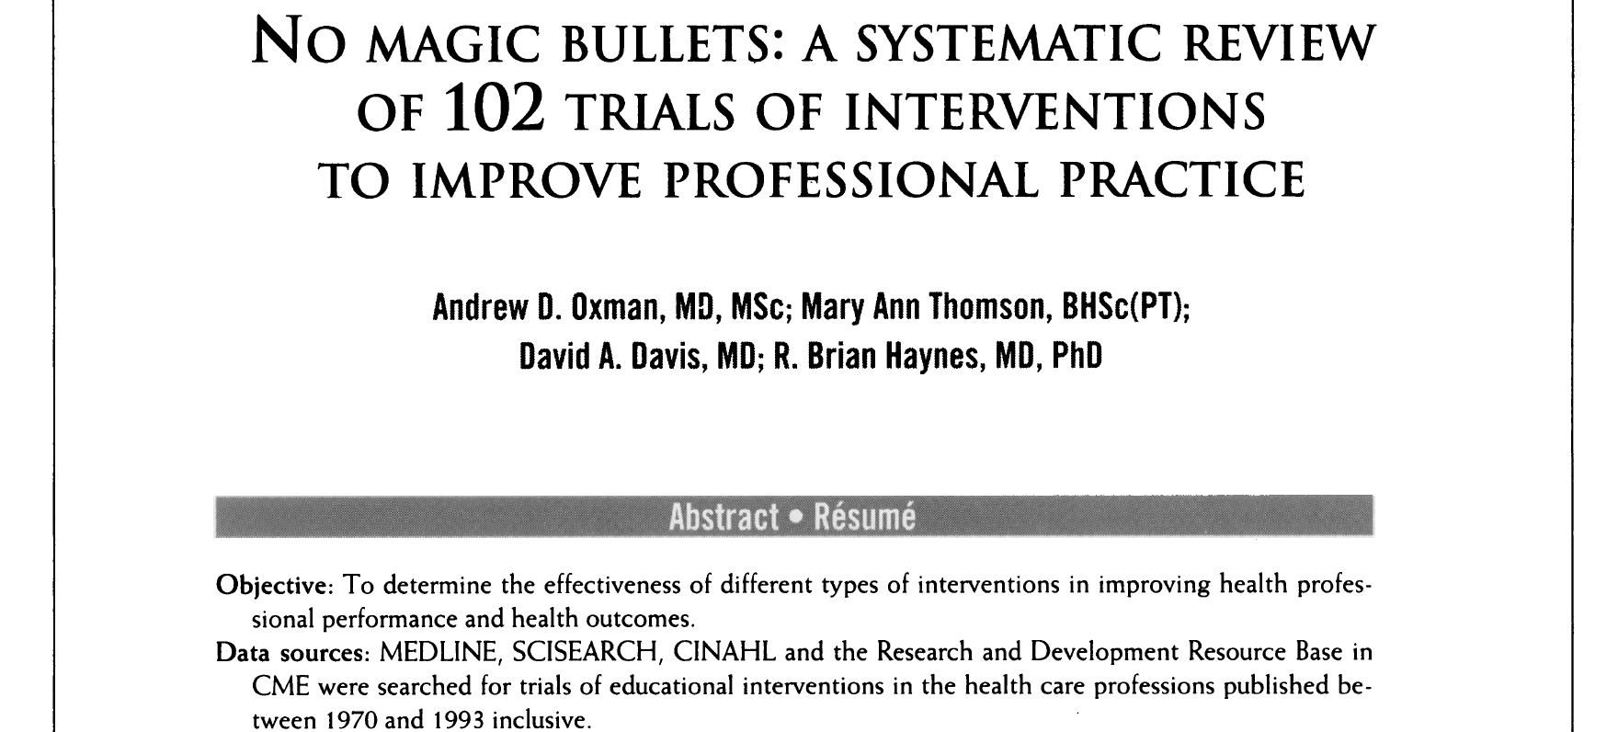
There is NO magic bullet

Slide 12
Davey et al. 2017
any behavioral stewardship intervention might work to improve professionals’ antimicrobial use
How then to select -from this menu of effective interventions- those interventions that might work best in a specific setting (e.g. hospital or ward)?
Notes:
Now I could obviously discuss some succesfull or less interventions that have been effective from this enormous amount of succesfull interventions, but I do think that the important thing is to be able to choose the right intervention for the right setting. There is the challenge for the ones leading the AMS team, and it is NOT easy. That is why I have chosen some interventions that have taken this process into account
Persuasive interventions (e.g. educational meetings, reminders, audit and feedback etc);
Restrictive interventions (e.g. compulsory order form, expert approval, or financial rewards or punishments etc);
Structural interventions (e.g. computerized systems, or introduction or organization of quality monitoring mechanisms etc)
Effect size of similar interventions, however, also varied between studies
Effect size of dissemination of educational materials varied between -3.1% and 50,1%.
The same phenomenon was seen for reminders, audit and feedback, educational outreach, compulsory order forms, expert approval, removal by restriction, review and make change, and the structural interventions

Slide 13

IMPLEMENTATION = TAILORING
Notes:
over 100 frameworks

Slide 14
IMPLEMENTATION = C’est l’adaptation!
Notes:
L’adaptation

Slide 15
Grol.
BMJ 1997
Systematic approach to implementation
Define ‘good quality care’
Analyse current performance of this ‘good quality care’
Analyse barriers influencing the provision (or not) of ‘good quality care’
Develop a quality improvement strategy based on this diagnosis
Develop plan, execute, evaluate this improvement strategy

Slide 16
Grol.
BMJ 1997
Systematic approach to implementation
Define ‘good quality care’
Analyse current performance of this ‘good quality care’
DIAGNOSTIC PHASE
Analyse barriers influencing the provision (or not) of ‘good quality care’
Develop a quality improvement strategy based on this diagnosis
Develop plan, execute, evaluate this improvement strategy

Slide 17
Examples from 3 settings
AGAR trial: Adherence to Guidelines for use of Antibiotics in Respiratory infections 2008
QUality of ANtibiotic use in uTI patients (QUANTI) trial 2015
The Dutch Unique Method for Antimicrobial Stewardship (DUMAS) Participatory Intervention Study 2019
Notes:
L’adaptation

Slide 18
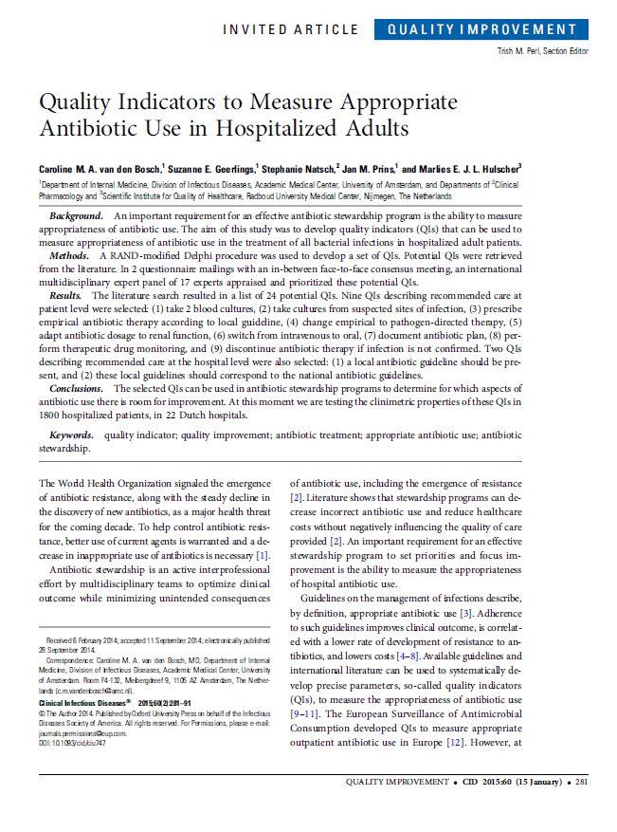
Systematic approach to implementation
1. Define ‘good quality care’
Notes:
First: as a part of every succesfull project: one should make sure to be able to DEFINE what IS good quality of care. To my opinion the best way to look at that is to FIRST assess quality indicators relevant to the process that you are trying to change

Slide 19
Definition of appropriate antibiotic use
QI | Description
Q1 | Empirical therapy prescribed according to the local guidelines
Q2 | At least 2 sets of blood cultures taken before starting antibiotic therapy
Q3 | Cultures from suspected sites of infection before starting antibiotic therapy
Q4 | Documentation of the indication in EPR
Q5 | Switch i.v. to oral antibiotic within 48-72 h
Q6 | Switch to pathogen-directed therapy when culture results become available
Q7 | Dose and dosing interval adapted to renal function
Q8 | Prolonged (> 7 days) antibiotic therapy justified
    Van den Bosch et al CID 2015;60(2):281–91

Slide 20
Definition of appropriate antibiotic use
QI | Description
Q1 | Empirical therapy prescribed according to the local guidelines
Q2 | At least 2 sets of blood cultures taken before starting antibiotic therapy
Q3 | Cultures from suspected sites of infection before starting antibiotic therapy
Q4 | Documentation of the indication in EPR
Q5 | Switch i.v. to oral antibiotic within 48-72 h
Q6 | Switch to pathogen-directed therapy when culture results become available
Q7 | Dose and dosing interval adapted to renal function
Q8 | Prolonged (> 7 days) antibiotic therapy justified
    Van den Bosch et al CID 2015;60(2):281–91

Slide 21
Definition of appropriate antibiotic use
QI | Description
Q1 | Empirical therapy prescribed according to the local guidelines
Q2 | At least 2 sets of blood cultures taken before starting antibiotic therapy
Q3 | Cultures from suspected sites of infection before starting antibiotic therapy
Q4 | Documentation of the indication in EPR
Q5 | Switch i.v. to oral antibiotic within 48-72 h
Q6 | Switch to pathogen-directed therapy when culture results become available
Q7 | Dose and dosing interval adapted to renal function
Q8 | Prolonged (> 7 days) antibiotic therapy justified
    Van den Bosch et al CID 2015;60(2):281–91

Slide 22
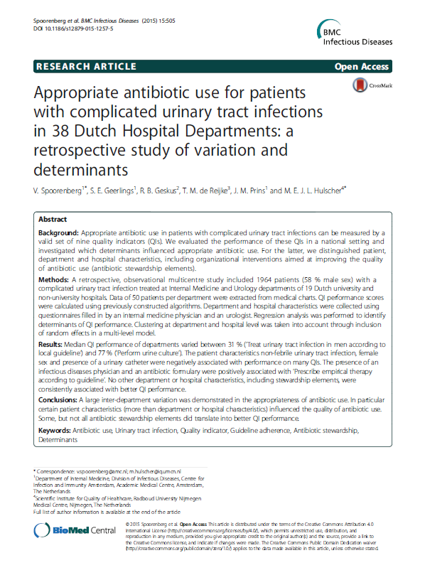
Systematic approach to implementation
2. Analyse current care
Notes:
You can measure current care by performing an audit for some weeks both prospectively as retrospectively but it can be as simple as one or two PPS’s Point Prevalence surveys. This obviously depends on what you need to measure

Slide 23
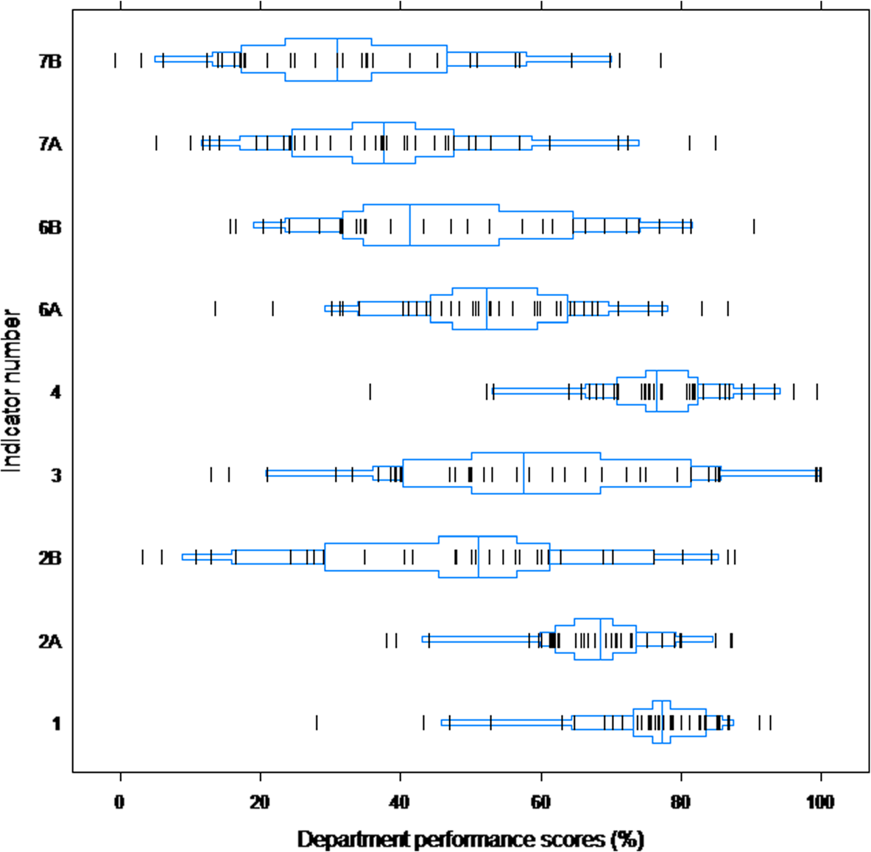
QUANTI study
1964 patients with complicated UTI
38 Dutch wards
19 hospitals
Streamline
Switch
Empirical therapy
according to local guideline
Spoorenberg et al. BMC Infect Dis 2015

Slide 24
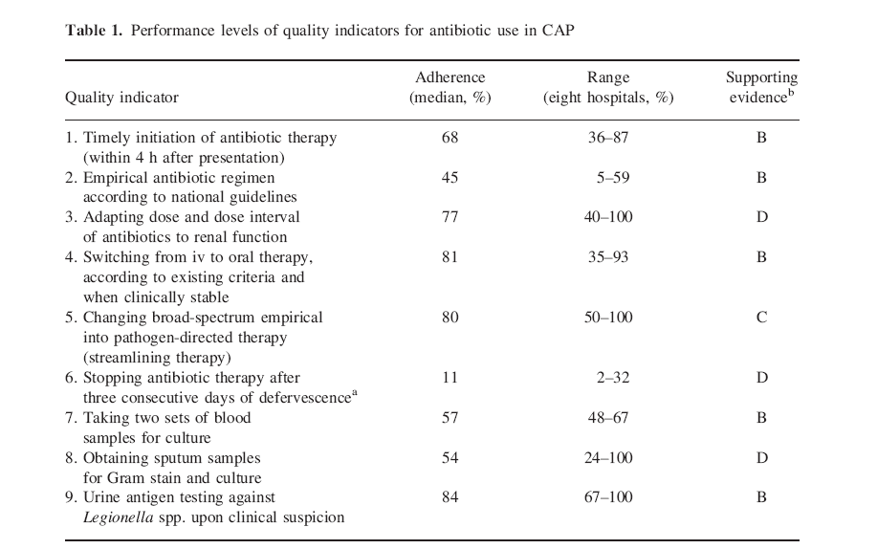
AGAR study analysis quality of care LRTI
Schouten JA, et al. JAC 2005
Notes:
Kwaliteitsindicatoren zijn ontwikkelt en in toenemende mate gebruikt om kwaliteit van zorg te meten

Slide 25
AGAR study analysis quality of care LRTI
Schouten JA, et al. JAC 2005
Notes:
So DO not intervene where there is no problem: it is a waste of time

Slide 26
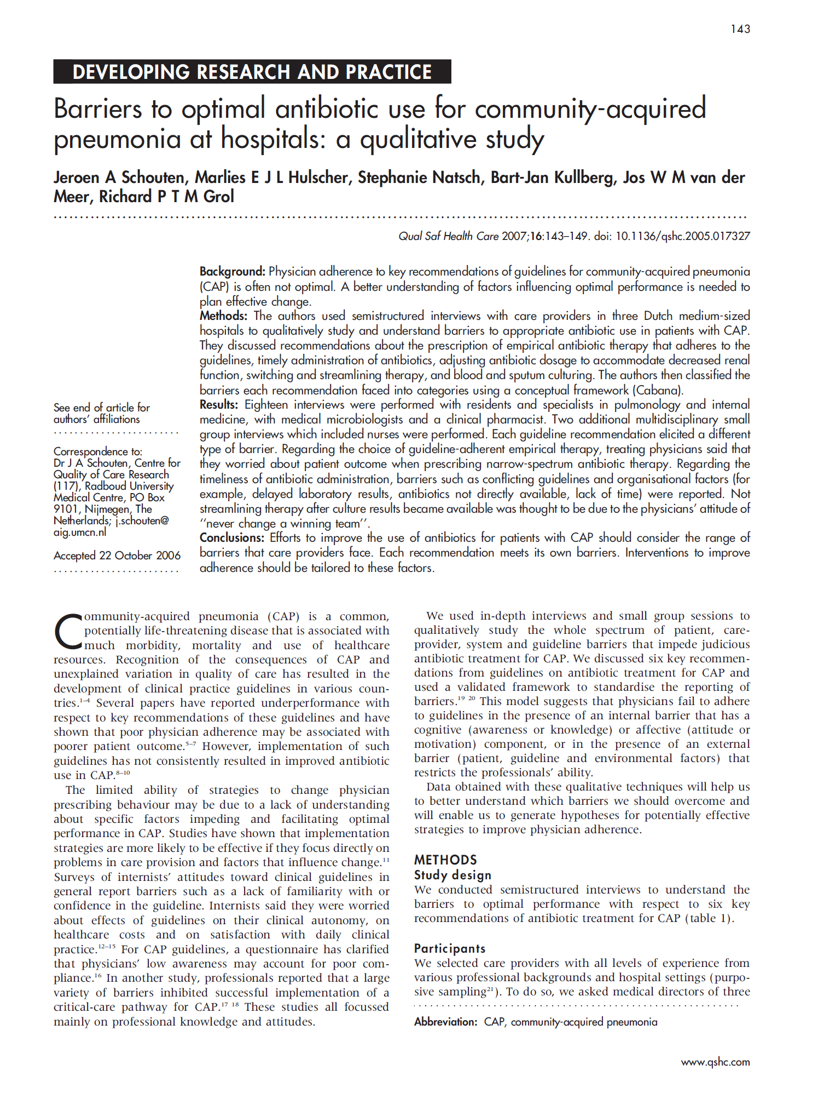
Systematic approach to implementation
Analyse factors influencing
appropriate care
Notes:
8 core elements

Slide 27
Cabana model of barriers to change
Systematic approach to implementation
Cabana JAMA 1999

Slide 28

Flottorp et al. Implementation Science 2013:
57 barriers within 7 domains
  Guideline factors
  Individual health professional factors
  Patient factors
  Professional interactions
  Incentives and resources
  Capacity for organisational change
  Social, political and legal factors

Slide 29
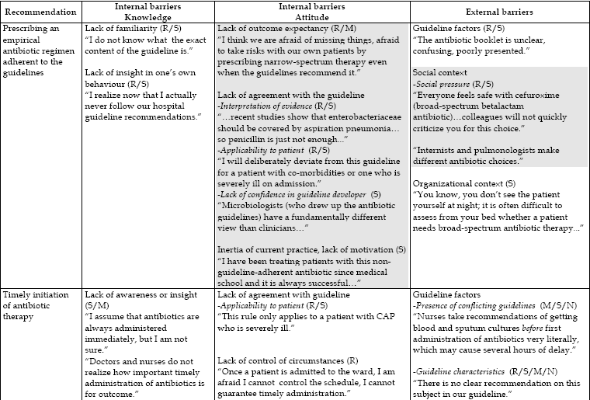
Mixed methods qualitative approach
R resident S specialist M microbiologist N nurse
Schouten, Quality and Safety in Healthcare, 2008

Slide 30
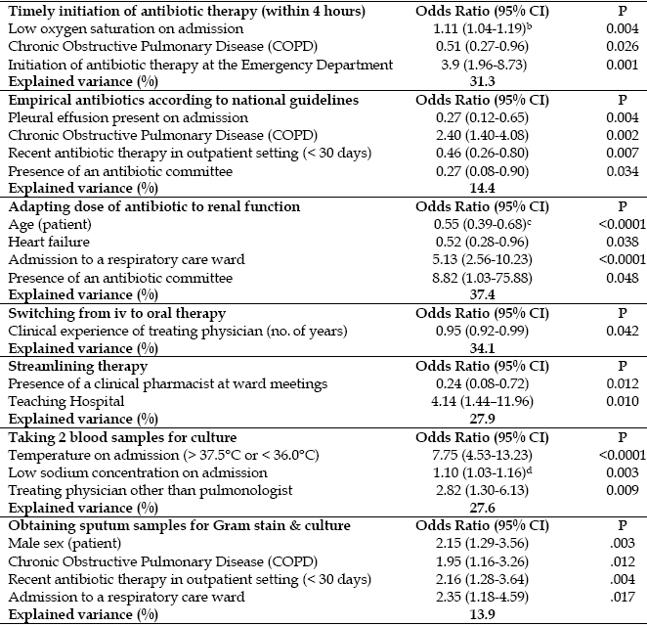
Schouten, JAC, 2005

Slide 31

Systematic approach to implementation
4. Develop a QI strategy

Slide 32

Addressing the determinants systematically
TYPES OF CHANGE STRATEGIES
Basic methods at individual level
Methods to increase knowledge
Methods to change awareness & risk perception
Methods to change habits, automatic and impulsive behaviors
Methods to change attitudes, beliefs, outcome expectations
Methods to change social influence
Methods to skills, capability, self-efficacy and overcoming barriers
Methods to reduce public stigma
Methods to change environmental conditions
Methods to change social norms
Methods to change social support and social networks
Methods to change organizations
Methods to change communities
Methods to change policy
A taxonomy of behaviour change methods, Health Psychology Review 2015

Slide 33
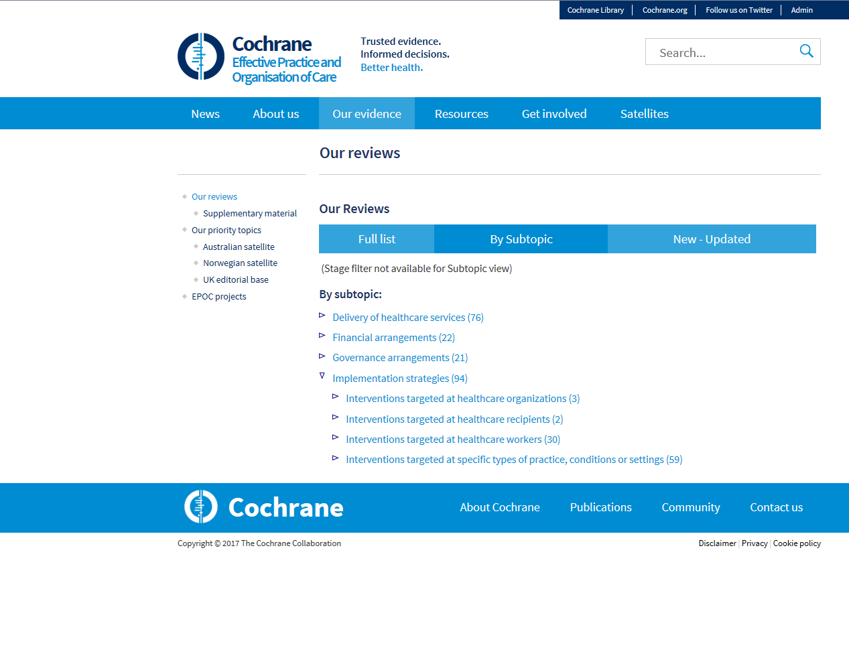
Addressing the determinants systematically:
EPOC taxonomy
http://epoc.cochrane.org/our-reviews

Slide 34
Development and testing of a strategy to improve prescribing in LRTI
PHASE 1
Installation local
committee
Consensus on treatment
protocol (guideline)
Start meeting
-global feedback
-education
Start therapy
PHASE 2
Individual feedback
prescribers
Peer group
comparison
small scale, interactive
education
Web education
Reminders
Proces analysis
and redesign
Adapt therapy
BARRIERS AND FACILITATORS
Diagnostics
Schouten, CID, 2008
Notes:
Hoe zag die strategie eruit? In een eerste fase, die voor alle ziekenhuizen identiek verliep, werd een lokaal comité van internisten, longartsen, microbiologen, ziekenhuisapothekers, verpleegkundigen en kwaliteitsmedewerkers opgericht, om de interventie te coördineren.Deze stelden in samenspraak een lokale richtlijn samen met duidelijke aanbevelingen en aanzien van de behandeling van LWI: een zogenaamd behandelprotocol. Tijdens bijeenkomsten van dit comité werden de ziekenhuisprestaties tot dan toe besproken en werden die aanbevelingen geselecteerd die het meest in aanmerking kwamen voor verbetering.
Op de startbijeenkomst werd door een expert op het gebied van luchtweginfecties een lezing over de richtlijn gehouden en werd het gemeenschappelijk behandelprotocol besproken en verspreid. Meetgegevens over patiënten van het betreffende ziekenhuis werden op deze bijeenkomst aan alle behandelaars gepresenteerd.
Vervolgens werden in drie achtereenvolgende modules (start therapie, wijzig therapie en diagnostiek) verschillende aanbevelingen aangepakt. Rekening houdend met de waargenomen belemmeringen werden verschillende combinaties van interventies samengesteld. Dit bestond uit een programma van onder andere individuele terugkoppeling, intercollegiale toetsing, kleinschalige scholing etc etc

Slide 35
QUANTI study
Spoorenberg, Plos One, 2015

Slide 36
DUMAS study
Sikkens, JAMA Internal medicine, 2017

Slide 37
Sikkens, JAMA Internal medicine, 2017

Slide 38
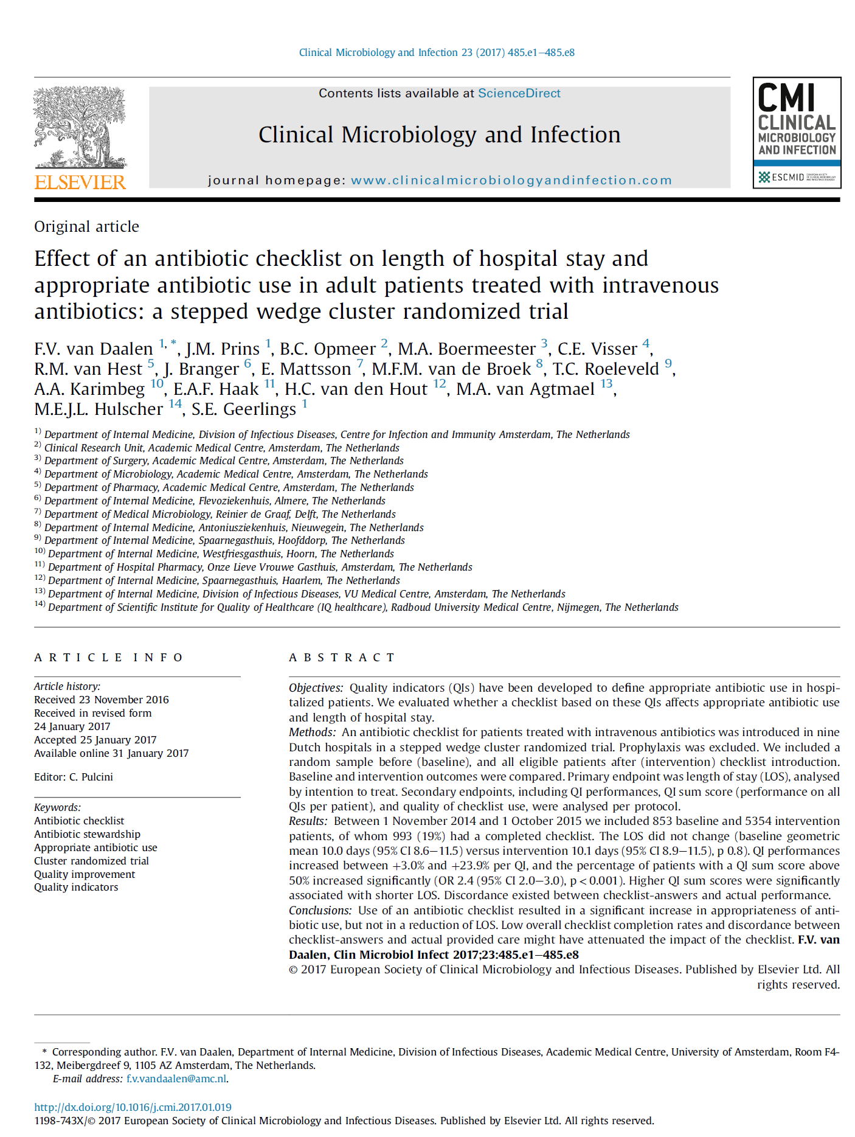
Systematic approach to implementation
Develop plan, execute, evaluate
a strategy

Slide 39
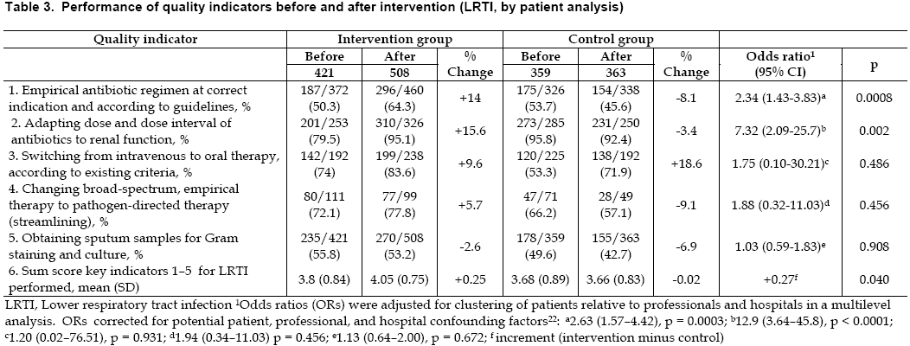
Evaluation of a targeted strategy in a cluster RCT
Schouten, Clin Infect Dis, 2008

Slide 40
Evaluation DUMAS strategy in Interrupt Time Interval
Sikkens, JAMA Internal medicine, 2017

Slide 41
Evaluation of a targeted strategy
Sikkens, JAMA Internal medicine, 2017

Slide 42
This is research, what about daily practice?
Start small
Choose limited amount of QI’s
Use PPS or small audits for baseline and follow-up measurement
Invest time in talking to professionals for barrier analysis
Adapt interventions to barriers using common sense

Slide 43


Masterclass Antimicrobial Stewardship
How to improve antibiotic use?
A practical introduction to the development and implementation of Antimicrobial Stewardship Programs
Registration open
13-17th May 2020, Nijmegen
The Netherlands
www.DutchAntimicrobialStewardship.com

